Slide 1

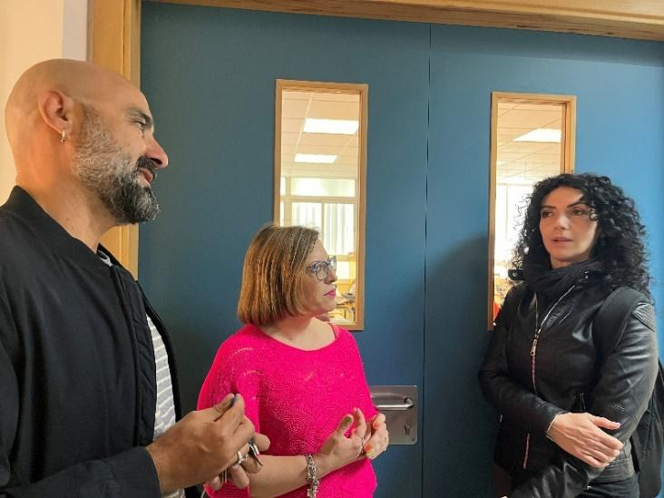
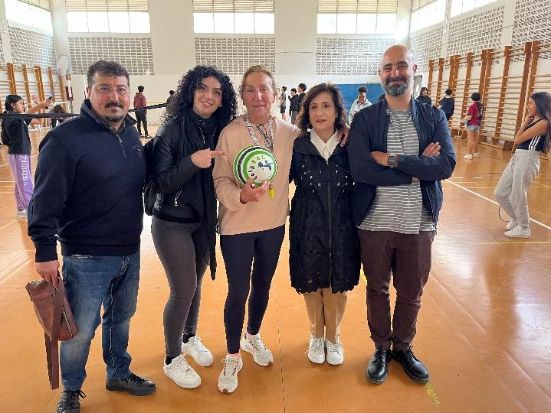
Approaches and initiatives against BULLYING AND CYBERBULLYING IN SPAIN AND ITALY
El Cid Campeador
Valencia 30th April-3rd May 2025
Jobshadowing
Lucia Sica
Anti-Bullying and Emergency Team Coordinator

Slide 2

Bullying: Intentional, repeated aggressive behavior (physical, verbal, social)
Cyberbullying: Abuse via digital platforms (social media, messaging, etc.)
Impact: Emotional distress, academic decline, social isolation

Slide 3
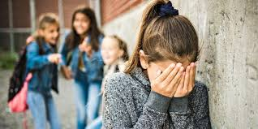
School-wide education awareness campaigns
Peer mentoring teacher-led discussions
Monitoring online behavior promoting digital citizenship
Actions

Slide 4

National guidelines issued by MIUR (Ministry of Education)
Protocols include prevention, identification, and intervention procedures:
Schools must have an anti-bullying team and a named coordinator
Italy

Slide 5

National guidelines issued by MIUR (Ministry of Education)
Protocols include prevention, identification, and intervention procedures:
Schools must have an anti-bullying team and a named coordinator
Italy

Slide 6
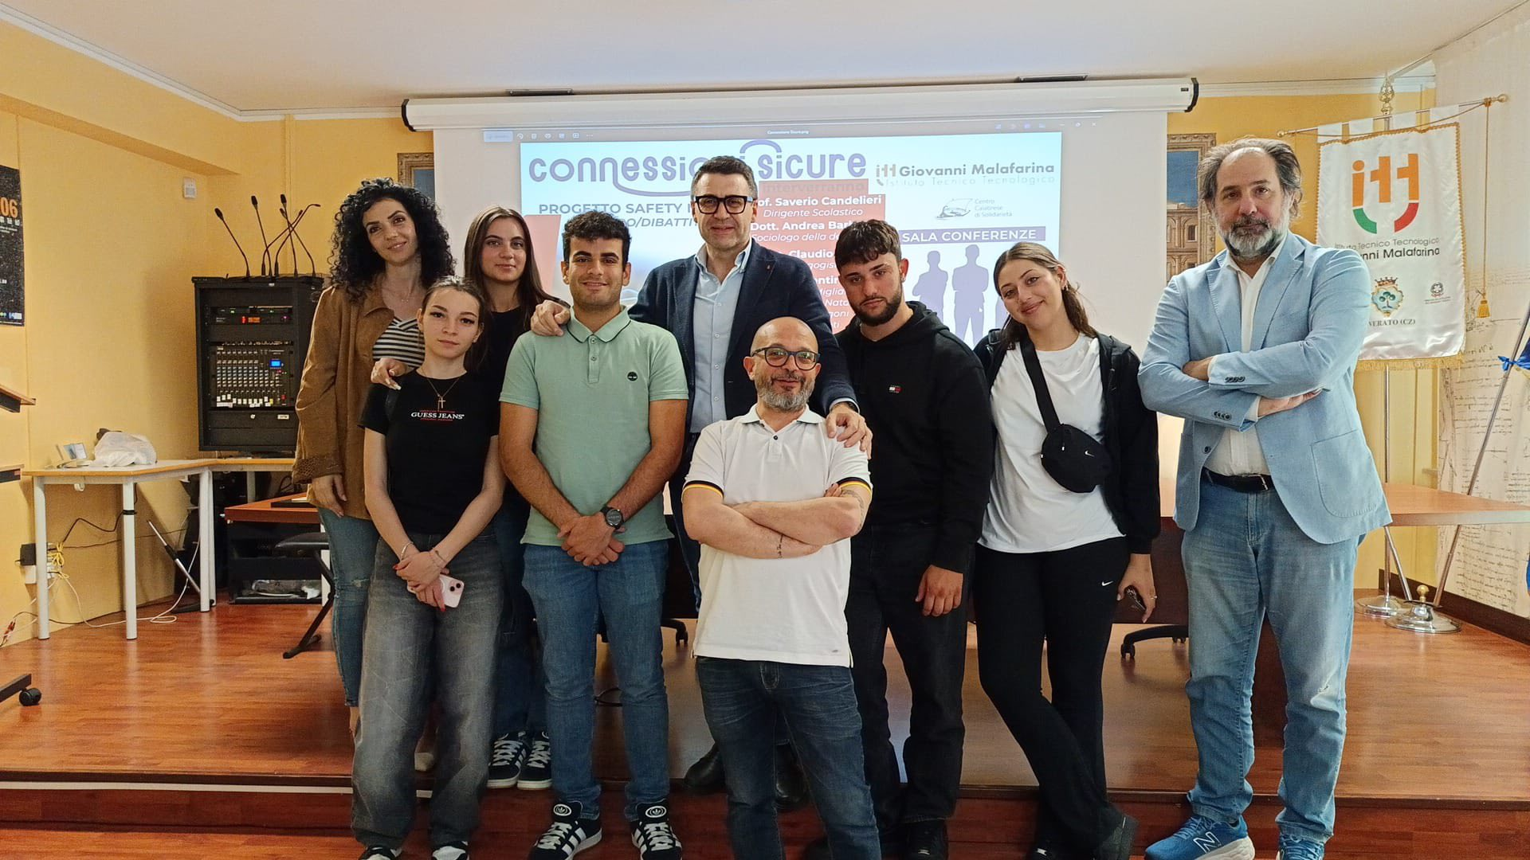
Safety Nets project -second edition
(Law 234/2021).
The project aims to gain greater awareness of the phenomenon of bullying within schools and to implement concrete measures to face it.
The task force of students called "Sentinella" appropriately trained has proven to be a key element, not only for data collection, but also as a point of reference for their peers.
The administration of questionnaires has guided intervention and prevention actions, making the school environment safer and more welcoming. laying the foundations for a shared path aimed at monitoring the phenomenon and increasingly promoting a culture of respect and solidarity.
Italy

Slide 7

Spain
POLICIES VARY IN THE AUTONOMOUS COMMUNITIES EVEN IF THERE IS A NATIONAL FRAMEWORK
Focus on inclusive education and respect for diversity
Programs often tied to digital literacy and emotional education curriculum

Slide 8
“Respect Each Other” Week:
Activities promoting empathy and respect
“Digital Responsibility Workshops ”:
Safe and respectful use of social networks
“Speak Up” Corners:
Anonymous reporting boxes for students
Spain

Slide 9

Continued teacher training on early detection and intervention
Involving parents through information sessions and workshops
Strengthening collaboration with local authorities and health services
Spain

Slide 10
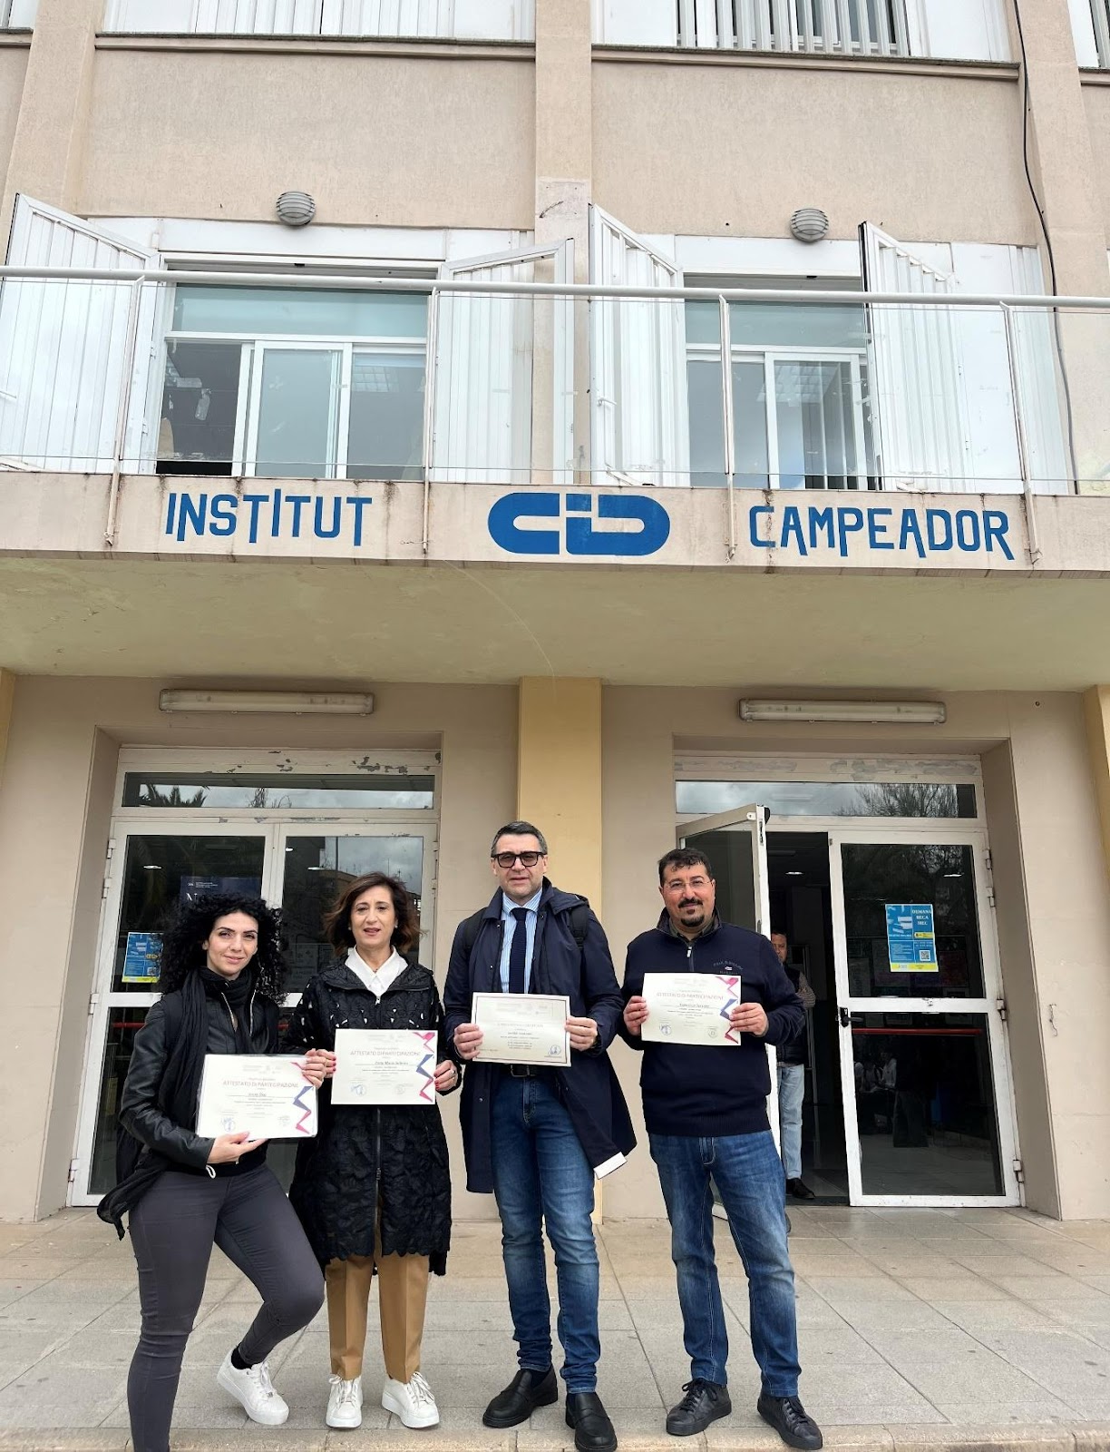
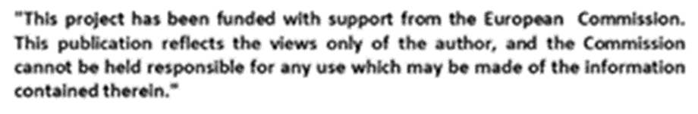
Final Considerations
I have gained invaluable insights across multiple domains. This experience has not only broadened my professional competencies but also enriched my personal perspective.
Exposure to innovative tools, policies, and educational frameworks across countries
Firsthand collaboration with motivated professionals and institutions
Deepened understanding of the cultural and systemic forces shaping our future
A deeply rewarding and intellectually stimulating experience—professionally engaging and personally fulfilling.
Looking ahead, I feel empowered to contribute with renewed vision and purpose

