Slide 1
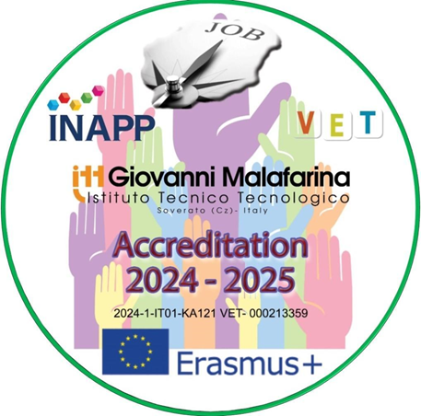

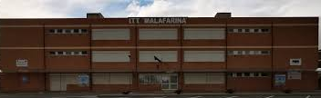
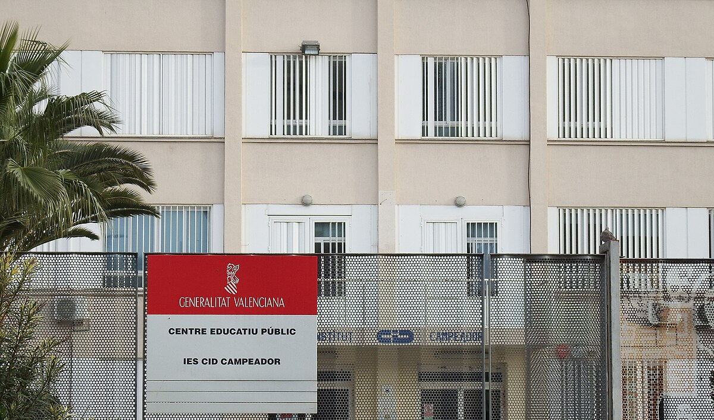
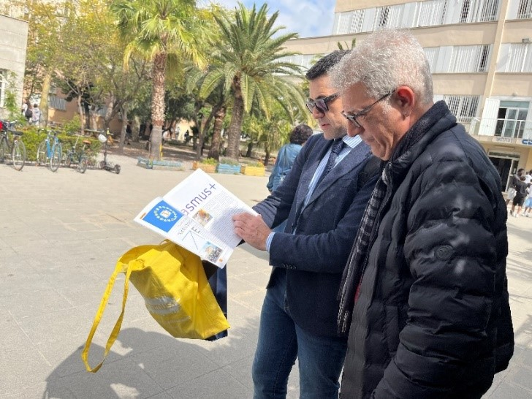
2024-1-IT01-KA121-VET-000213359
Jobshadowing Activity
A comparison between the Italian and the Spanish School Systems
with a focus on recruitment and professional trainings
El Cid Campeador
Valencia 30th April-3rdMay 2025
Prof. Saverio Candelieri
Headmaster
Prof. Alfons Martínez Jiménez
Director

Slide 2
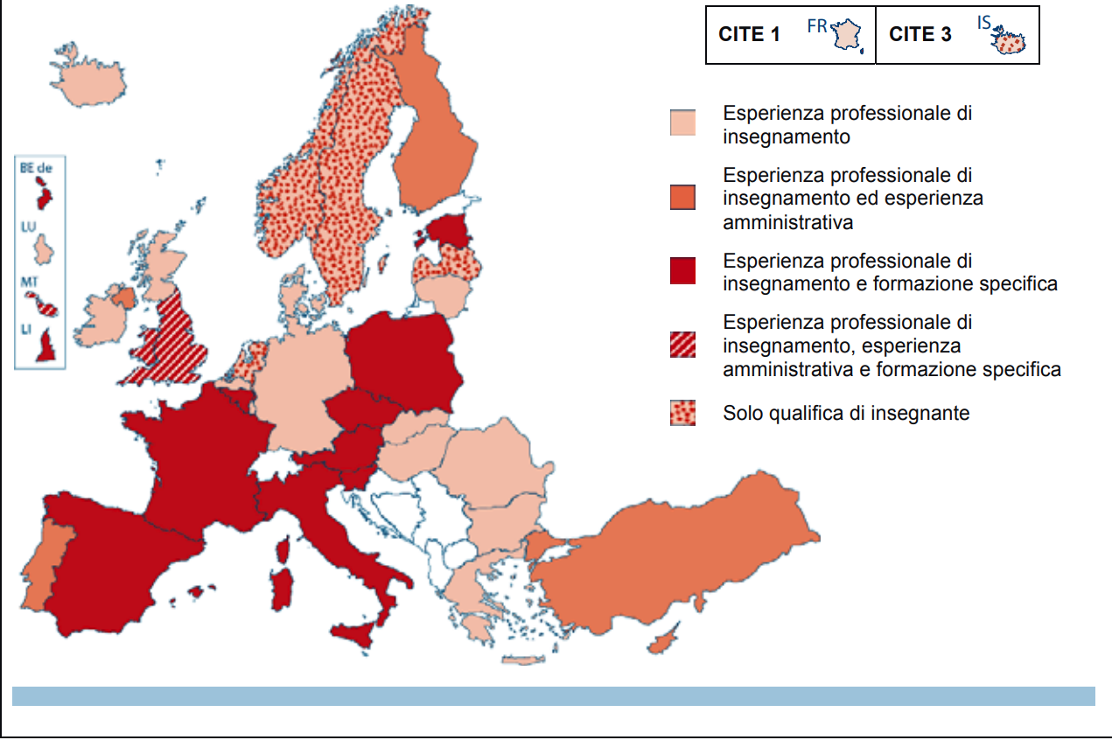
Management of schools
In the Communication of the European Commission of 3 July 2008, entitled Improving skills for the 21st century, it was highlighted that schools in Europe, which have become "increasingly complex and autonomous organisations", need headmasters who are able to combine the school management aspects of their role with those of a leadership focused on learning. Given the increasing autonomy of schools in most European countries, school heads are now faced with more and more tasks related to the management of teaching staff, financing and curriculum content. Selection criteria are therefore essential, along with some prerequisites for appointment as school head, in particular professional teaching experience, administrative or management experience or specific training for the leadership function. In almost all European countries, there are official documents setting out the requirements for candidates.

Slide 3
Selection procedures in Italy and in Spain
While in Italy headmasters must pass a hard national public competition announced by the Ministry of Education (MIUR which includes a pre-selection, a written test and an oral interview, in Spain for the position of Director, the following requirements are necessary:
− have at least 5 years of seniority as a tenured teacher (Maestros, Profesores de Enseñanza Secundaria, Profesores Técnicos de Formación Profesional);
− have taught for at least 5 years in any of the subject areas offered by the school for which the selection is open;
− have taught at a public school of the corresponding level and type for at least one year at the time of publication of the announcement;
− present a management project for the educational institution which includes, among other things, the objectives, the lines of implementation
The Director is chosen and appointed through a selection procedure in which the tenured teachers of the specific educational level and type of education offered by the institution that he or she will direct participate. The selection, which involves the educational community and the educational authorities of the individual Autonomous Communities, takes into account the academic and professional merits of the candidates, as well as the experience and positive evaluation of the work they have previously carried out in managerial or teaching roles. Preference is given to those who have taught in the institution for which the post is vacant. The choice is made by a commission composed of representatives of the educational authorities and at least 30% of the representatives of the institution (50% must belong to the teachers' assembly). The educational authorities of the different Autonomous Communities determine the total number of members that make up the commission and the percentages of representatives. The same authorities establish the criteria and procedures to be applied in the selections.
The selected candidates must complete a specific initial training program. The educational authorities appoint Director of the institution, for a period of 4 years, those who have successfully passed this initial training period. The appointment can be renewed, for the same duration, to those who receive a positive evaluation at the end of the 4 years.

Slide 4
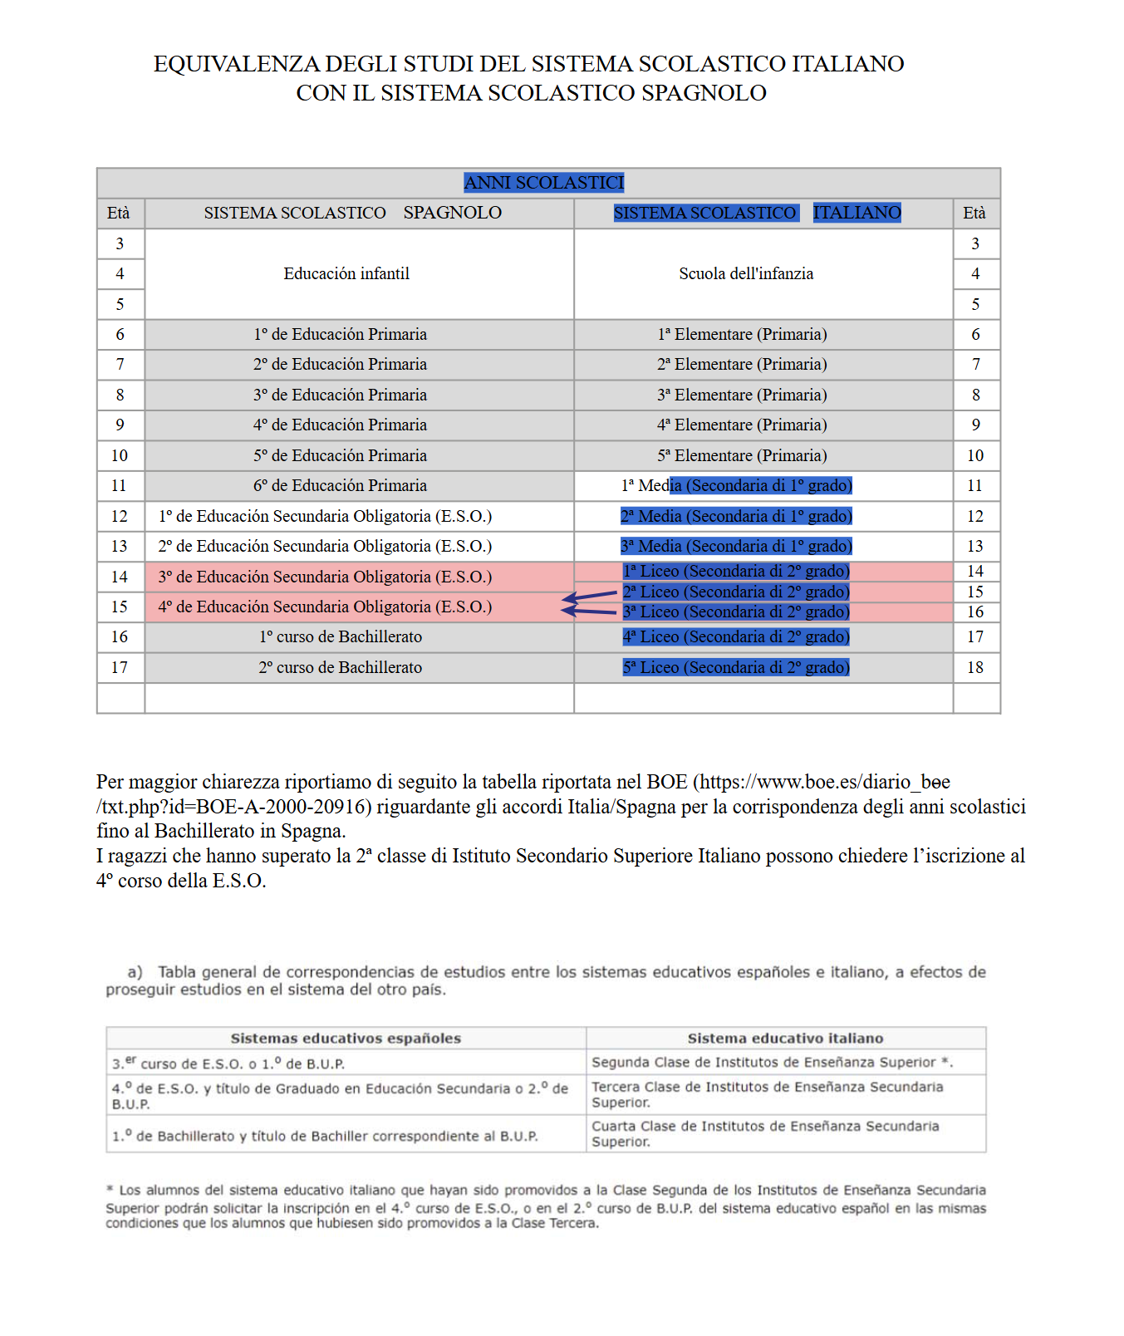
The Italian and Spanish school systems are not the same!
The Spanish system requires 1 less year of school to reach the corresponding Italian Diploma called “selectividad”, the outcome of which can be decisive in enrolling in the future faculty that one will attend at university, yet their short-cycle degree is based on four years against the three of the Italian Bachelor’s Degree. In addition to this, there is no differentiation among professional, technical and lyceums as in Italy, but each student attends a single "bachillerato" and then chooses any optional subjects, according to their interests or future field of specialization in university.

Slide 5
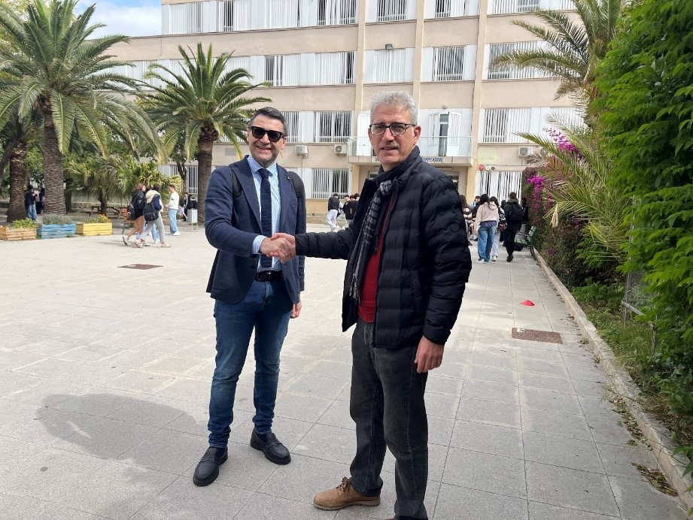
The school system is divided, as in Italy, into three main parts: preschool, primary school and lower secondary school. Preschool is divided into nursery school and kindergarten, while primary school is attended by students from 6 to 12 years old. Lower secondary school or middle school lasts 4 years and involves students from 12 to 16 years old. At the end of the course, students must take the end-of-course exam. Upper secondary school or high school lasts 2 years and involves students from 16 to 18 years old. Students can choose between 3 types of high schools, based on their objectives: Bachillerato, Professional training and Higher professional training. The university path in Spain generally lasts 4 years, then there are some longer courses
.
The school system is divided into three main parts: preschool, primary school and lower secondary school. Preschool is divided into nursery school and kindergarten, while primary school is attended by students from 6 to 11 years old. Lower secondary school or middle school lasts 3 years and involves students from 11 to 13 years old. At the end of the course, students must take the third-grade middle school exam. Upper secondary school or high school lasts 5 years and involves students from 14 to 19 years old. Students can choose between 3 types of high schools, based on their goals: Lyceum, Technical institute and Professional institute. The university course in Italy lasts 5 years, in which the first two are basic and the last three are specialized.
The School Systems
Italy
Spain

Slide 6
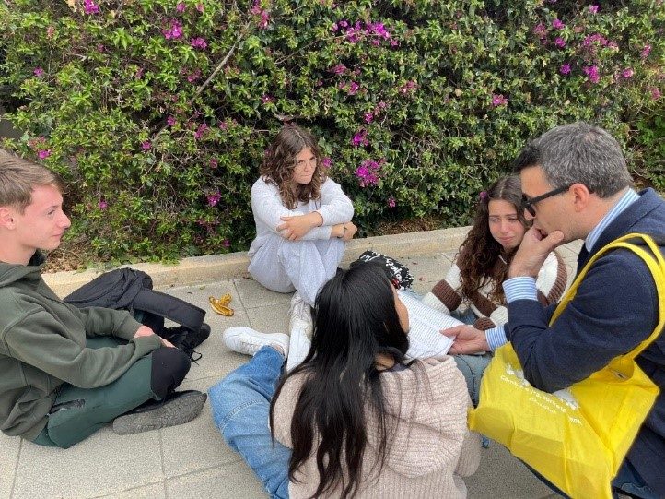
Fees
Both in Italy and Spain Preschool, both nursery school and kindergarten, is not mandatory.
Primary school is compulsory and free, while lower secondary school is compulsory but not free. Upper secondary school is optional and requires a fee. In Italy, public schools are financed by the state, while private schools are supported by fees, which are sums of money paid by students. Catholic religion is optional and when the child starts school, parents are asked if they want their child to attend religion classes.
Catholic religion is optional and when the child starts school, parents are asked if they want their child to attend religion classes.
Religion
Timetable and logistics
In Italy, but for Technical and Professional Institutes students are used to staying six consecutive hours in the same room where the change of subject occurs thanks to the coming and going of the professors.
Instead, in all Spanish schools students are used to going from one classroom to another.

Slide 7
Alternanza scuola-lavoro- Work-based learning
In Italy it is run from the third year (or from the second if attending an abbreviated 4⁻year cycle) of high school according to a minimum of hours decreasing from lyceum to technical and professional institutes. In Spain, it is only provided for the professional sector of the Formación Profesional Especifica de grado medio. The total duration of the training cycle ranges from 1300 to 2000 hours (one and a half or two years), of which 350 – 700 hours (10 to 20 weeks) must be dedicated to on-the-job training. The duration depends on the training cycle or the educational authorities. The total number of hours also includes the hours that must be dedicated to counseling and orientation sessions with the teacher-tutor and that generally take place every 15 days at school. This is organised into different ciclos formativos, corresponding to 22 professional sectors, consisting of theoretical learning modules and a period of mandatory practical training in the workplace. In fact, the Ley Orgánica de Ordinación General del Sistema Educativo, LOGSE (Organic Law on the General Organisation of the Education System) of 1990 establishes that all those who attend the Formación Profesional Especifica de grado medio must complete a training module in the workplace called Formación én centros de trabajo (FCT). However, it can also be provided for in the following cases:
• Social guarantee and initial training programmes intended for young people aged 16 and over who have not obtained a certificate of completion of compulsory secondary education. They aim to facilitate their entry into the world of work.
• Formación Profesional Especifica de grado superiore (Specific professional training of higher level): that includes practical training in the workplace organised on the basis of that of the intermediate level.

Slide 8
Specific laws in Spain regarding curriculum
In Italy 20% of national programmes can vary, in Spain curricula are organized according to:
Organic Law on the General Organization of the Education System, LOGSE of 1990 (Organic Law on the General Organization of the Education System): reference legislation on the education system.
Organic Law on Qualifications and Professional Training, LOCFP of 2002: its purpose was to organize a comprehensive system for professional training, qualifications and accreditation that would respond to the demands of the social and economic world through different types of training, including Specific Professional Training.
The different Autonomous Communities have integrated the national legislation and have defined the curricula of the training cycles corresponding to each qualification, available in their area of ​​competence. The individual institutions develop these curricula through the development of the curricular project (proyecto curricular) and the annual programming, whose objectives, content, evaluation criteria, methodology must correspond to the characteristics of the students and the training opportunities of the area. Periodically, the Government, on its own initiative or upon recommendation of the Education Administrations, the General Council for Professional Training or the social partners, review them and, if necessary, update the professional titles or create new ones, in order to ensure an adaptation to the evolution of the professional qualifications required.
In addition, the Autonomous Communities establish measures and adapt the curriculum, so that students with special educational needs can also access specific professional training.

Slide 9
Training in Work Centers-FCT
The main characteristic is that it actually takes place in a company, workplace or production environment where students develop tasks typical of their profile. Likewise, they must know the production work and service procedures and how work relationships are organized. Through this process, students are advised and guided by two subjects: the teacher-tutor (from the school) and the trainer-tutor (from the company).
The main objectives of the FCT are the following:
Complementing the professional skills obtained at school;
Acquiring knowledge of the organization of production and the work relationships that are created in a work environment;
Helping students acquire both an identity and a maturity to continue learning within their professional profile;
Evaluating the professional skills of students in real work or production environments.
Access methods
The Formación Profesional Especifica de grado medio can be accessed by those who have a Graduado en Educación Secundaria Obligatoria or Técnico Auxiliar or Técnico certificate, which are generally obtained at 16 years of age, at the end of compulsory education. Those who do not have the aforementioned certificates can still access this type of training by demonstrating, through a test, that they have the required aptitude for the courses they intend to attend. To be admitted to the test, you must have at least one of the following conditions:
being at least 18 years of age;
having at least one year of work experience in the sector of the required training cycle;
having completed one of the Programas de Garantía Social (Social Guarantee Programs).

Slide 10




