Slide 1


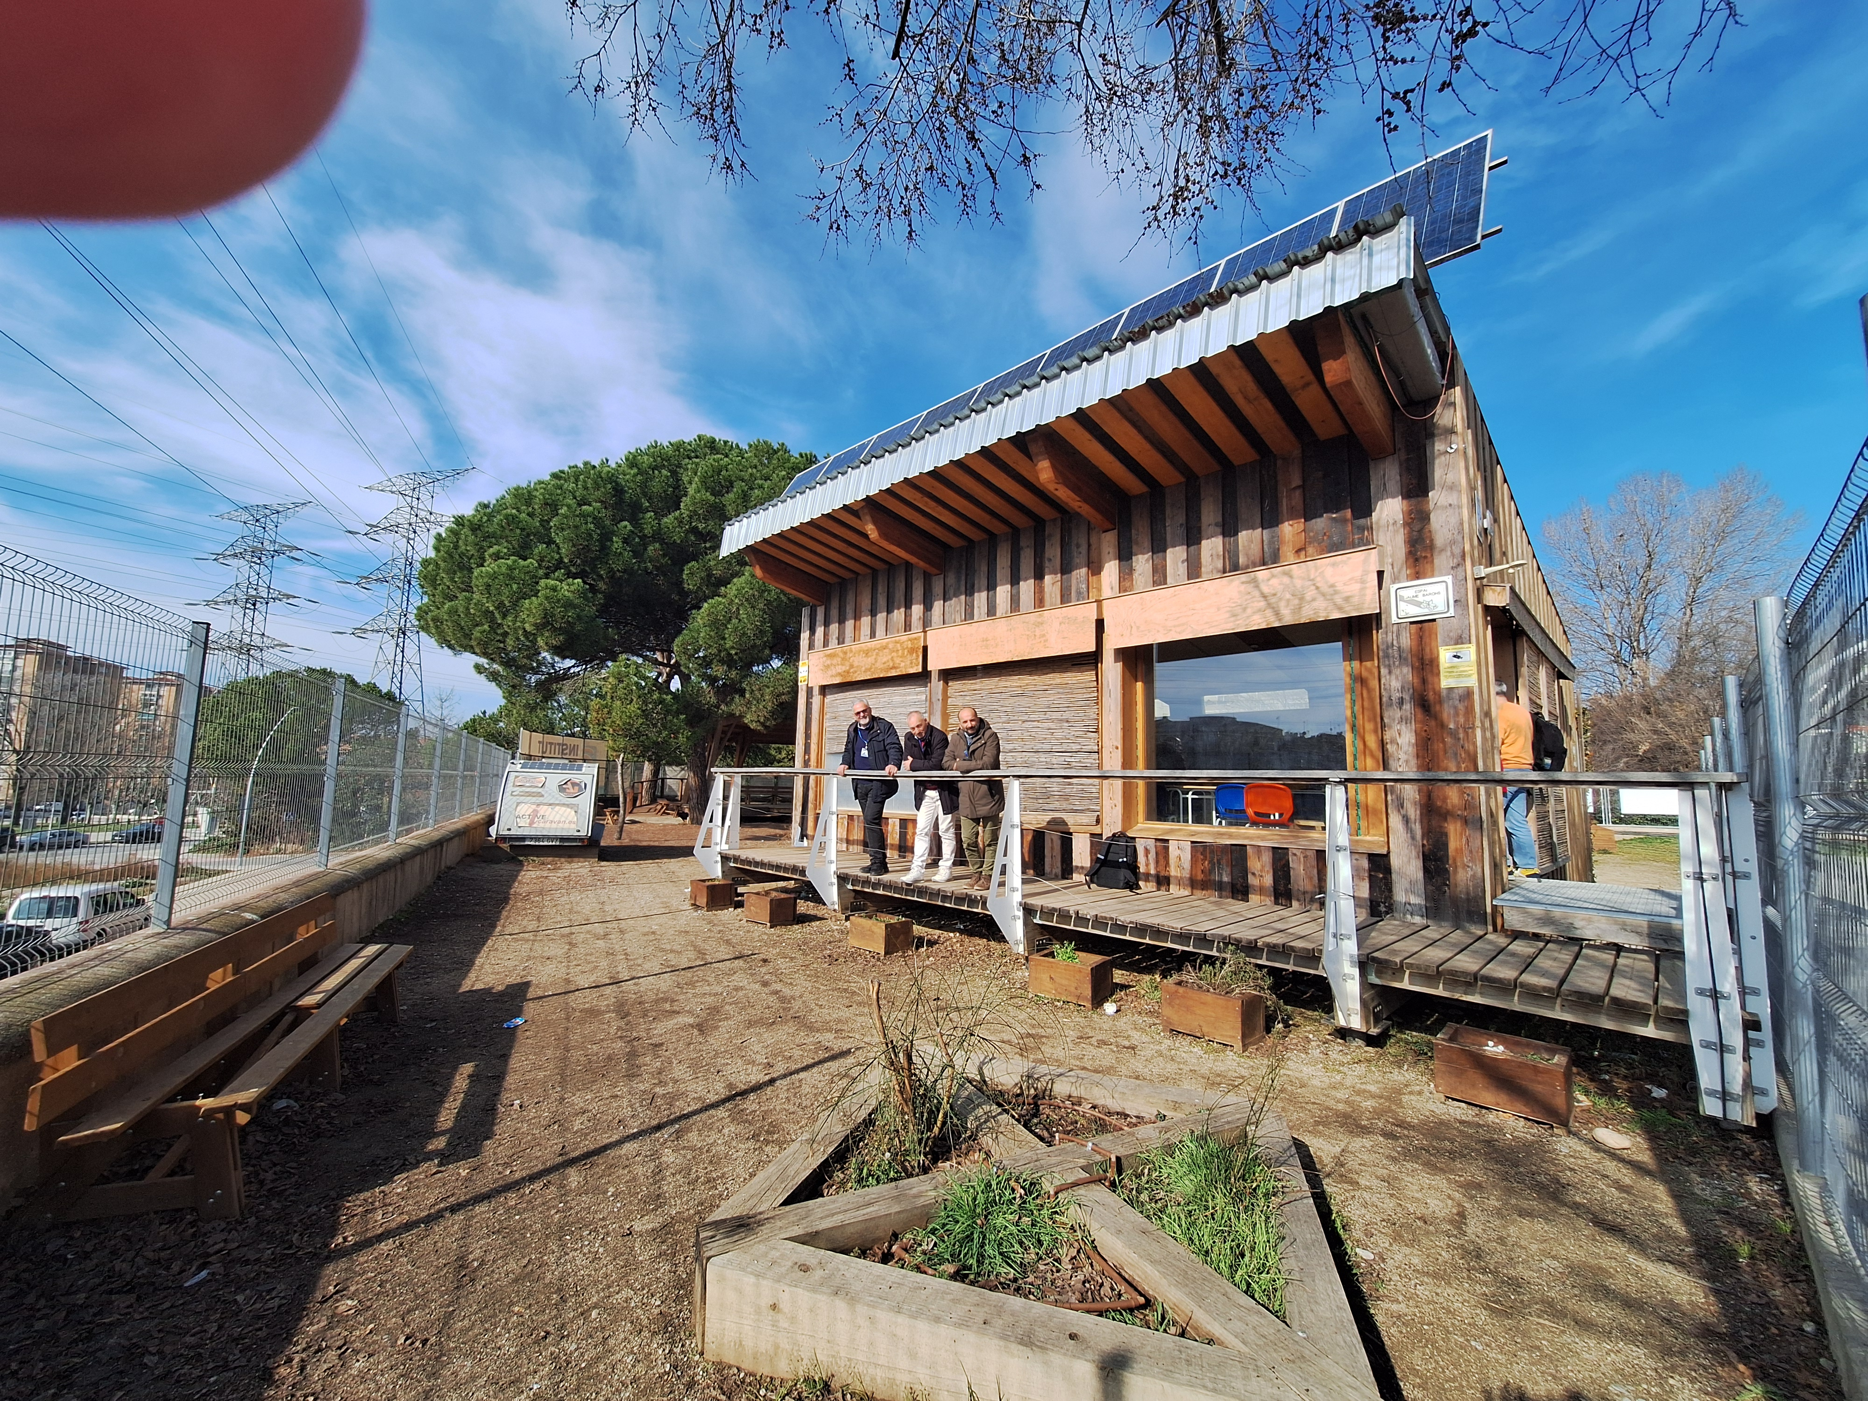
MANRESA 10/02/2025 -14/02/2025
PROF GIUSEPPE DONATO
Jobshadowing Activity at Institute Guillem Catà- Spain
2024-1-IT01-KA121-VET-000213359

Slide 2
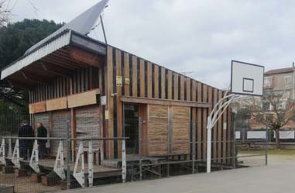
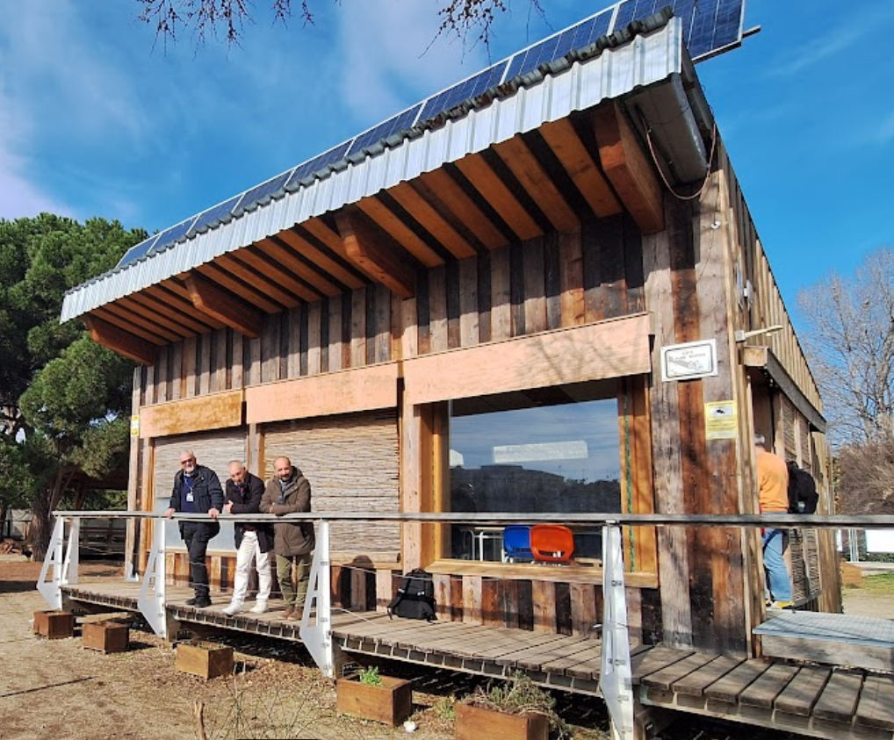

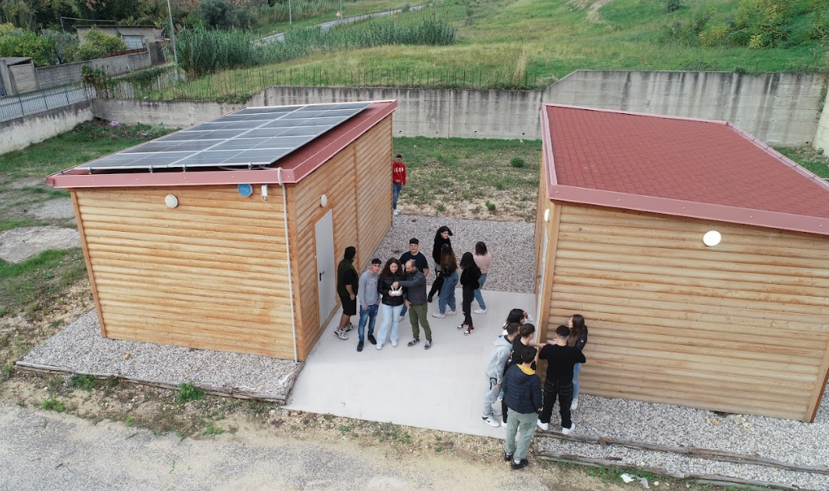
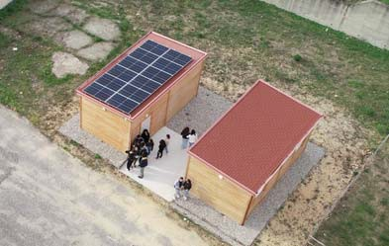
COMPARISON BETWEEN THE TWO BUILDINGS

Slide 3
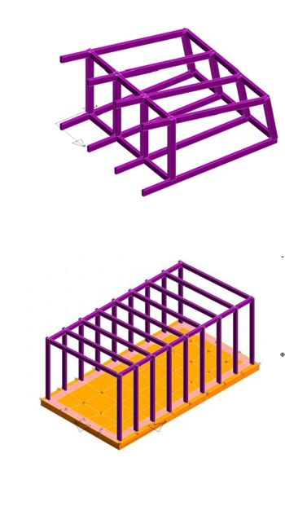
MAIN DIFFERENCES
DIMENSIONS
In Soverato the shape is regular with the vertical structural part hidden and of smaller dimensions; pillars and beams are arranged every 85 cm obtaining reduced dimensions of the load-bearing elements, the pillars and beams are in axis and emerge, the block of the single environment rests on the ground through a direct connection on a reinforced concrete foundation, the surface for each single environment is approximately 26 m2.
In Manresa the foundations are made with metal supports fixed in the ground, above them there is a lattice of laminated wood beams to which the pillars are connected. The 4 main frames are spaced from each other by approximately 2.40 meters. The size of the class that is created is approximately 45 m2
STRUCTURAL MODEL
*

Slide 4
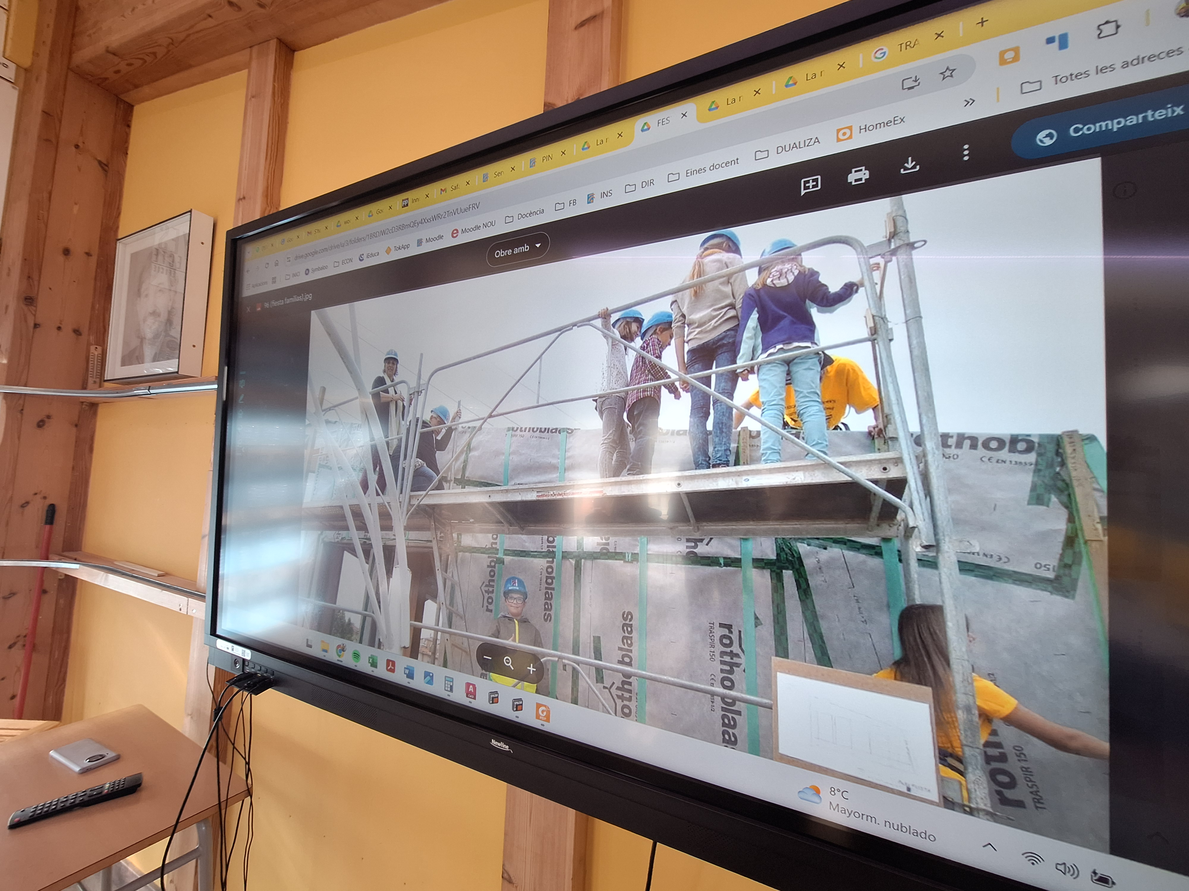
STRUCTURAL DIFFERENCES I
STRUCTURAL TYPOLOGICAL ANALYSIS
FOUNDATIONS
Malafarina buildings are directly connected with a reinforced concrete plate
Manresa building is connected to steel helical poles fixed into the ground that allow it to be dismantled without producing waste, positioning the building in another place. The difference involves a separation from the ground with better thermal insulation but the need to create a lattice of beams suspended at the base.
PILLARS
BEAMS
MATERIALS
*

Slide 5
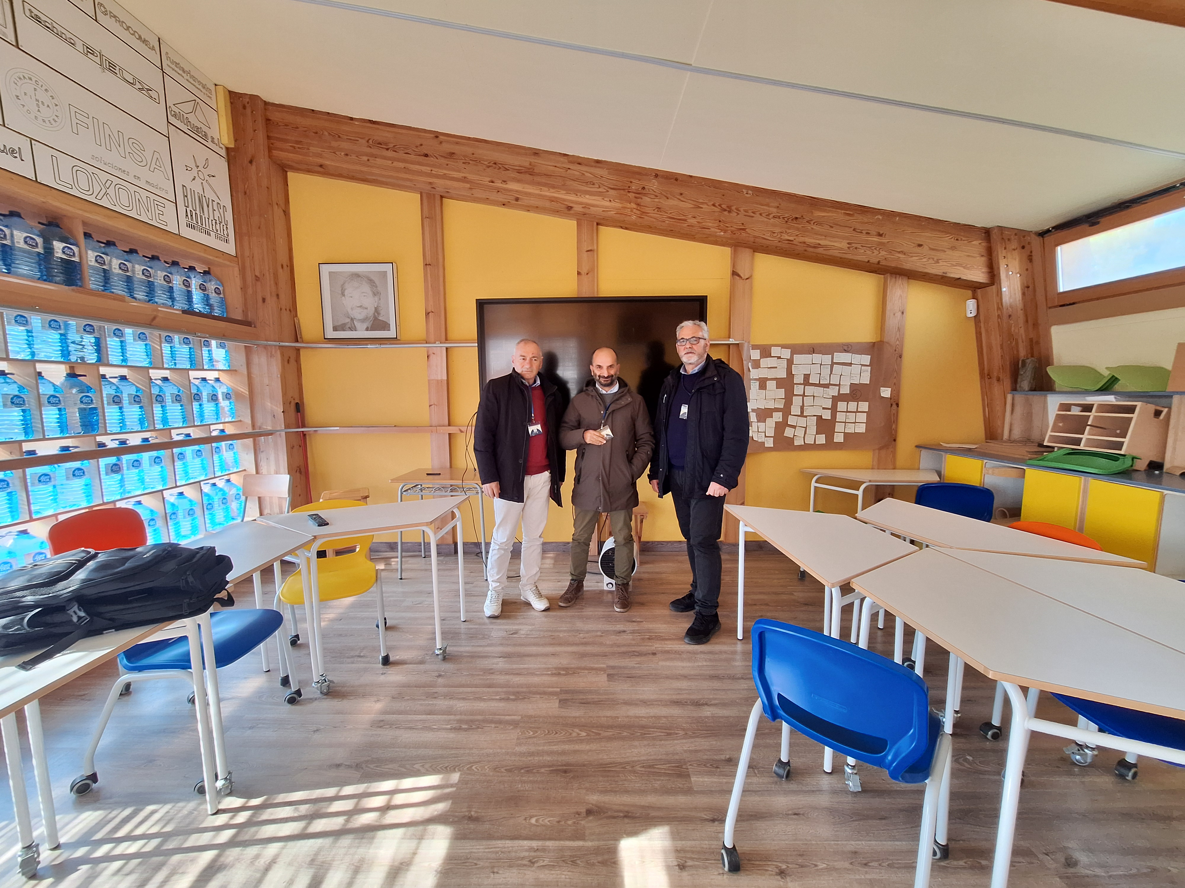
STRUCTURAL DIFFERENCES II
STRUCTURAL TYPOLOGICAL ANALYSIS
PILLARS
In Malafarina buildings there are several scattered and hidden pillars
in Manresa building there are only 8 pillars for an almost double surface area. The dimensions are larger than the Italian building, they are also exposed and doubled so that the upper beam is connected to the center.
BEAMS
MATERIALS
*

Slide 6
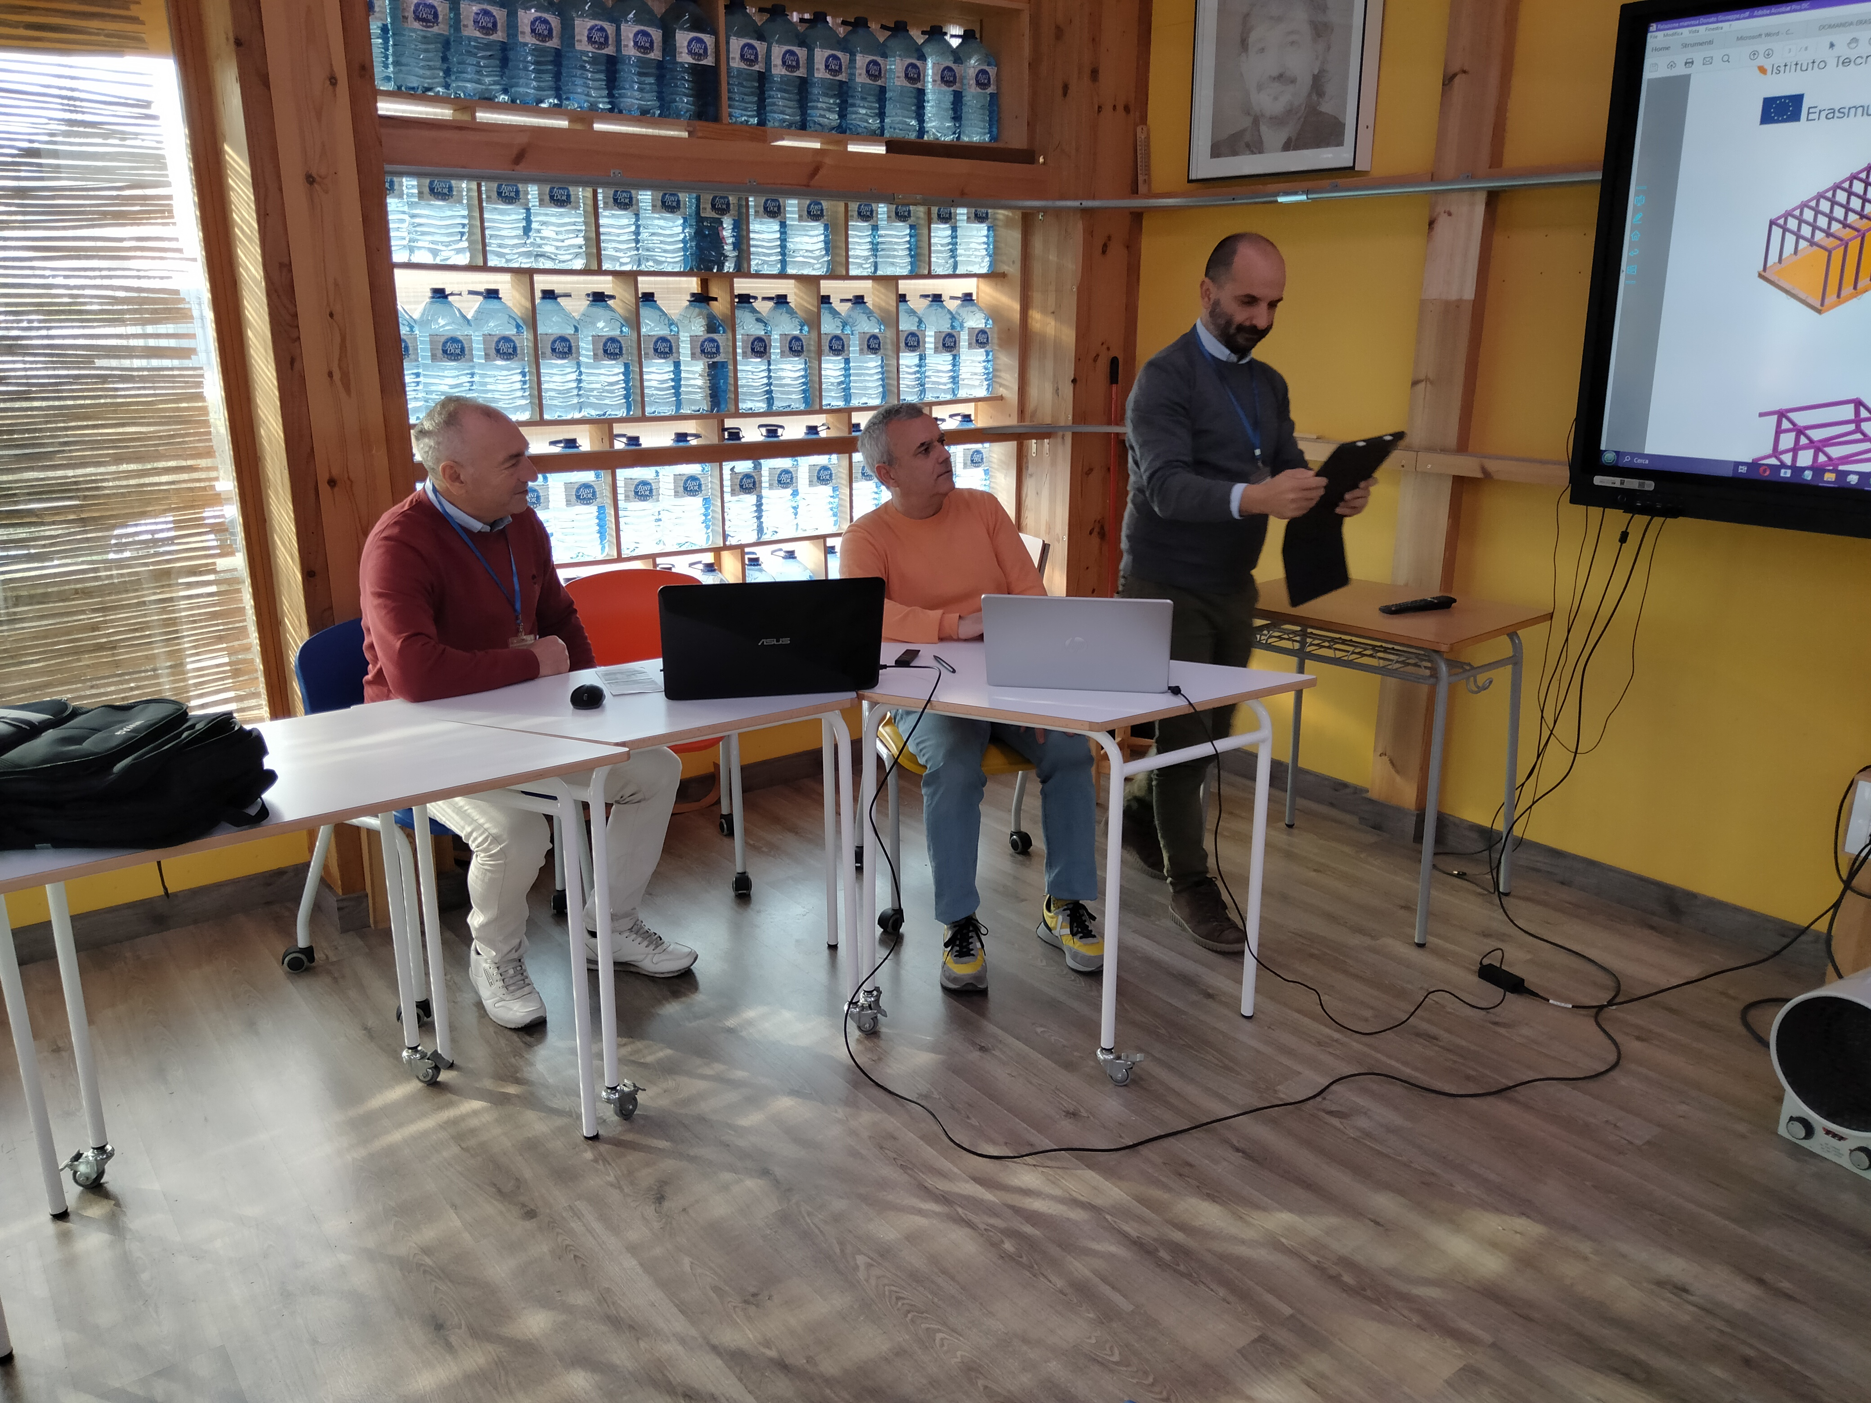
STRUCTURAL DIFFERENCES III
STRUCTURAL TYPOLOGICAL ANALYSIS
BEAMS
In Malafarina buildings the beams are exposed and small in size,
in Manresa buildings they are decidedly larger and protrude to the south for shading.
MATERIALS
*

Slide 7
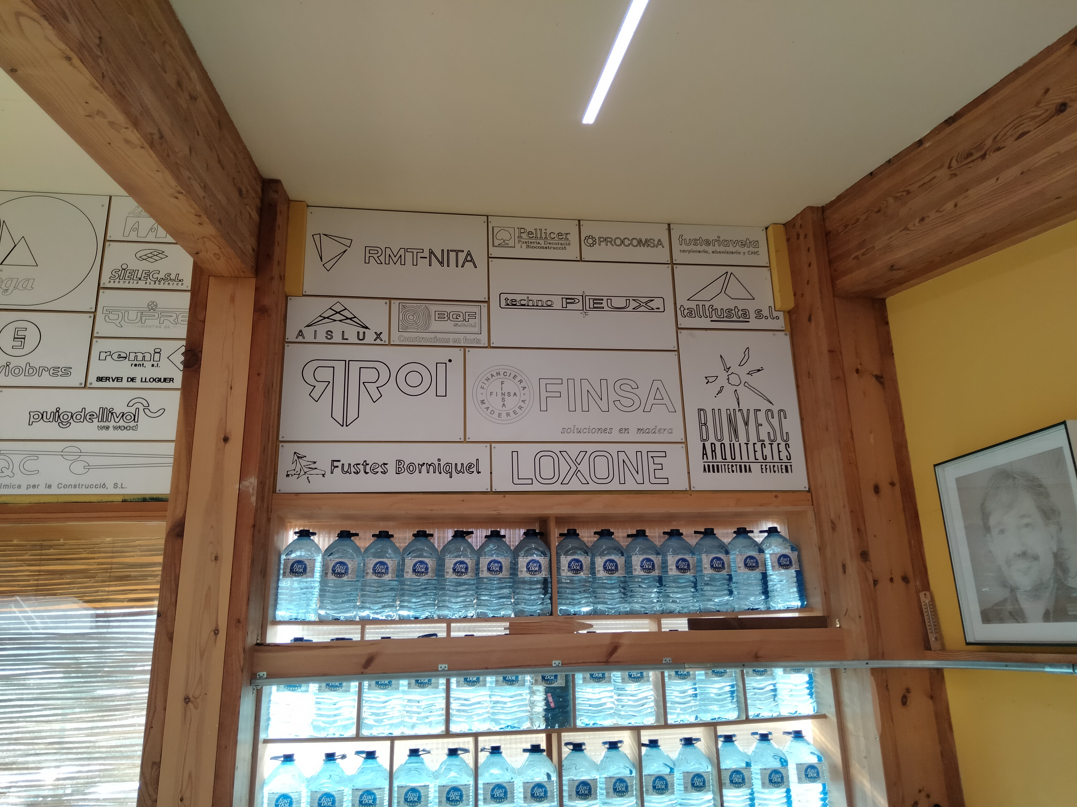
STRUCTURAL DIFFERENCES IV
STRUCTURAL TYPOLOGICAL ANALYSIS
MATERIALS
In Malafarina buildings the load-bearing material is laminated wood
In Manresa the main material is also laminated wood but coupled with laminated and compressed materials that provide the structure with adequate transverse rigidity.
*

Slide 8
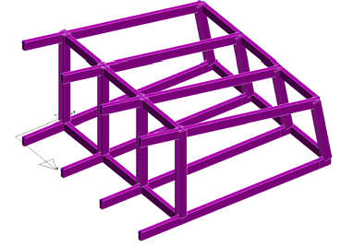
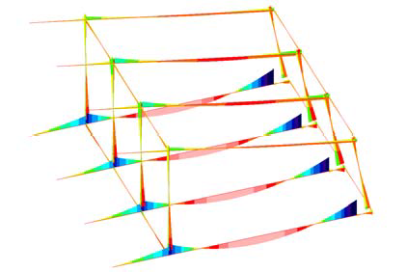
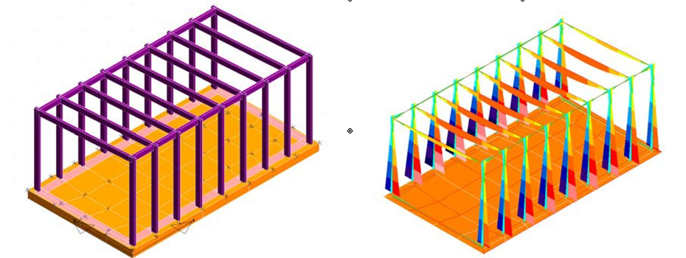
STRESS ANALYSIS
MANRESA
MALAFARINA
*

Slide 9
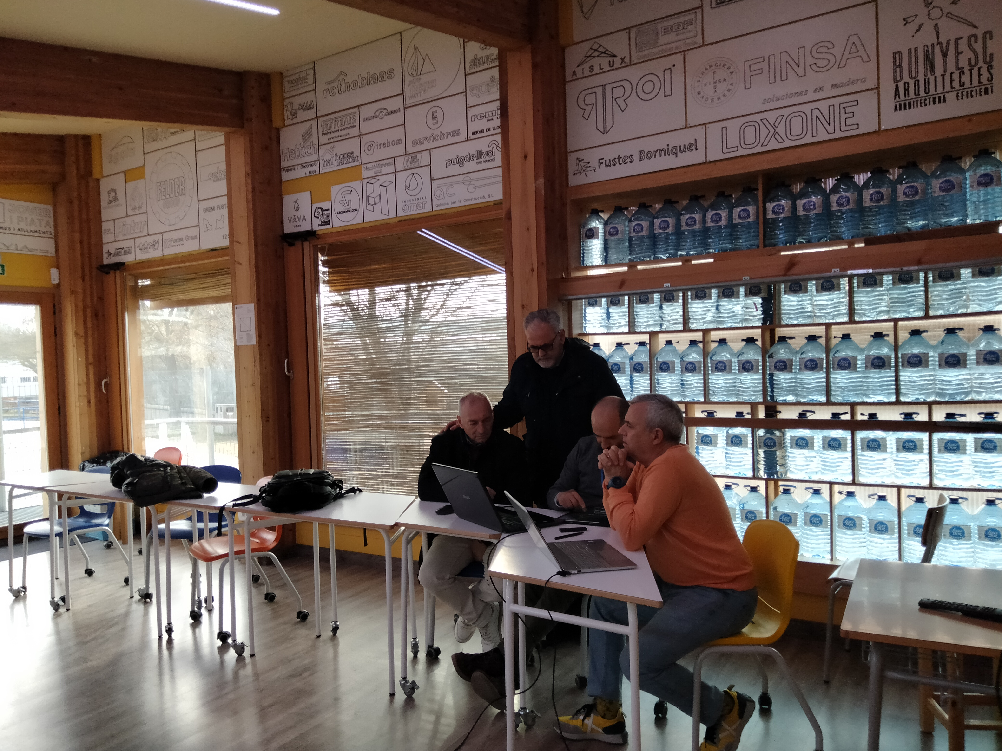

Thanks for your attention

