Slide 1
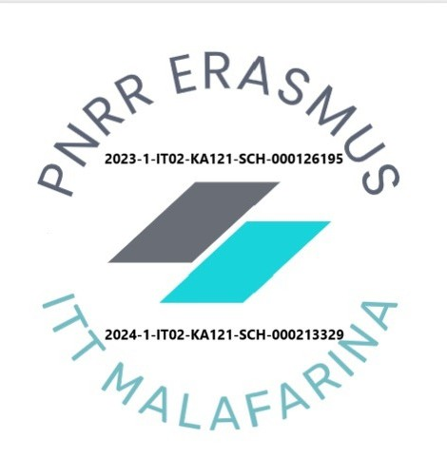
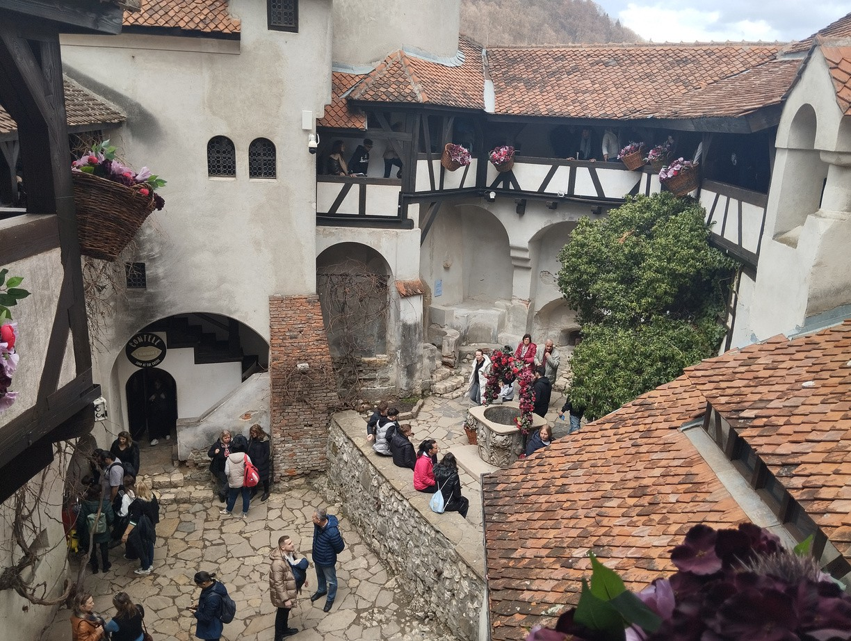
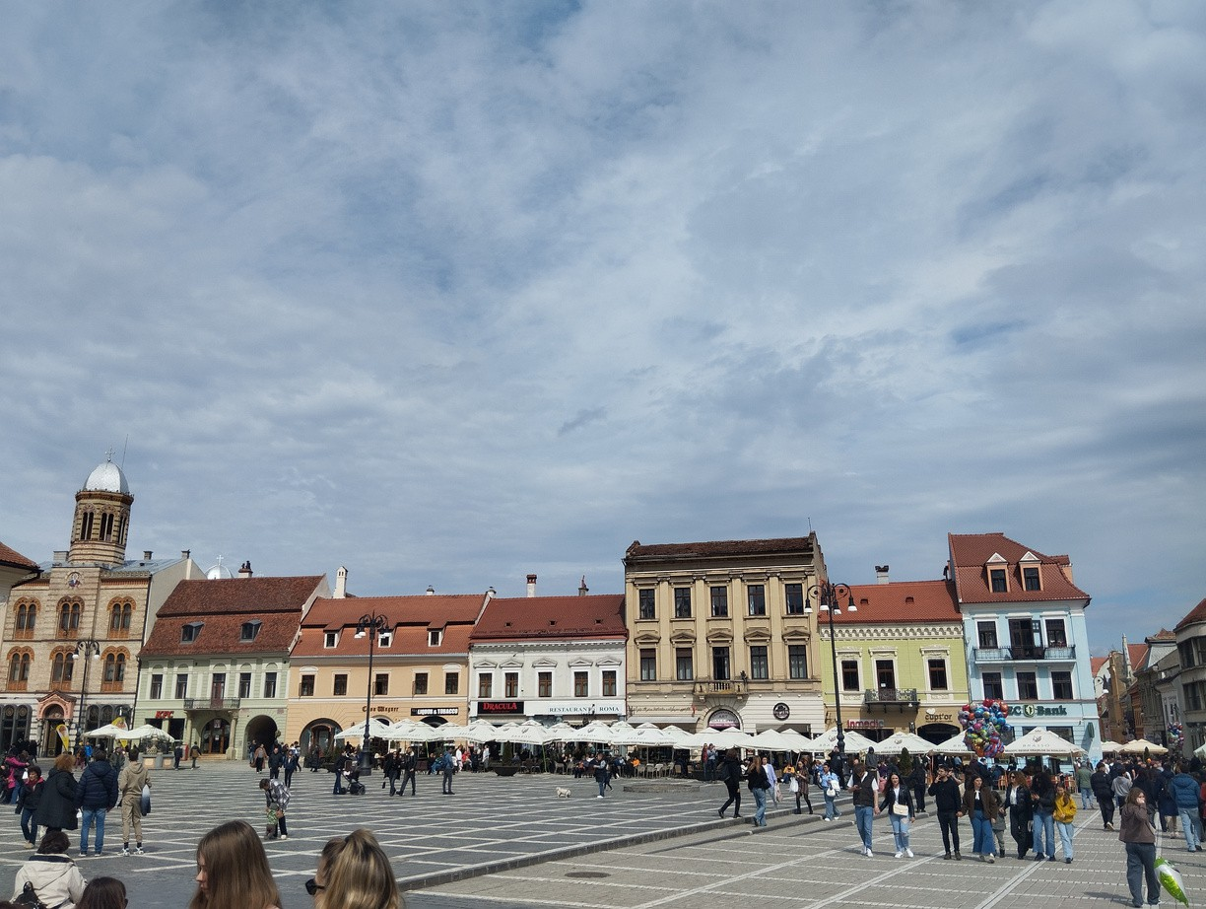
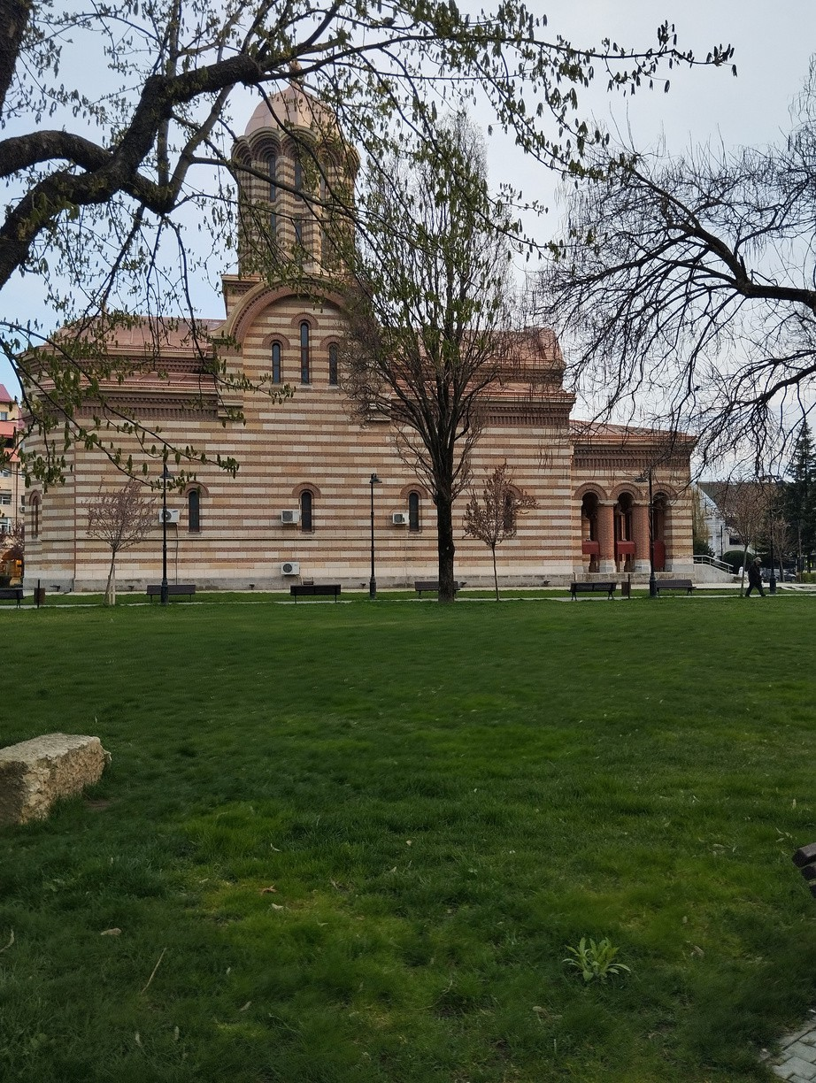
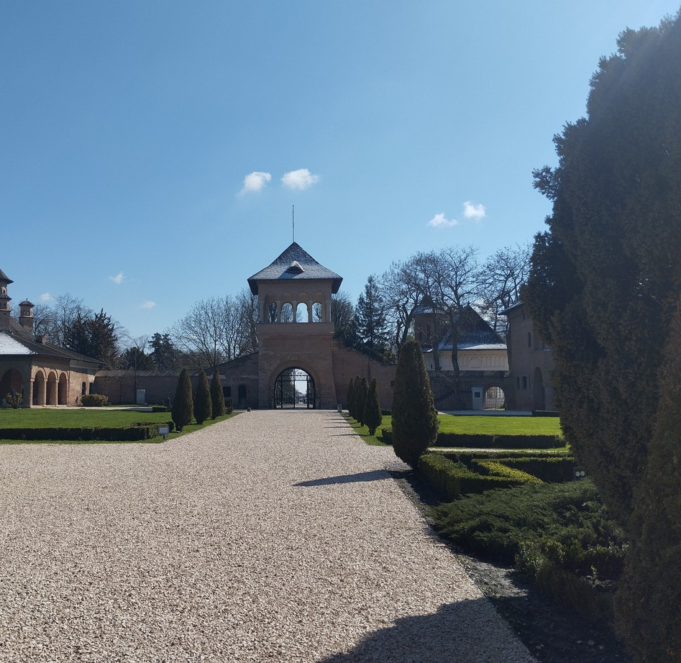
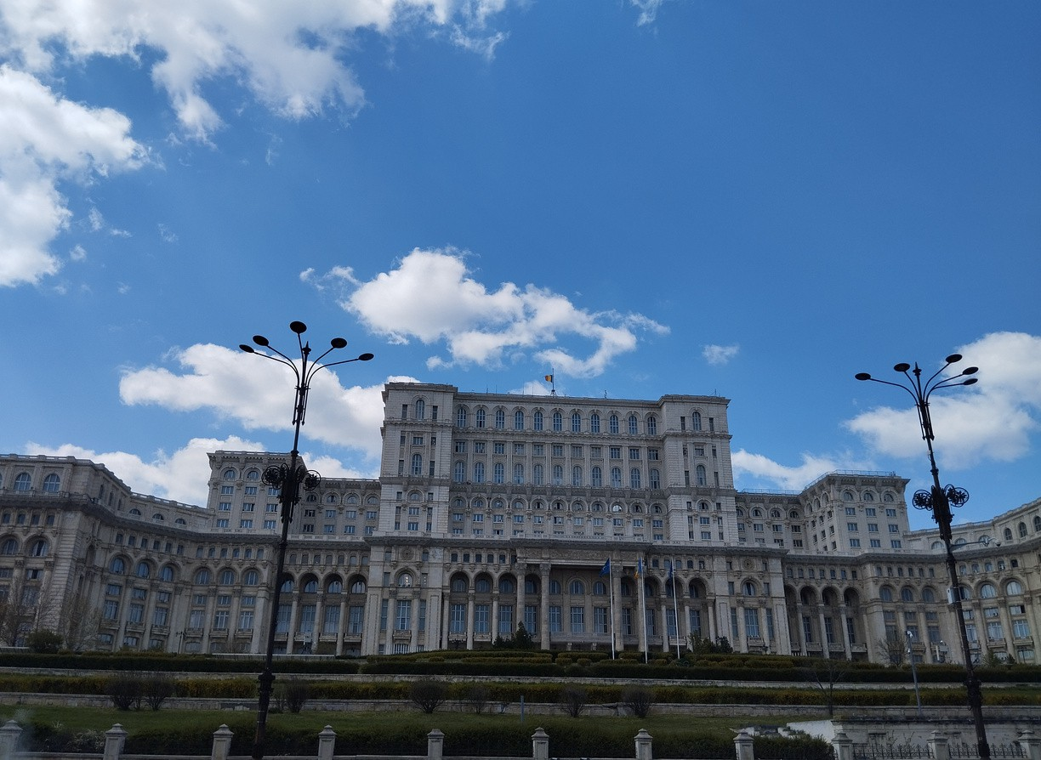
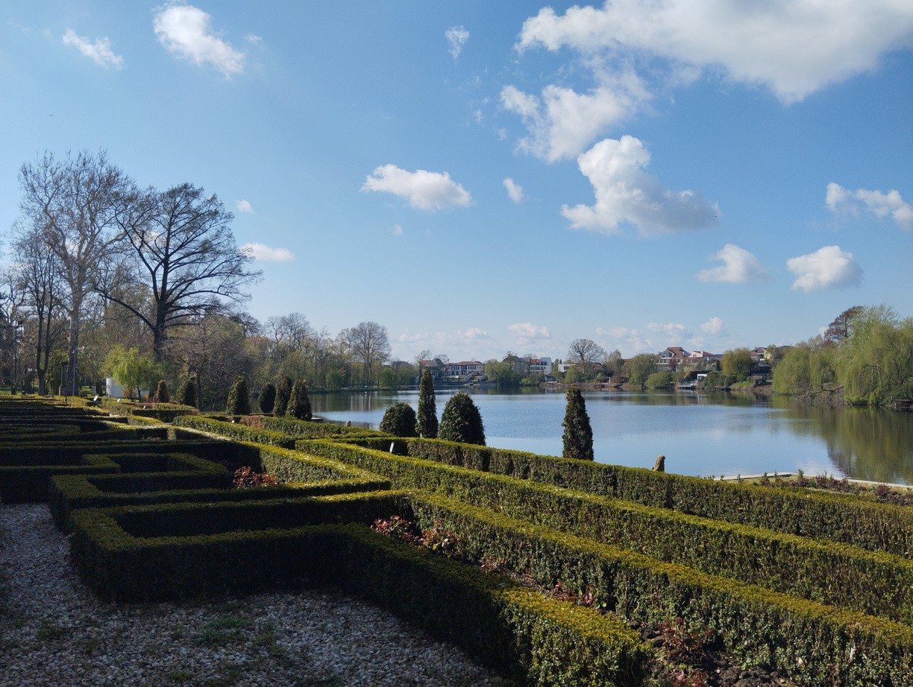


Overview of Education Systems: Italy & Romania

Slide 2
Italy: Structure at a Glance
Compulsory Education (6-16): 10 years total
Scuola Primaria (Primary School, 6-11): 5 years, basic skills.
Scuola Secondaria di Primo Grado (Lower Secondary School, 11-14): 3 years, deeper knowledge.
Scuola Secondaria di Secondo Grado (Upper Secondary School, 14-19): 5 years, various tracks (Liceo - academic, Technical Institutes - practical/theoretical, Professional Institutes - vocational).
Higher Education: Universities, AFAM (Arts, Music, Dance), ITS (Technical).

Slide 3
Romania: System Snapshot
Compulsory Education (approx. 6/7 - 15/16): Usually 9 years
Învățământ Primar (Primary School, approx. 6/7 - 11/12): 5 years, basic skills.
Învățământ Gimnazial (Lower Secondary School, approx. 11/12 - 14/15): 4 years. National Evaluation at the end.
Învățământ Liceal (Upper Secondary School, 14/15 - 18/19):* 4 years, different profiles (Theoretical, Technological, Vocational).
Învățământ Profesional (Vocational Education):* After 8th grade, various durations (typically 3 years).
Higher Education: Universities (Bachelor, Master, PhD), Post-secondary non-university.

Slide 4
Despite structural differences, both Italy and Romania show increasing adoption of:

Slide 5

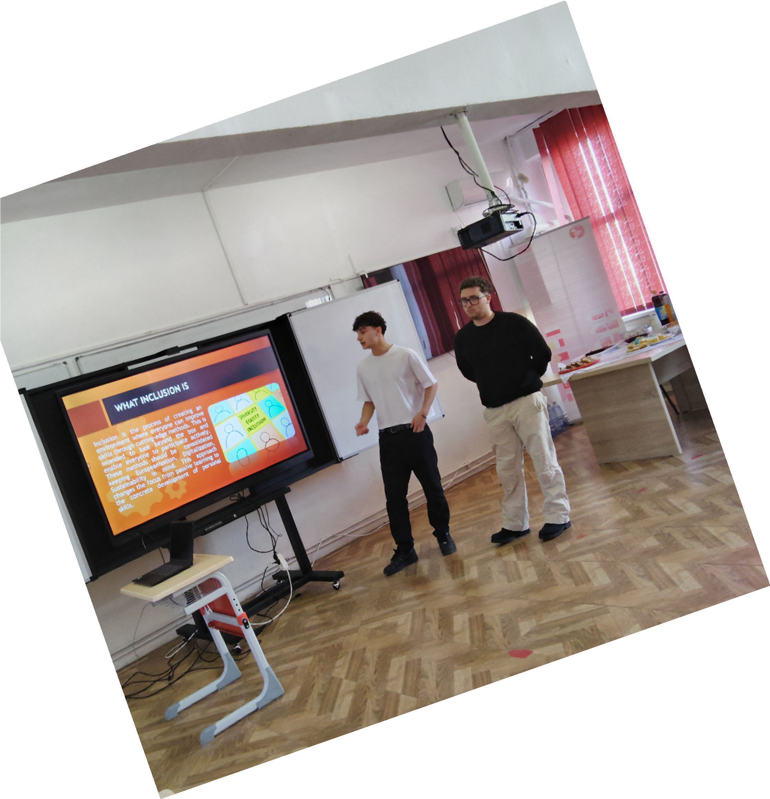
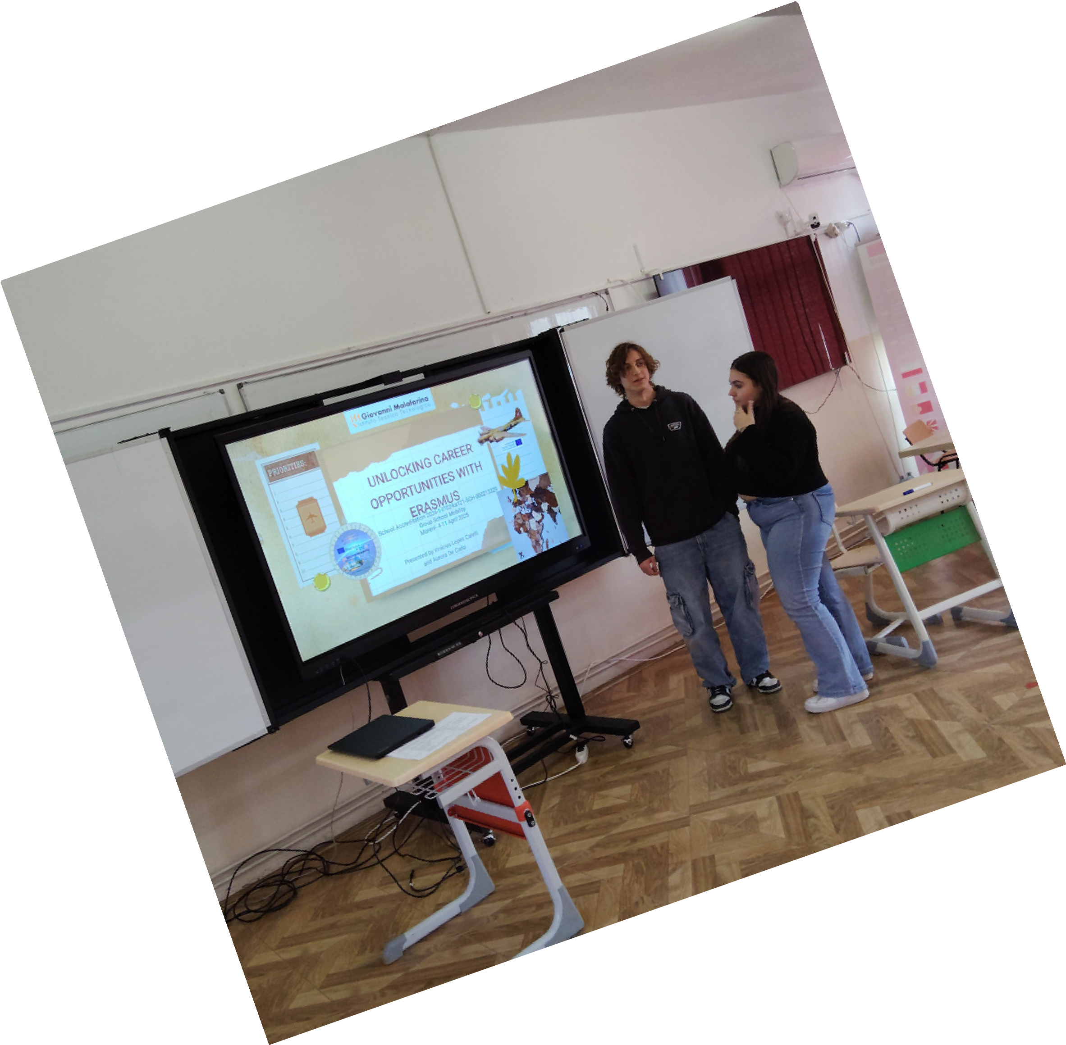
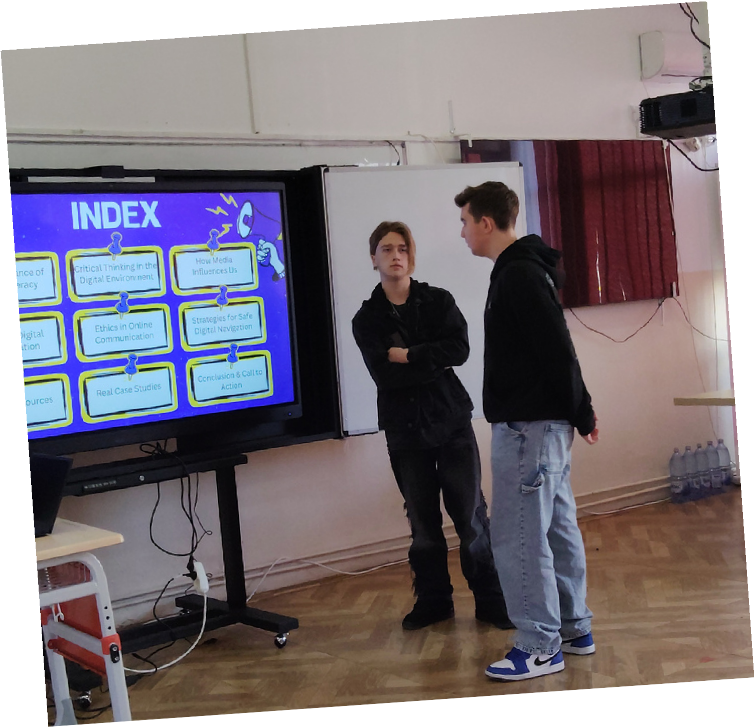


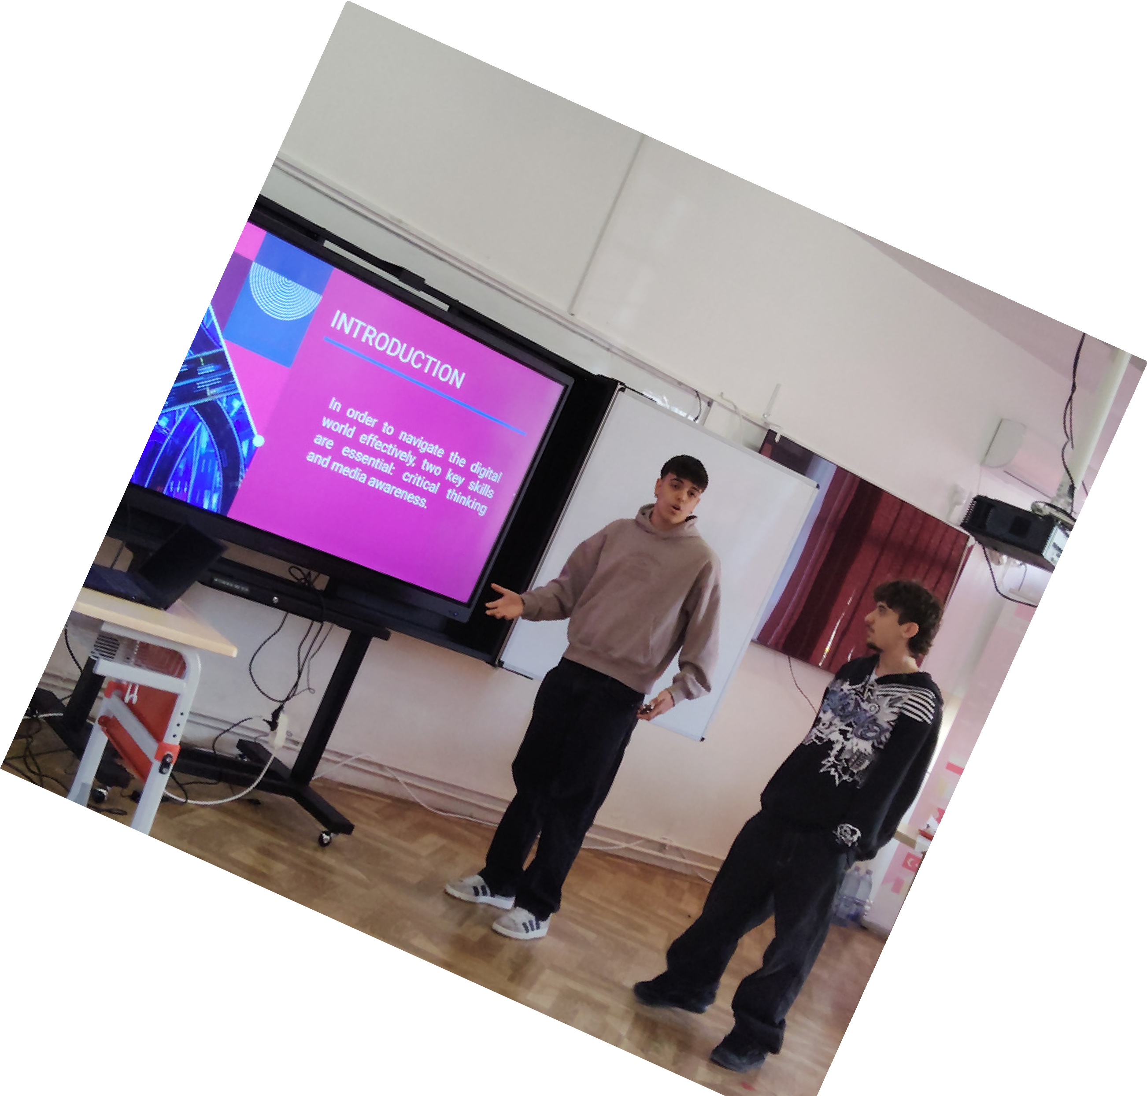
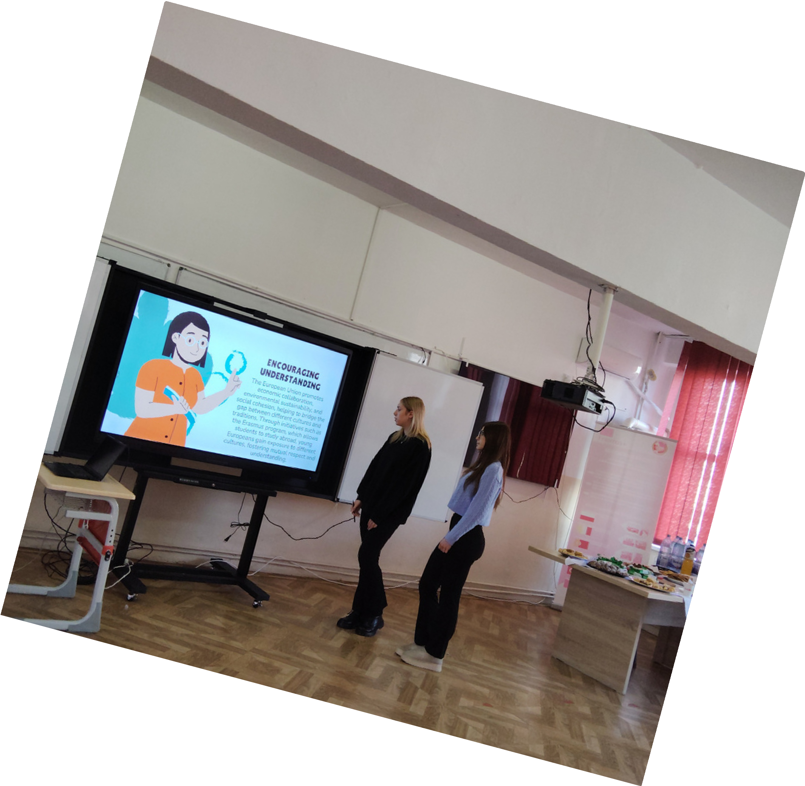
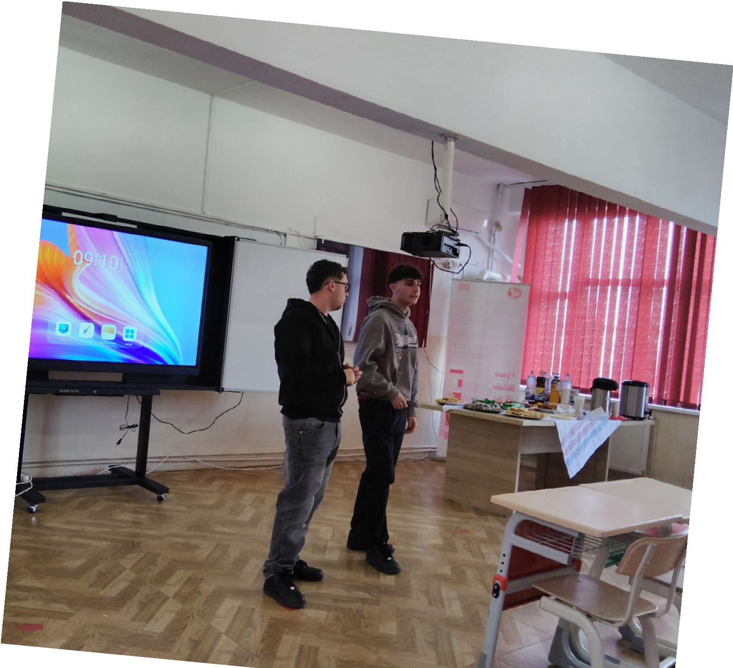
Student-Centered Learning: Moving beyond traditional lectures.
Experimentation with Innovation: Gradual introduction
of methods like PBL
and flipped
classrooms.

Slide 6

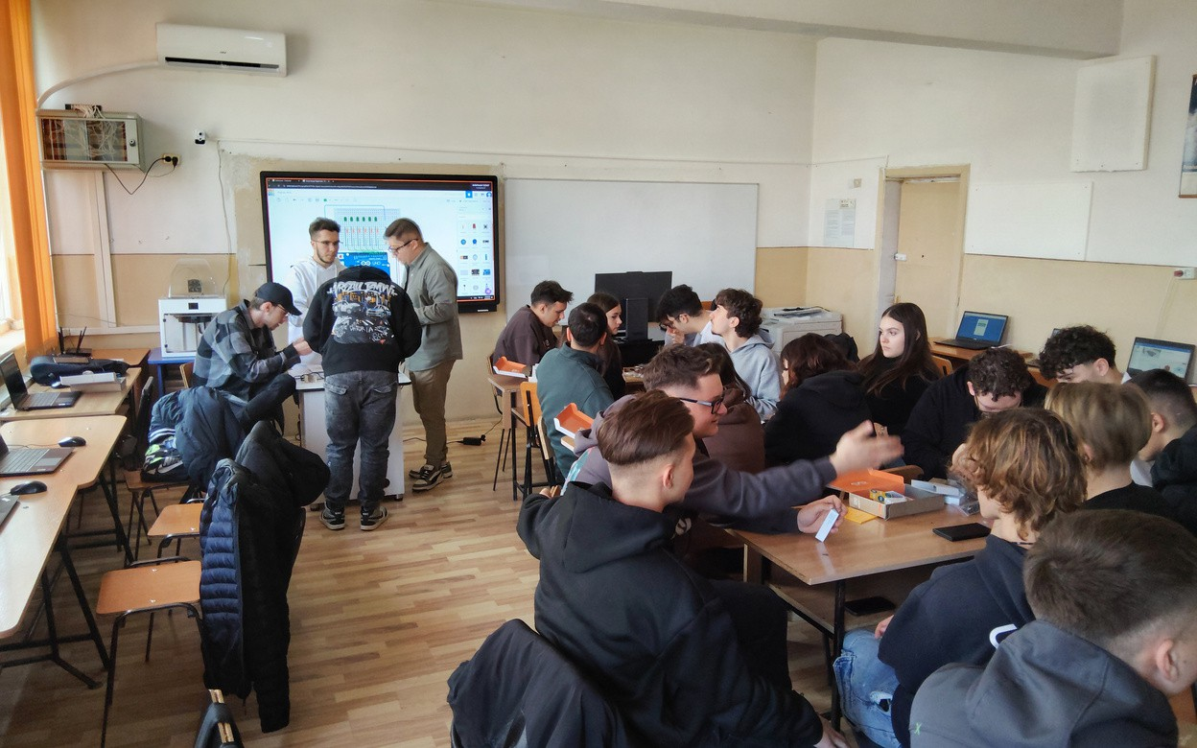
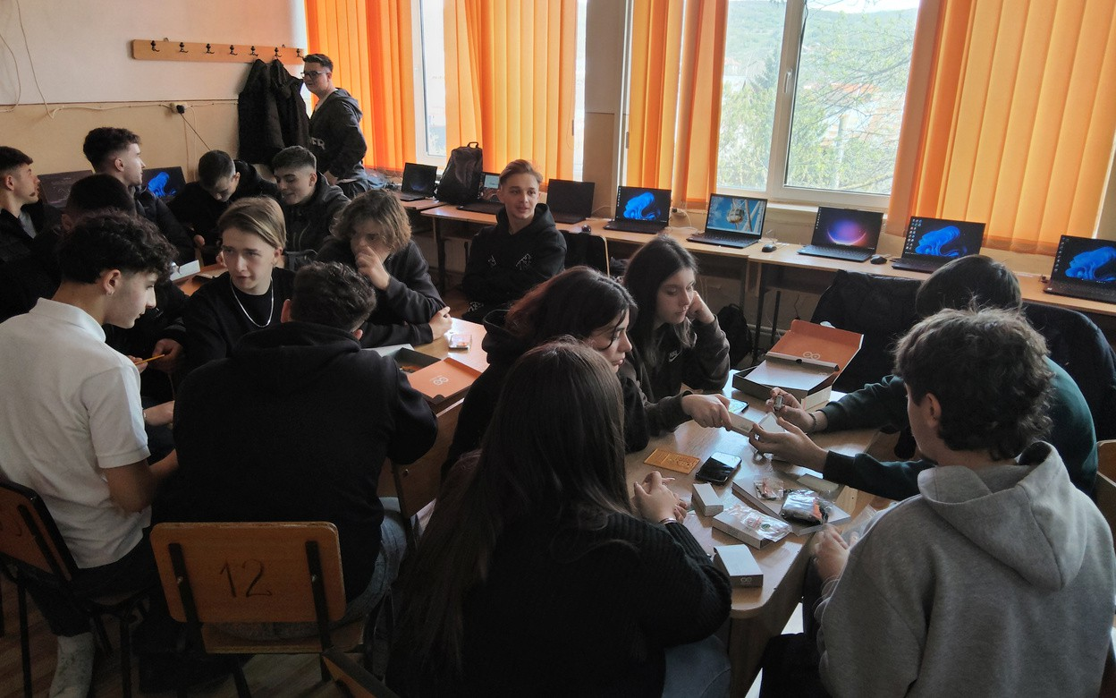
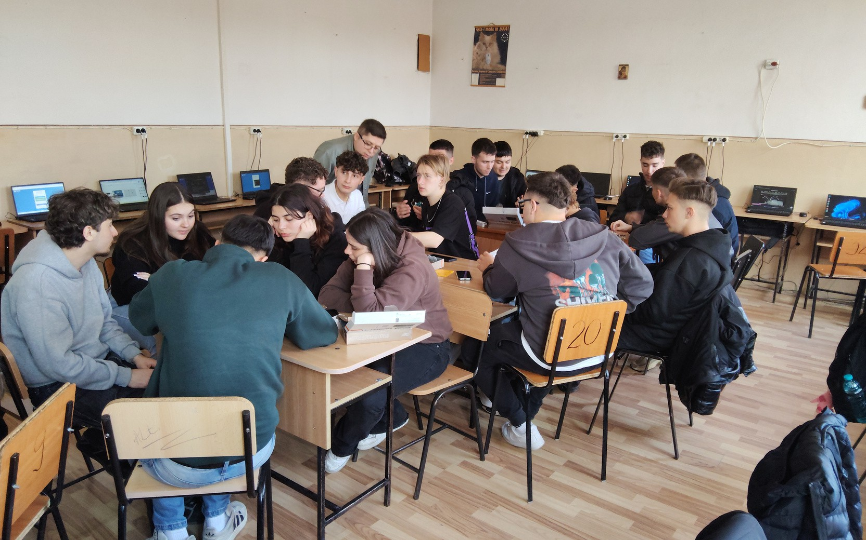
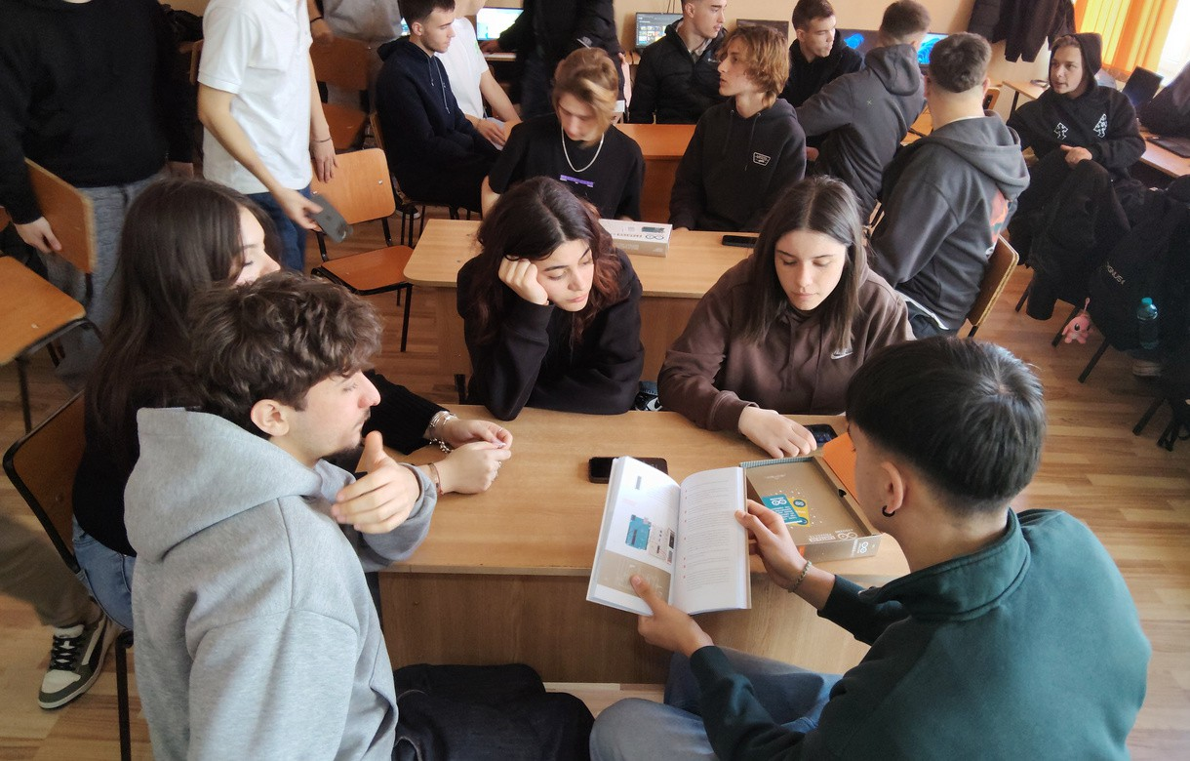
Active Engagement: Growing use of group work, discussions, and hands-on activities.

Slide 7
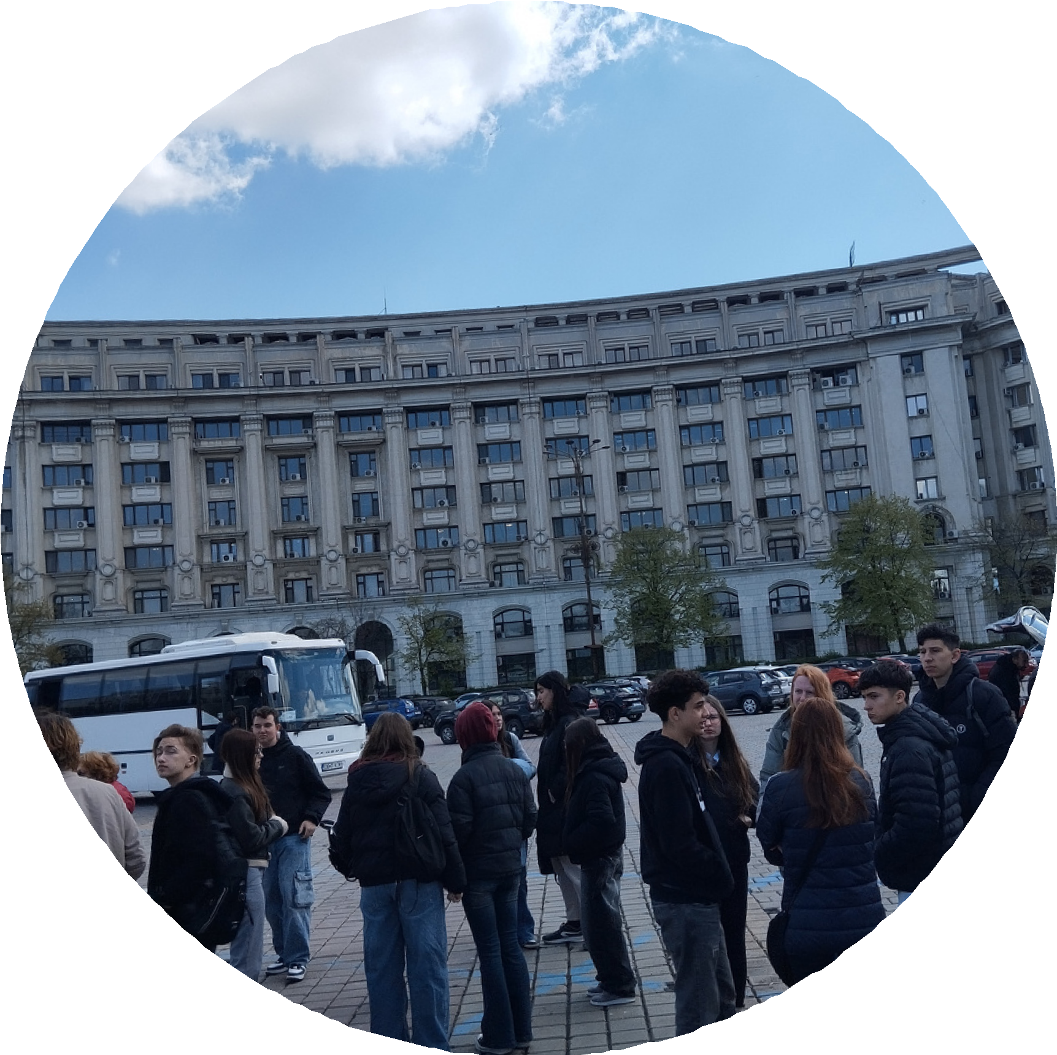
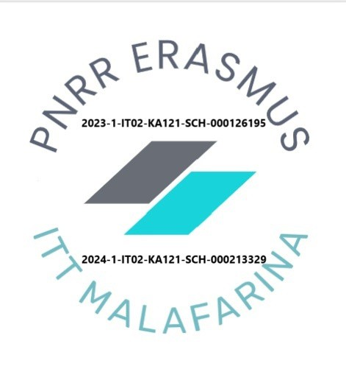
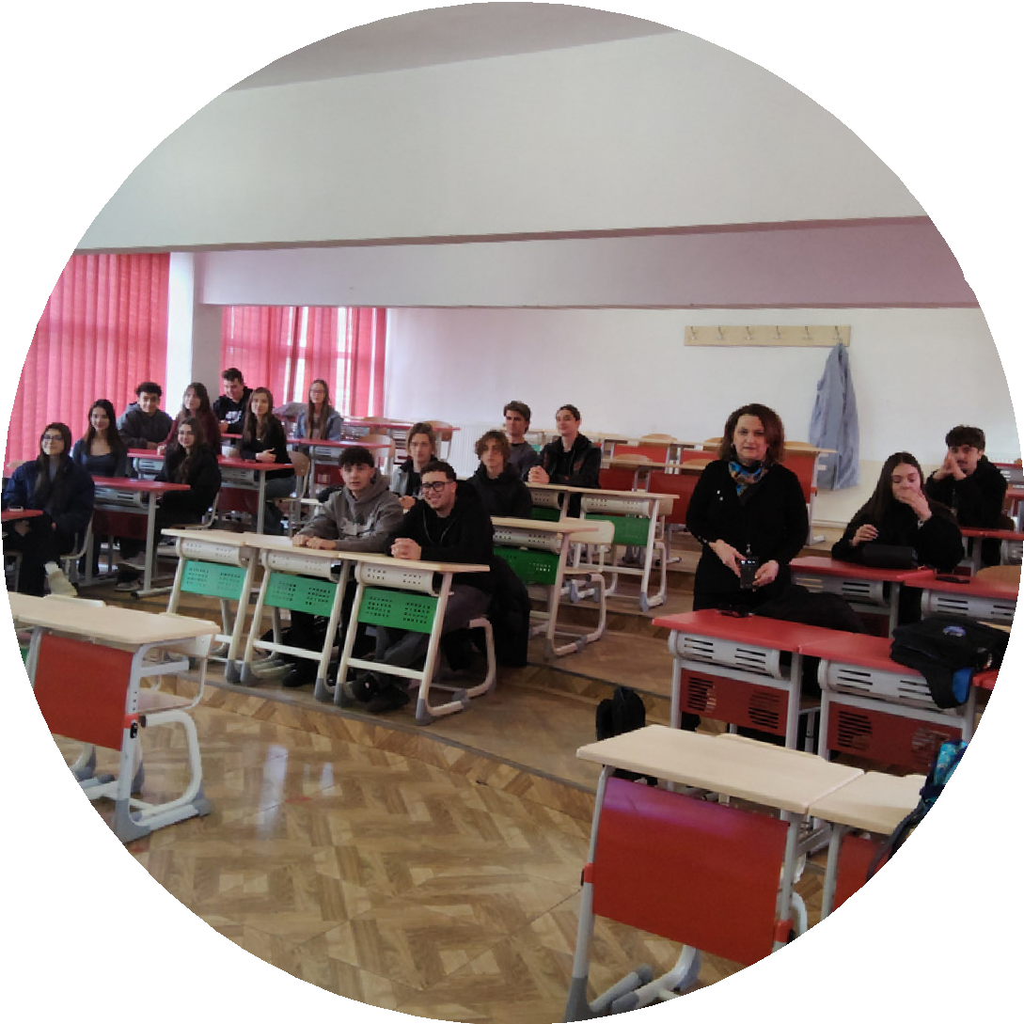
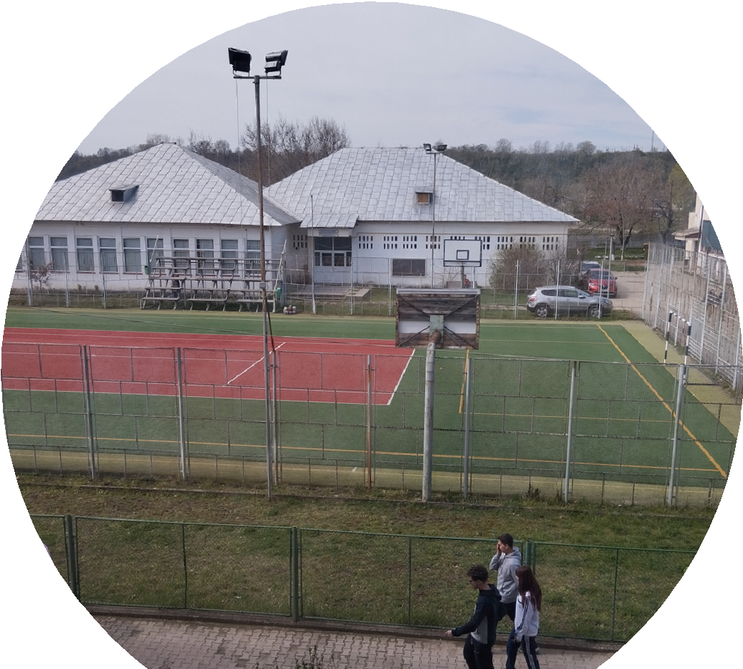
Practical Skill Focus: Recognizing the importance of real-world competencies.

Slide 8
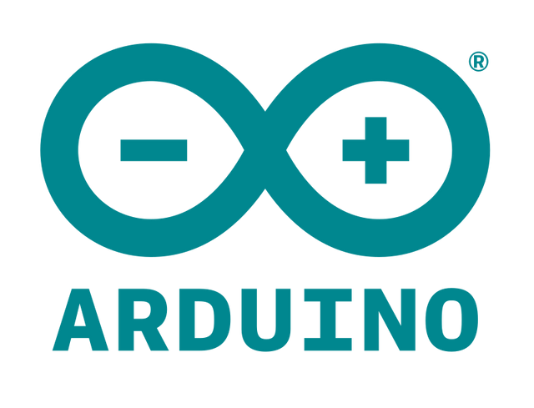
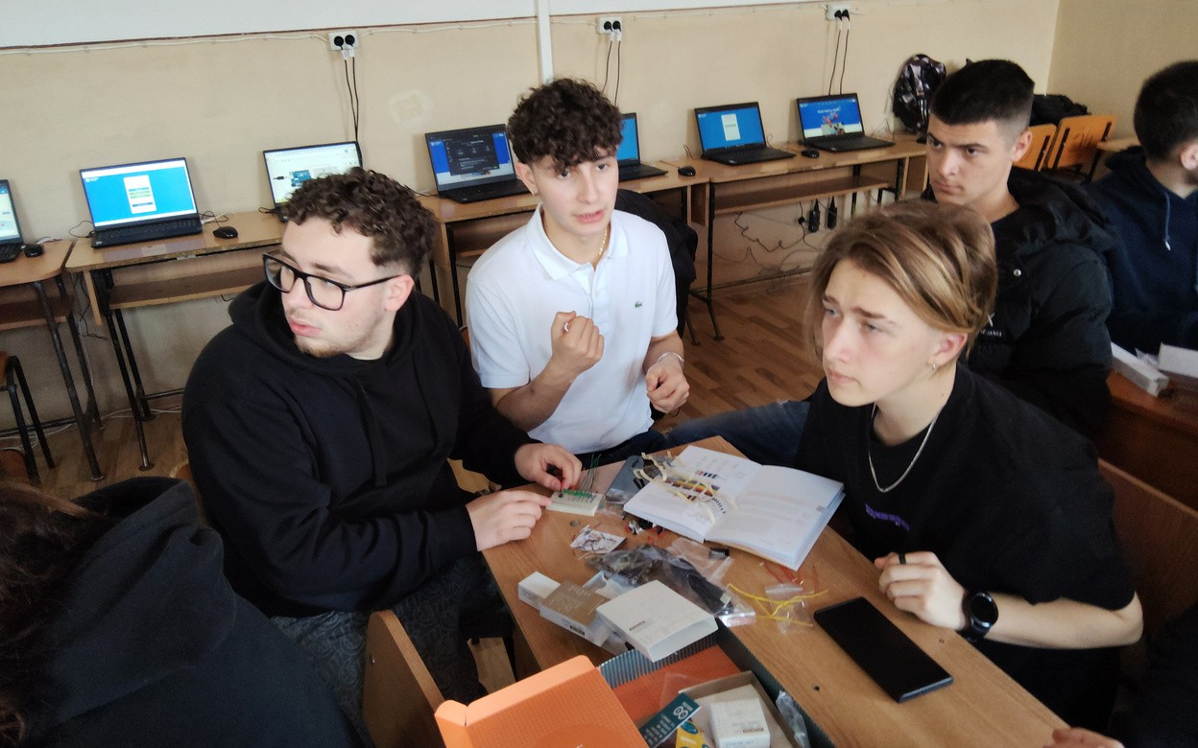
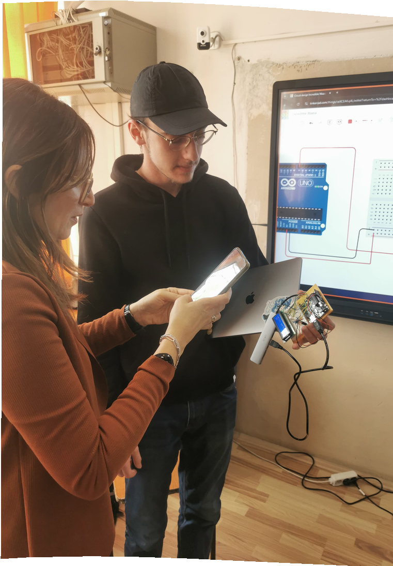
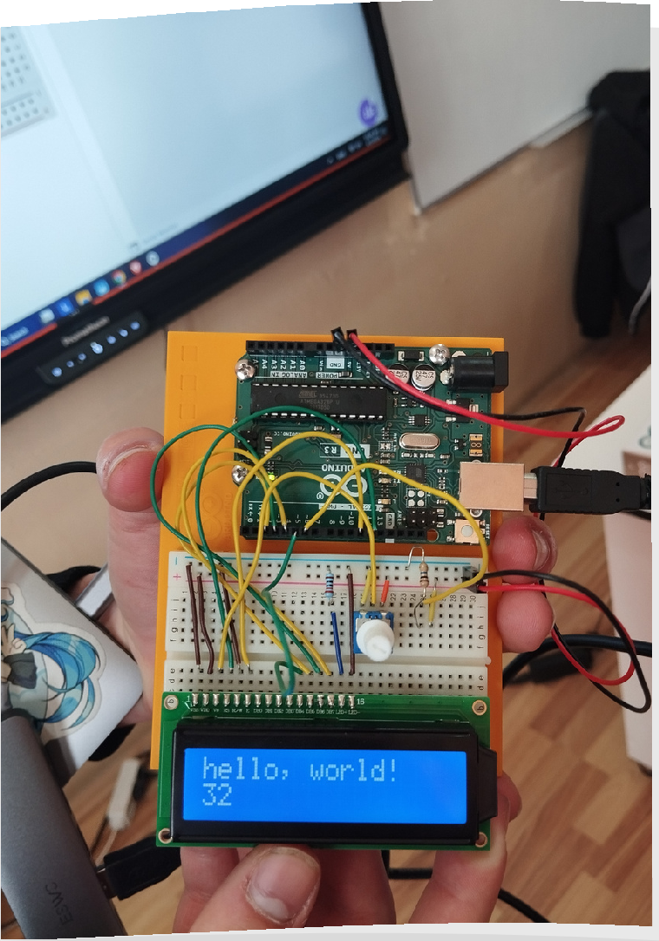
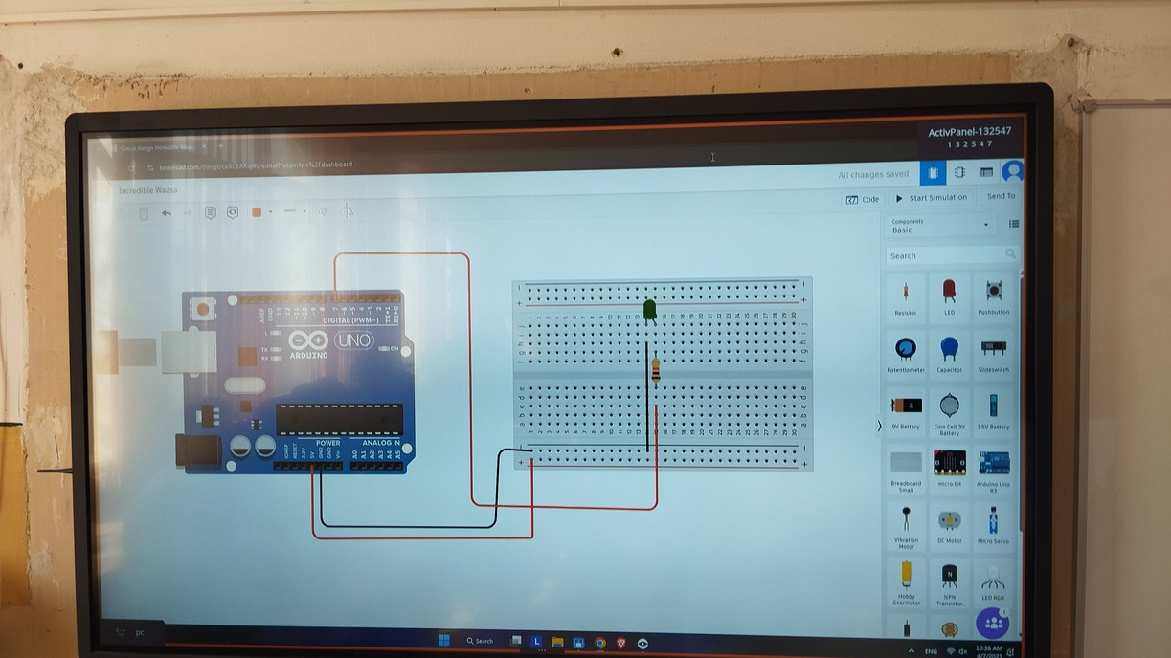
Technology Integration: Exploring digital tools for enhanced learning.
Competency-Based Learning: Shifting focus to skill development.

Slide 9


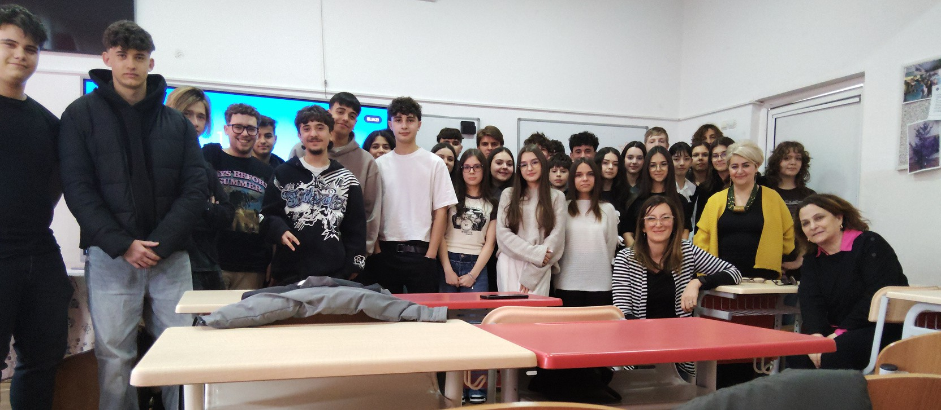




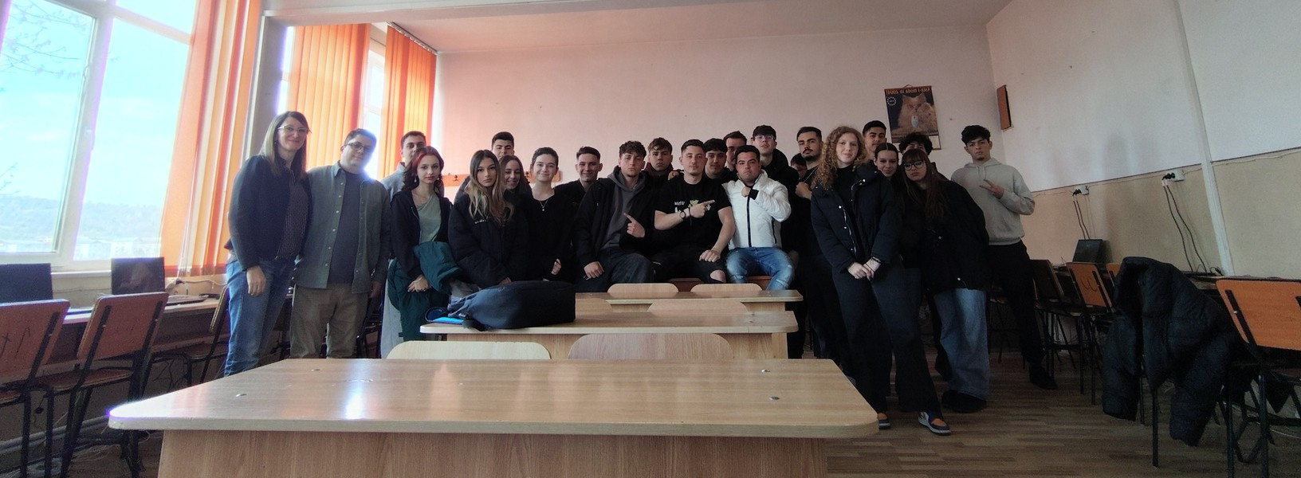
Emphasis on Inclusion: Addressing diverse needs in the classroom.
tthe beautty off beiing ttogetther

