Slide 1



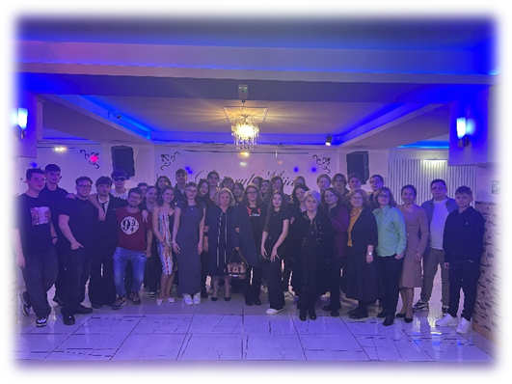
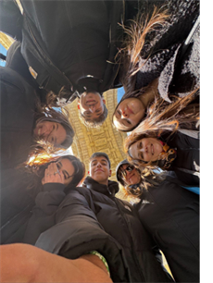

Moreni- 5-10 April 2025
PNRR 2023-1-IT02-KA121-SCH-000126195
held at Colegiul National „Ion Luca Caragiale” Moreni, Romania
Memories
This mobility represents my second Erasmus+ project. It was a great experience, I visited fantastic places like Dracula's Castle, the capital Bucharest, Brasov and I met kind and helpful people. Thanks to it I was able to strengthen my English language skills and to deal with Intercultural Dialogue. I stayed with a Romanian family and my host welcomed me warmly, they were very kind and helpful. One of the things that struck me most is their way of teaching: I attended really engaging and interesting English, Chemistry and Computer Science classes. I can't wait to see the Romanian kids again in May and introduce them to our traditions.
Gualtieri Sophia

Slide 2
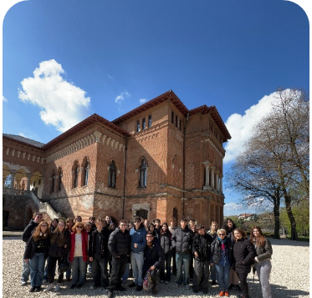
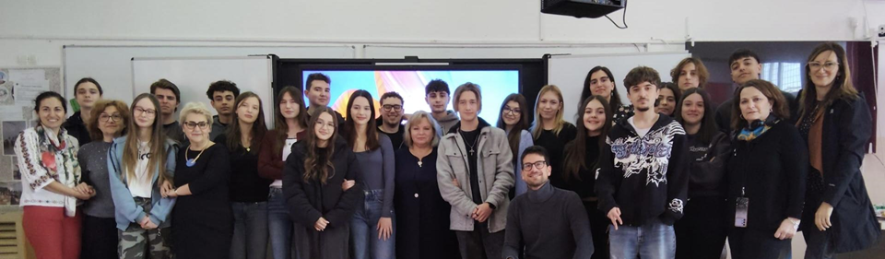
This was my seventh and last Erasmus mobility, and I am very sad that this wonderful experience has come to an end. Every Erasmus project has taught me something new, helping me grow as a person and create amazing memories and this experience was no exception!
Even though it was my second time in Romania, I was very happy to return. This country left a great impression on me, and I had always wanted to come back, so my dream came true. This time, I stayed with a Romanian family instead of in a hotel. They welcomed me warmly and truly made my stay unforgettable.
We went on fascinating trips to Dracula's Castle, Bran, Brașov, and Bucharest. We also had interesting classes in English, IT, and chemistry. I’ve learned a lot about culture: differences and similarities. I did this thanks to the lessons but also I had the chance to experience them on my own. I also made a presentation about European Cooperation.
Of course, I can’t talk about this trip without mentioning the people. The Romanians were very fun and friendly, and we had a great time together especially at the farewell party. I can’t wait to see them again in May!
Benedetta Chiefari

Slide 3
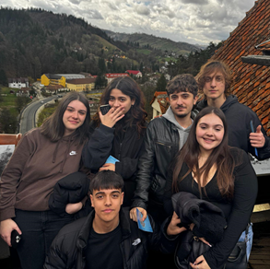
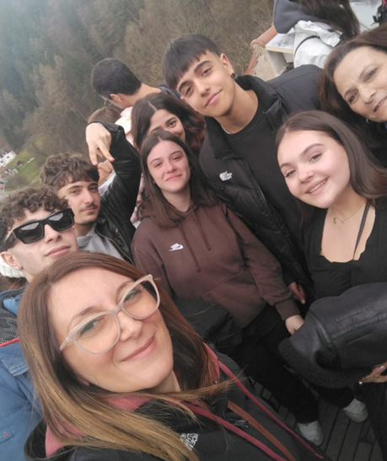
My school gave me the opportunity to take part in a group school mobility in Romania. The project took place in the city of Moreni.
The activities throughout the week were diverse: we attended presentations prepared by Italian and Romanian students about what it means to be a European citizen, the value of knowing more than one language, and the importance of inclusiveness in Europe. In particular I contributed to the layout of a presentation about Digital Word skills. We had also the chance to visit Bucharest, a city full of history and culture, and we spent an entire day discovering Dracula's Castle, known for its historical importance. There were also several moments dedicated to socializing, which helped us become a group.
I realized how meaningful these projects are for me. Not only from an academic point of view, but also on a personal level: these mobilities offer the chance to connect with new people and build friendships that could last a long time. I owe a lot to these projects, because without them, I would never have had the chance to meet such amazing people.
Samuele totino

Slide 4
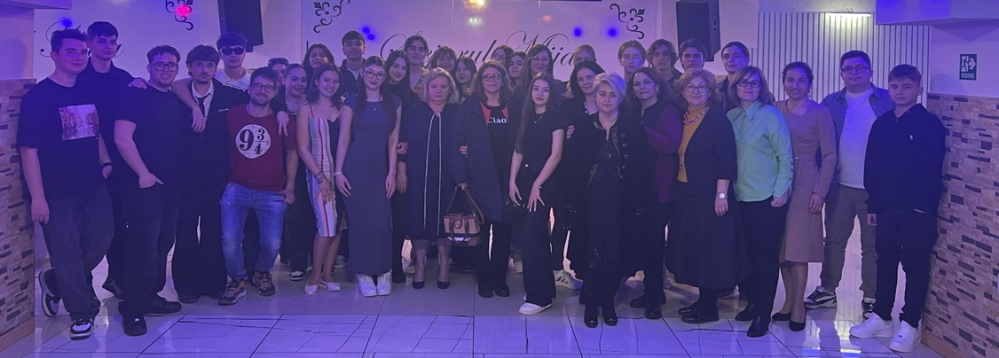
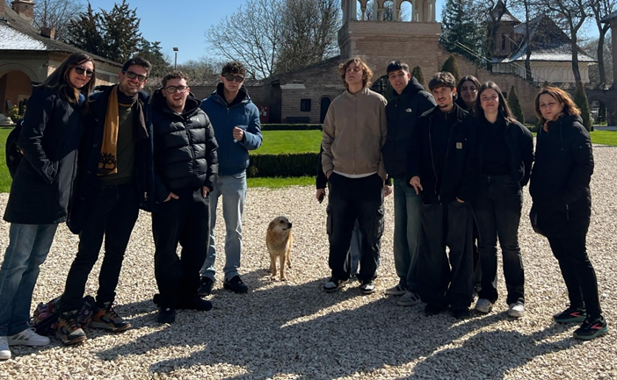
This was my third Erasmus, I was hosted, unlike the previous time, by a family consisting of four people plus a wonderful dog who treated and welcomed me and my partner with whom I lived, very well. Also at the end of Erasmus, the girl who hosted me, gave me a typical Romanian cake and bracelets for me and my family. The first visit I made was to Dracula's castle, in Bucharest, the girl who hosted me explained the history behind this castle and also, overall, the history of Romania, the castle was very beautiful outside and also inside, although the corridors, at least some of them, were very narrow, also at the base of the castle there were a number of souvenir stores. During school hours we had very interactive and interesting lectures, I introduced a presentation about Critical Thinking and Media Awareness. In conclusion to say that this, among the three mentioned above, was the best Erasmus, and the last one in my school.
Antonio Lorenzo Lazzaro

Slide 5
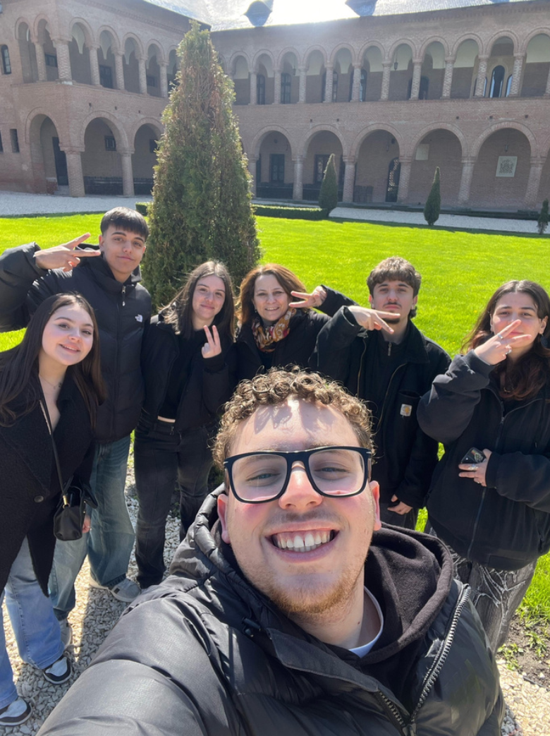
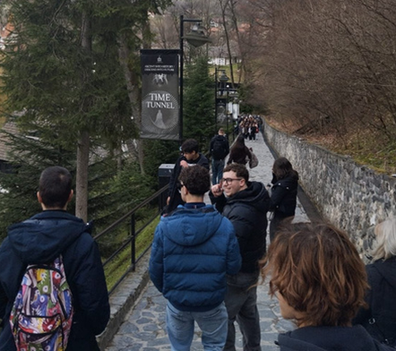
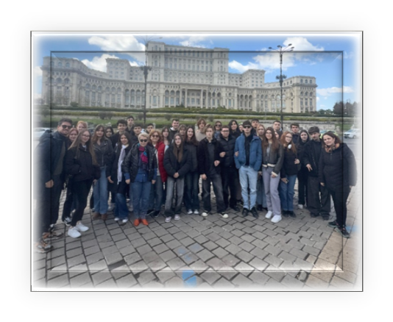
In the month of April I had the opportunity to partecipate in the Erasmus PNRR project, it was my first time in a short mobility where I would have been hosted, we visited many really interesting and fascinating places, and also really wonderful cities like Brasov and Bucharest. I experienced firsthand how it is to live in another house and nation, trying the real culinary culture that doesn’t belong to me, like ciorba, but apart from all this, it was a truly beautiful experience like few others: I learnt a lot and I deepened my knowledge about the value of Basic Skills for Inclusion; I went out of my comfort zone expanding my horizons to a new culture that made me learn a lot both at a scholastic and personal level, as I had the opportunity to be with my Romanian mates and spend always good time all together, they are truly wonderful students. Andrea Francesco Montesano

Slide 6
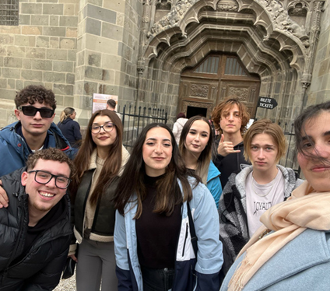
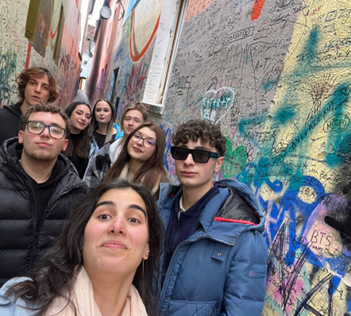
This was my fifth and last Erasmus project, unfortunately this opportunity has reached its end as it is my last year. Romania left me amazed not so much for its territory, which is what it is, but for the magnificent people I met and with whom I had to deal. I was hosted by a special person and family who ensured me a week of serenity. I had the opportunity to visit two breathtaking cities such as Brasov and Bucharest. Also the school, where interesting lessons were held with equally entertaining topics was a surprise. I learned a lot about their culture, between similarities and differences, for example the teaching method, slightly different from the Italian one and to be honest slightly better. Finally, I would like to further thank the Romanian guys, with whom we spent memorable moments and who allowed us to have fun for the last time together, especially at the farewell party.
Simone Camillo Dominianni

Slide 7
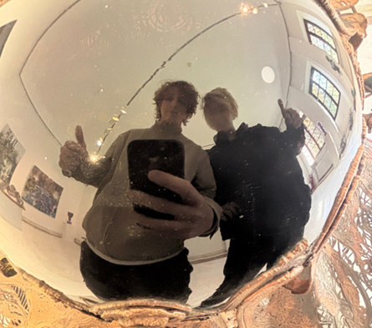
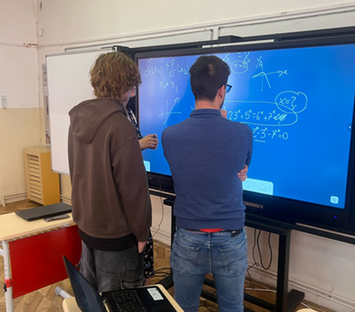
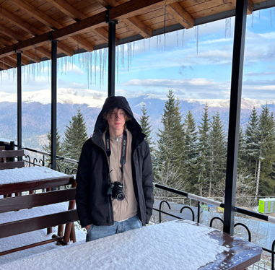
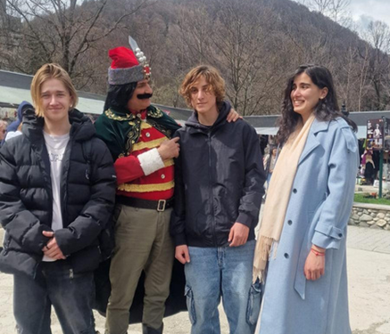
Between April 5th and 10th, I had the opportunity to take part in an Erasmus project for the first time. As soon as I arrived, I was warmly welcomed by David and his family. I had the chance to visit many beautiful places rich in historical culture, such as Dracula’s Castle and the city of Bucharest.
I tried new food that I immediately liked, such as sarmale and mici. But above all, it was an experience that was worthwhile not just because of the material things, but mainly because of the people I met. I made many friendships and grew very close to some people in such a short time.
In the end, in my opinion, that’s what life is really about: the connections we make along the way. We know we are truly living when we have stories to tell — and this trip to Romania will definitely be one of them. Thank you for the opportunity. Vinicius Lopes Carelli

Slide 8

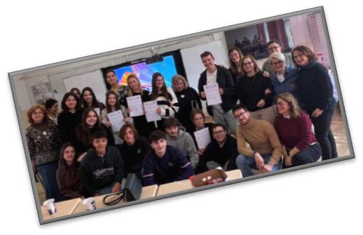

Thanks for watching
From April 4th to April 11th, 2025, I had the wonderful chance to take part in an Erasmus mobility project in Moreni, Romania — an experience that truly stayed close to my heart.
What made this journey unforgettable was, above all, the incredible hospitality we received. The Romanian students and their families welcomed us with such kindness and warmth that we immediately felt part of their community. Their generosity and openness turned every moment into something special.
We also had the opportunity to visit Bucharest, a city full of culture and history, and to explore the fascinating Dracula’s Castle, a place that combined legend and heritage in a truly unique way. Looking back, I realize how deeply these Erasmus projects have impacted me. They’ve given me not only new knowledge and skills, but also unforgettable memories
Aurora puntieri

