Slide 1







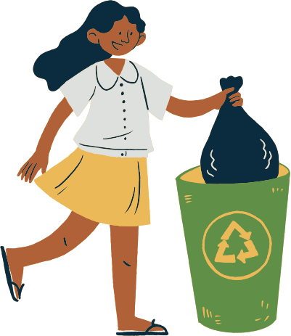
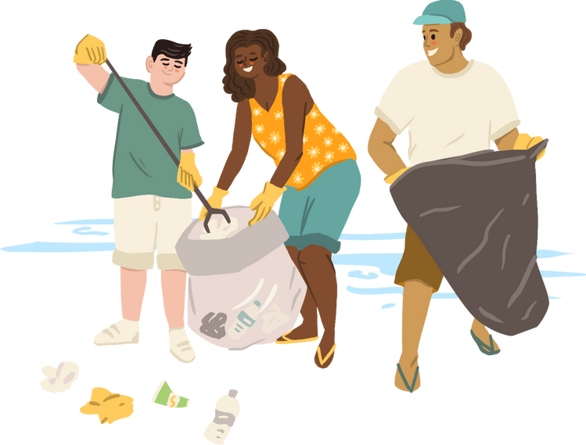

SUSTAINABLE
FUTURE
Building a Better World for the Future
By Giuseppe Pallone and Antonio Meliti

Slide 2



LIST OF CONTENTS
Introduction
What is Sustainability?
Environmental Sustainability
Social Sustainability
Economic Sustainability
Conclusion

Slide 3


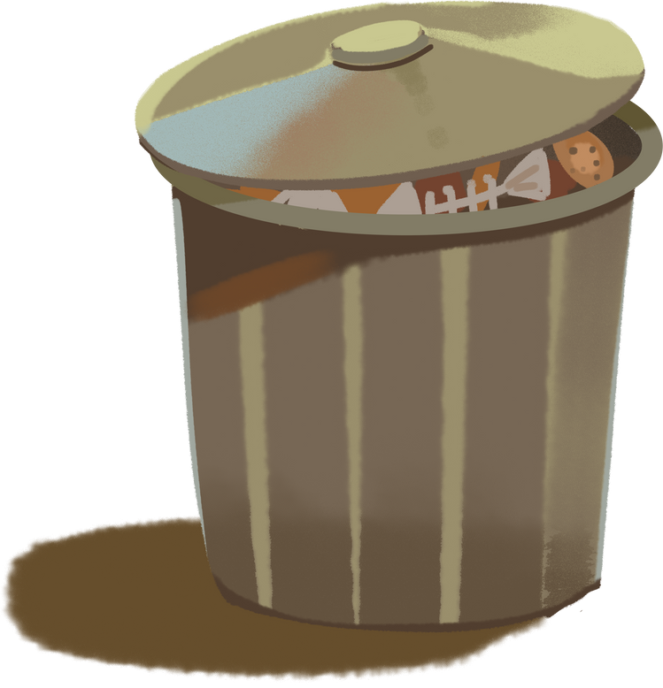

INTRODUCTION
Sustainability is about taking care of what we need now without stopping future generations from having what they need. Let's look at the main parts of sustainability and see how we can work together to build a more sustainable world!

Slide 4

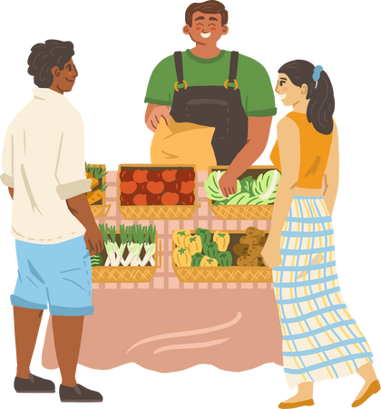
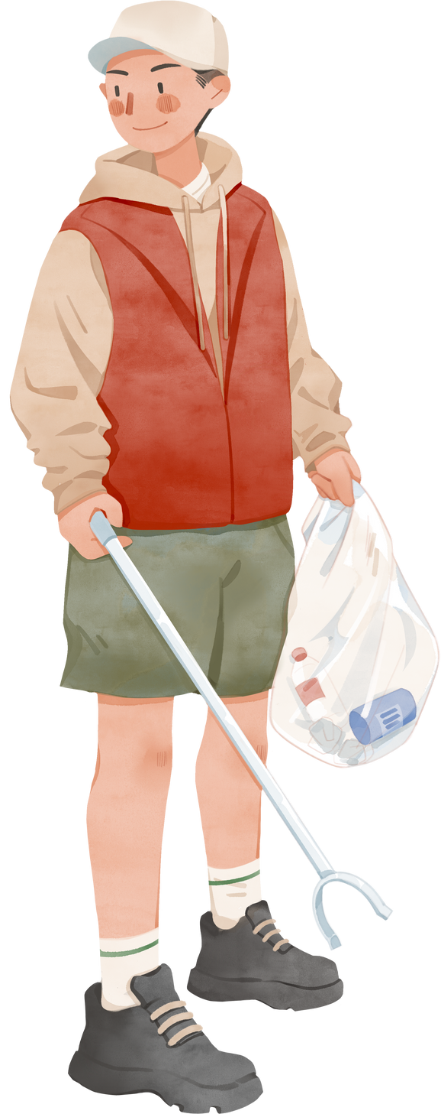
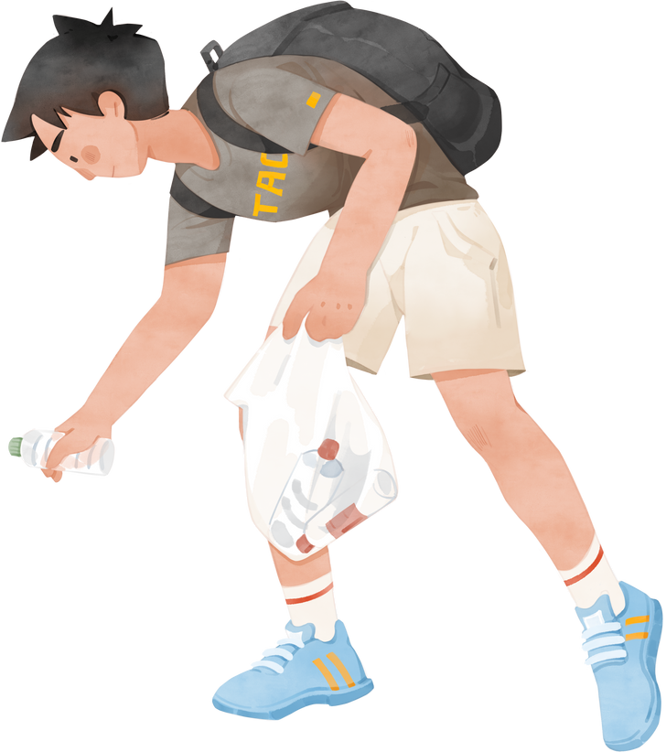
WHAT IS SUSTAINABILITY?
Sustainability includes three main pillars:
Environmental Sustainability
Social
Sustainability
Economic
Sustainability

Slide 5
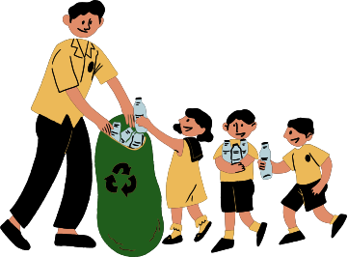

ENVIRONMENTAL SUSTAINABILITY
  Reducing Carbon Footprint: Using renewable energy sources and increasing energy efficiency.
  Save Water: Implementing water saving techniques and reduce waste.
  Protecting Biodiversity: Preserving natural habitats and endangered species.
  Waste Management: Promoting recycling, composting and reduction of single use plastics.
Environmental sustainability includes:

Slide 6
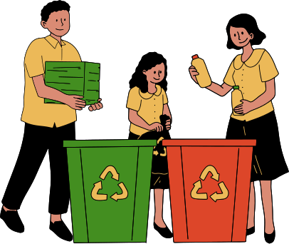
SOCIAL SUSTAINABILITY
Social sustainability focuses on:
  Equity and Inclusion: Guaranteeing fair treatment and opportunities for everyone.
  Community Engagement: Fostering participation and collaboration within the community.
  Education and Awareness: Advocating for sustainable practices through educational initiatives.
  Health and Wellbeing: Promoting access to healthcare services and healthy living environments.

Slide 7



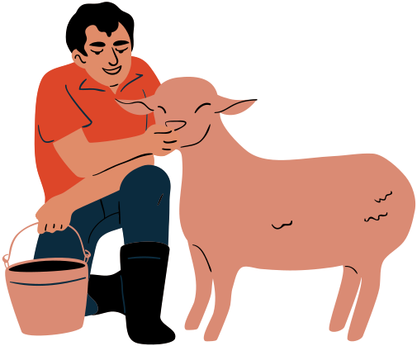

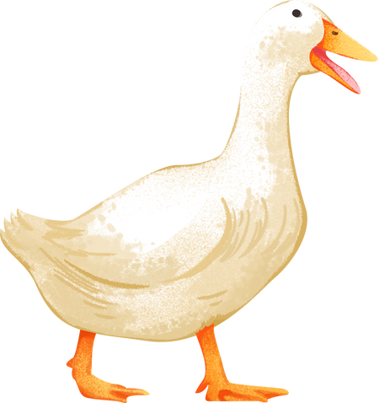
ECONOMIC SUSTAINABILITY
Economic sustainability includes:
Essential Ideas for a Sustainable Future
  Green Economy: Developing businesses that minimize environmental impact.
  Sustainable Agriculture: Implementing farming practices that safeguard nature.
  Fair Trade: Ensuring that workers receive fair compensation and operate in safe environments.
  Resource Efficiency: Utilizing resources effectively to reduce waste and save costs.

Slide 8

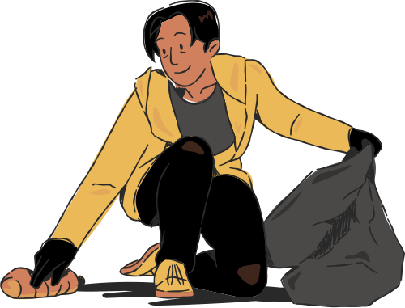
CONCLUSION
By working together and making conscious choices, we can create a healthy, just and prosperous world for future generations.

Slide 9


“LET'S COMMIT TO BUILDING A SUSTAINABLE FUTURE NOW!”

Slide 10




THANK YOU

