Slide 1


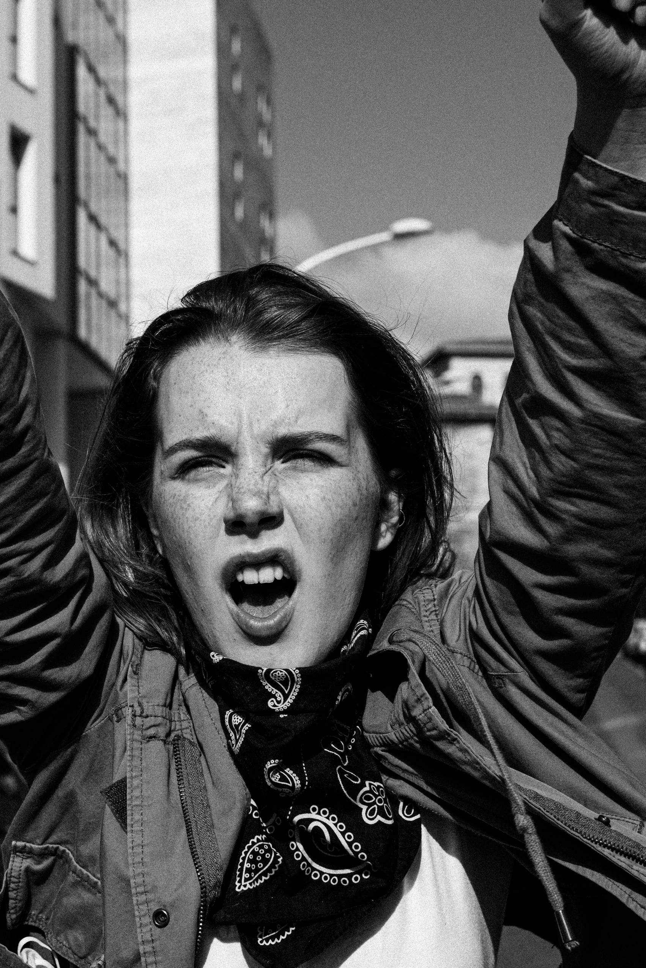


Entry mobility 18th-22nd November 2024
THE ROLE OF WOMEN AGAINST TOTALITARIANISM
PRESENTED BY CHIARA DE FRANCHIS

Slide 2
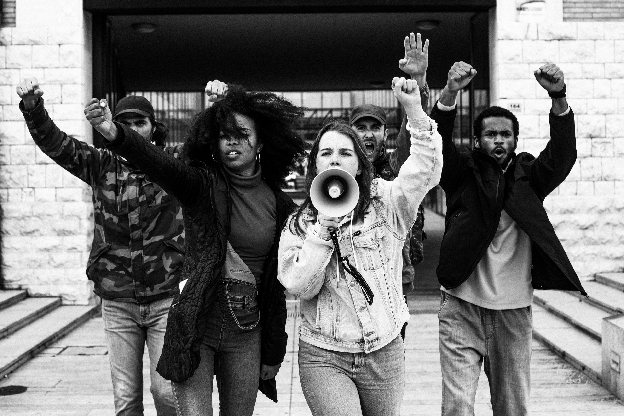

1. KEY CHARACTERISTICS OF WOMEN’S RESISTANCE
Nonviolent Protest: many women-led movements focus on nonviolent resistance, using tactics like peaceful marches, hunger strikes, and public demonstrations.
Symbolism and Art: women frequently use literature, art, and symbolic attire to communicate their messages, often to circumvent censorship.
Advocacy for Human Rights and Justice: women often lead or join movements that focus on universal rights and justice, striving to protect vulnerable populations affected by oppressive regimes.

Slide 3
2. HISTORICAL EXAMPLES OF WOMEN’S RESISTANCE AGAINST TOTALITARIANISM
Spanish Civil War and Franco’s Dictatorship
Las Trece Rosas (The Thirteen Roses): a group of young women executed by Franco’s regime for their involvement in the Republican resistance during the Spanish Civil War.
Dolores Ibárruri (La Pasionaria): a communist leader and orator who was famous for her passionate speeches against fascism and for social justice.
Impact: their courage inspired future generations to resist oppressive rule and remember the costs of authoritarianism.

Slide 4
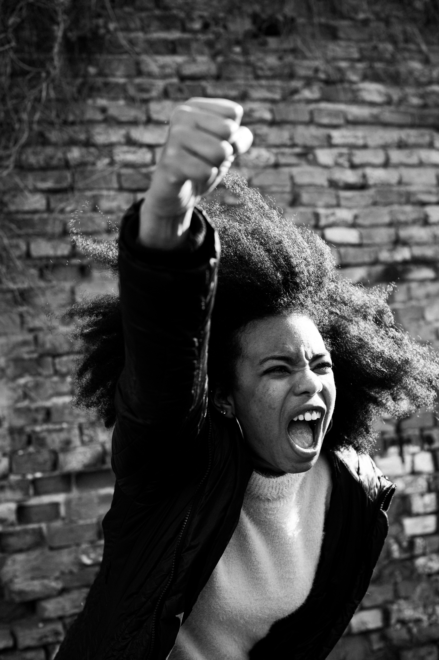

3. MODERN EXAMPLES OF WOMEN OPPOSING TOTALITARIANISM
Latin America: the Mothers of the Plaza de Mayo in Argentina
Background: during Argentina’s military dictatorship (1976–1983), many political dissidents “disappeared.”
Action: the Mothers of the Plaza de Mayo protested every week, demanding information about their missing children and drawing global attention to the regime’s human rights abuses.
Impact: their movement inspired international human rights advocacy and showed the power of collective maternal protest.

Slide 5
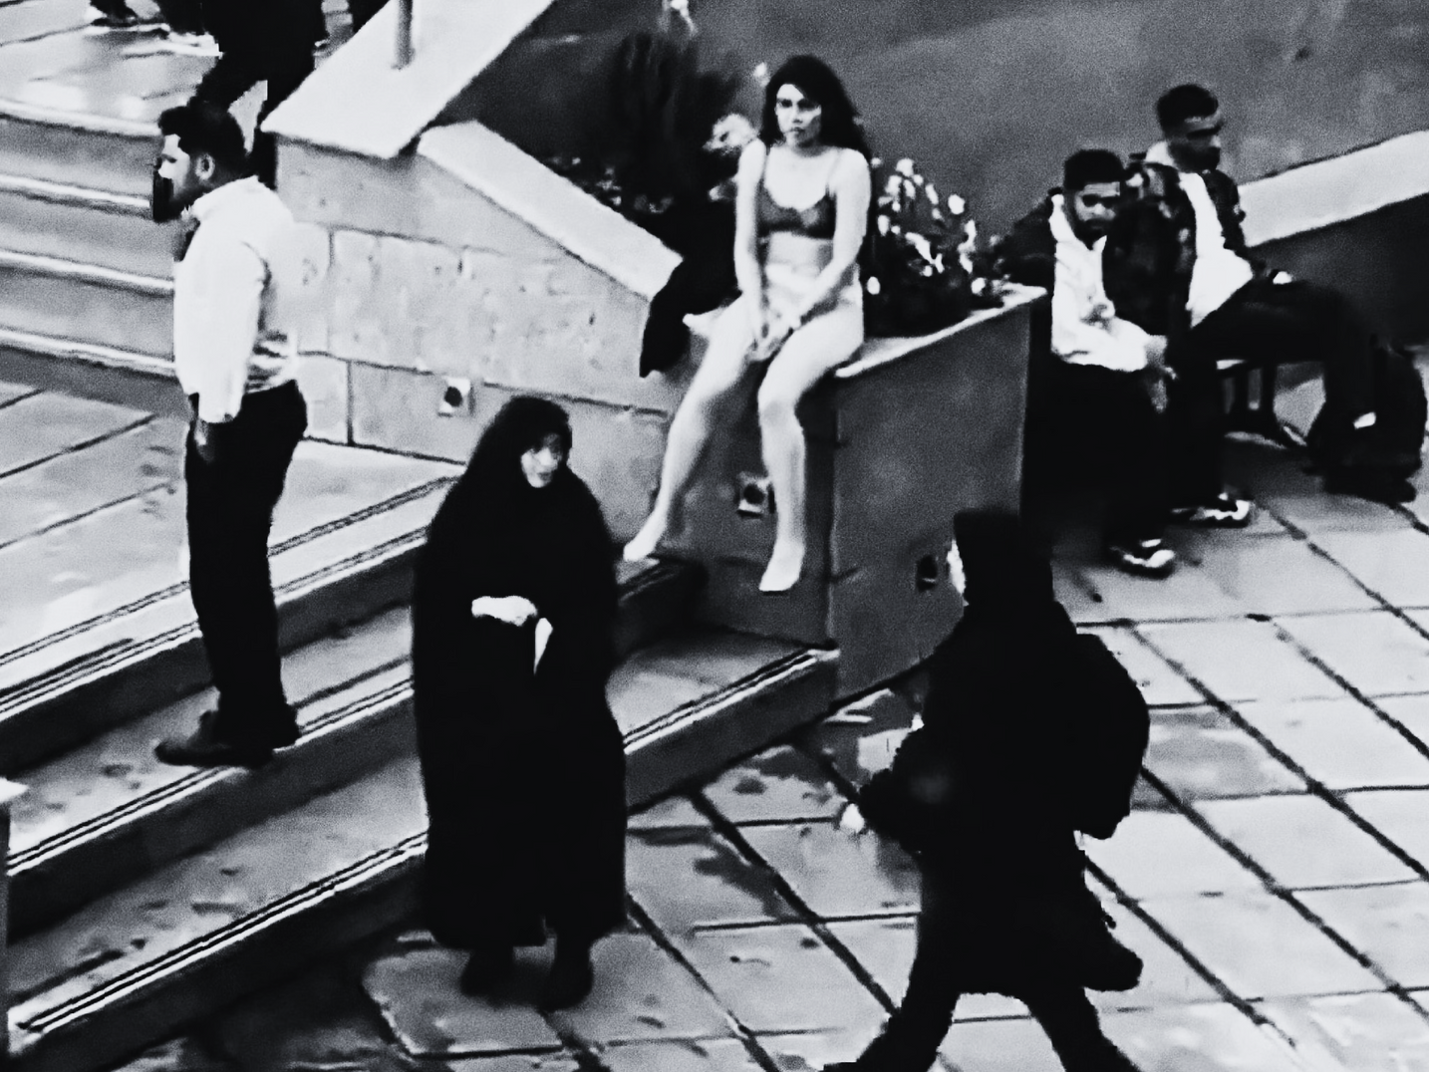
4. WOMEN IN CONTEMPORARY ANTI-TOTALITARIAN MOVEMENTS
Iran: women’s Rights Movement and Anti-Regime Protests
Women have long protested against the strict social and political controls imposed by the Iranian regime, especially over dress codes and personal freedoms.
Recent Protests: in 2022, the death of Mahsa Amini led to widespread protests, with women at the forefront calling for justice and an end to authoritarian policies. Two weeks ago the young woman, identified as Ahu Daryaei, was arrested on Saturday after walking in her underwear inside the Islamic Azad University in the capital Tehran, an incident that social media had linked to the requirement to wear a headscarf.
Impact: the movement has sparked a new wave of global solidarity and awareness regarding women’s rights and anti-authoritarian resistance in Iran.

Slide 6

5. COMMON CHALLENGES FACED BY WOMEN RESISTING TOTALITARIANISM
Repression and Censorship: women activists often face imprisonment, harassment, and violence.
Gender Discrimination: totalitarian regimes frequently marginalize or attempt to silence women, who are seen as doubly “subversive.”
Sacrifice and Resilience: many women risk their lives, families, and livelihoods in their fight for freedom.

Slide 7
6. CONCLUSION
Women’s resistance against totalitarianism highlights their critical role in advocating for freedom, equality, and justice. Whether through organized protests, underground movements, art, or literature, women have shown resilience and courage in the face of extreme oppression. Their stories inspire continued struggles for democracy and human rights worldwide.
Key Takeaway: Women’s resistance is not only about opposing authoritarianism but also about reshaping societies to be more just, inclusive, and democratic.
This outline should provide a solid foundation for a presentation on the role of women in resisting totalitarian regimes. Feel free to include impactful quotes, images, and short videos to illustrate the bravery and influence of these women.

Slide 8

THANK YOU VERY MUCH!
"This project has been funded with support from the European Commission. This publication reflects the views only of the author, and the Commission cannot be held responsible for any use which may be made of the information contained therein".

