Slide 1





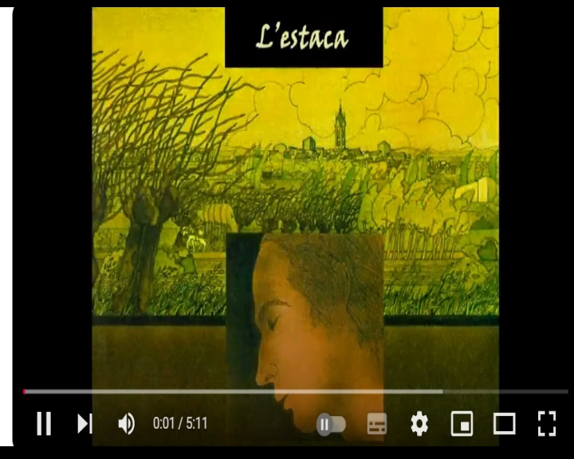
Entry mobility 18th-22nd November 2024

Slide 2
L’ estaca
Song by Lluís Llach

Slide 3
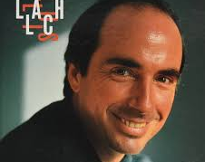
Who is Llach?
Lluís Llach is a Spanish singer-songwriter.
He is the best known representative of the Catalana Nova cançó and he wrote his own songs in Catalan. His journey began in 1967 as a member of Els setze jutges; and from his early years he wrote authentic anthems of antifascist struggle and resistance which soon became very well known throughout Spain although composed in the Catalan language.

Slide 4
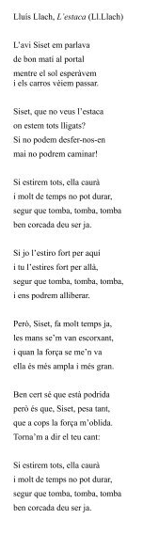
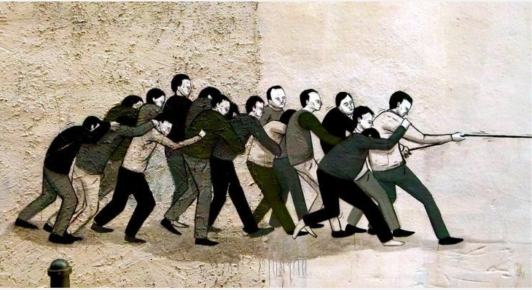
What is the song about?
The song tells an imaginary dialogue inspired by some conversations that Llach had had with the grandfather of a friend of his (˝Siset˝, in the song): it talks about the fact that we are all tied to a stake from which we cannot free ourselves, but if we pull hard we will be able to make it fall.

Slide 5
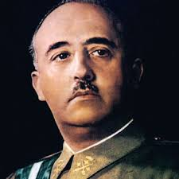
When and where was it written?
It was composed during the dictatorship of General Francisco Franco in Spain in 1968.

Slide 6
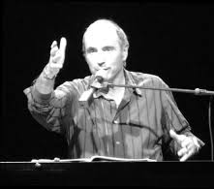
Why was it written?
It was written because during the dictatorship, Francisco Franco placed many limitations on freedom.

Slide 7
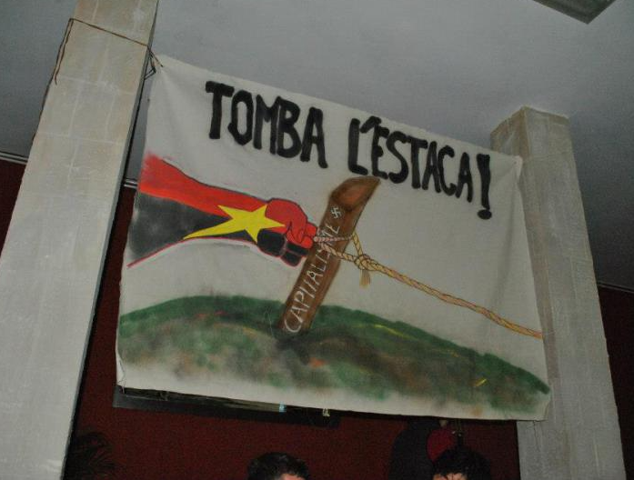
THE SONG - TODAY
If a song may be called a myth, this song is a myth. It has been translated in such a vast number of languages, that it is considered in many countries as a national song, e.g. in Poland, where Jacek Kaczmarski's rewriting, Mury, was one of the anthems of the free trade union Solidarność. The song has turned into a universal hymn of liberation from any form of authoritarian and oppressive regime; considering its nature of a call to action and union to eradicate oppression and achieve liberty. Thus, the song turned into a symbol of struggle for freedom with its metaphor of the stake you have to pull down all together.

Slide 8
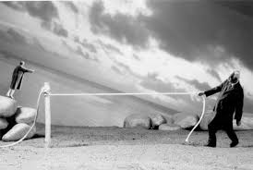

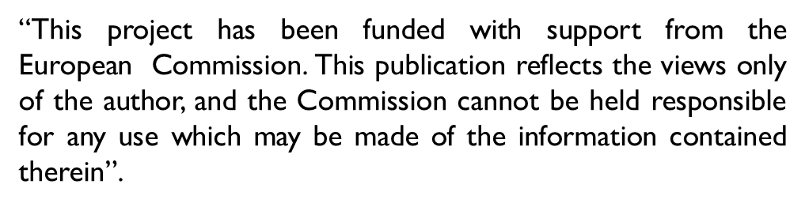
THANKS FOR YOUR ATTENTION
Giulia Mariacarola Gualtieri &
Dante Mazzucco

