Slide 1




MUSIC FOR INCLUSION
Entry mobility 18th-22th November 2024
presented by Andrea Brutto

Slide 2

Music as a means of inclusion
Music has an extraordinary power to promote inclusion, with the ability to break down social and cultural barriers. Furthermore, it can offer opportunities for learning and active participation. This makes it a valuable tool in the educational, social and cultural fields.

Slide 3
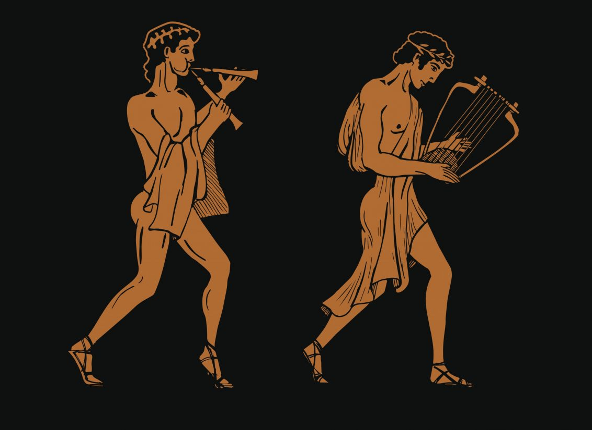
Music in history
Since the origins of civilization, music has represented a universal language capable of uniting, exciting and transmitting values. In ancient times, the Greeks and Romans considered it a sacred art linked to philosophy. With the Middle Ages, music was linked to the Church with its Gregorian chants. The Renaissance marked a turning point, developing a greater attention to form and composition. The Baroque era saw the birth of great composers such as Bach, Vivaldi and Händel. In the 20th century, music freed itself from the constraints of the past, giving rise to musical genres such as jazz, rock and electronic.

Slide 4

The Role of Music in Education and Society
Music in education is not limited to learning notes and rhythms, but extends to enhancing social, cognitive and emotional skills. In addition, it plays a vital role in society in promoting cultural diversity and providing an opportunity to share one's musical experiences and traditions.

Slide 5
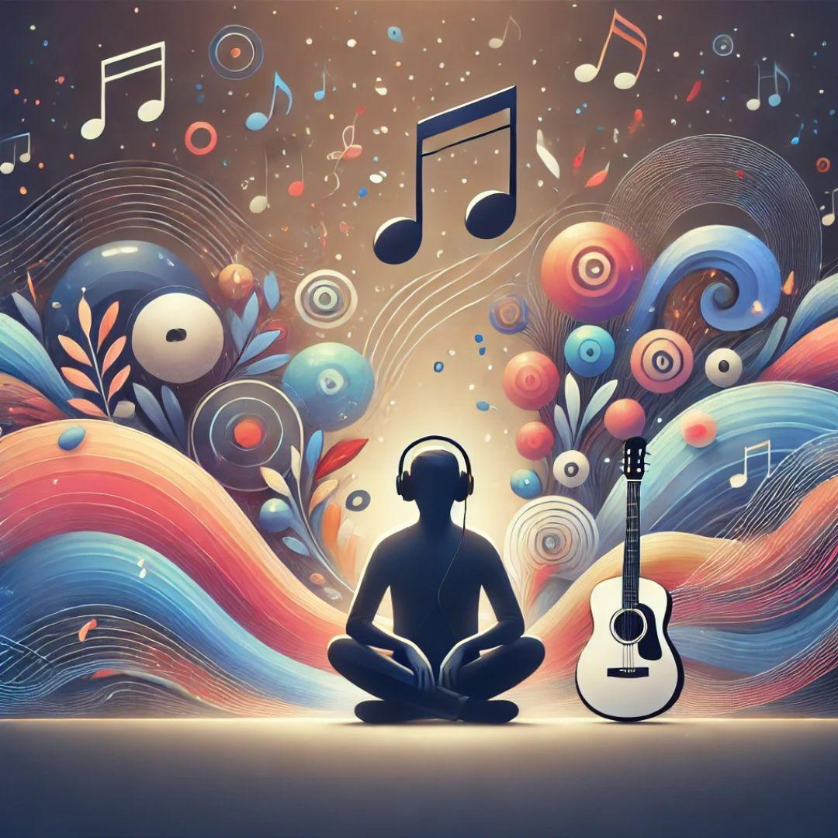
Music and therapy. New reality of education
Music should promote the linguistic, social, emotional, cognitive and physical development of students. In addition, music lessons can be a welcoming and inclusive space, especially for disadvantaged students. In terms of therapy, music teaching can offer therapeutic benefits to students with learning difficulties, obviously adapted to the specific needs of each student

Slide 6
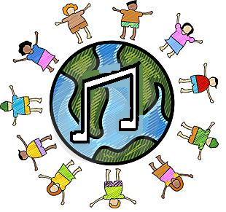
Music at school
Music is one of the most powerful tools for the effective implementation of inclusion at school. Using music at school allows you to explore your emotions, discover your inner dimension and therefore develop and refine your affectivity. It allows you to experience a multisensory approach that supports the activation of different learning processes

Slide 7

Music helps disability
The disabled person who has difficulty using the conventional communication system can find in music a means to interact with others, express their emotions and needs. Disabled people can express themselves freely through music but at the same time guided exercises allow them to self-manage.

Slide 8
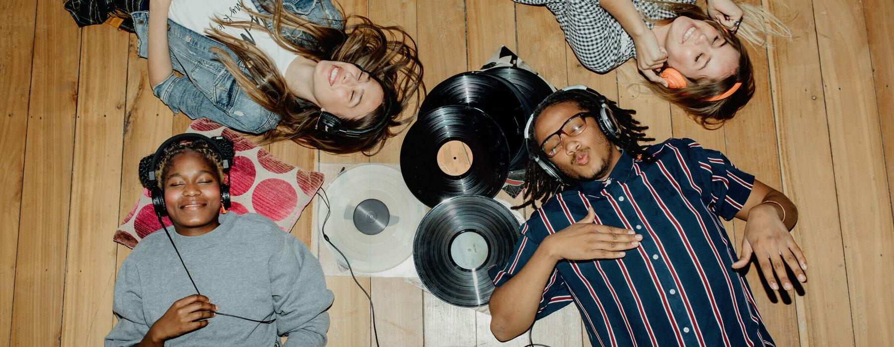
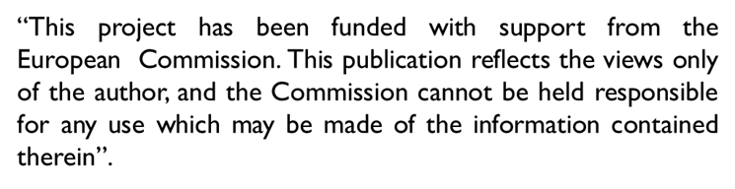
Thank you for your attention.

