Slide 1



Music For EUROPEAN ALLIANCES
The power of Music as way of communication
School Accreditation 2024-1-IT02-ka121-SCH-000213329
Group School Mobility
Valencia 6th-12th April 2025

Slide 2

The Value of Music
Music has always been a powerful vehicle of messages because concepts and emotions remain imprinted in our brain, as if they were a photo: the limit of verbal language through words or written text is in fact to be able to describe emotions, but not to pass them on. Music adds emotions to verbal language by transferring to those who listen both the description and the emotion itself, thus becoming the most complete human expression, something superior to other expressions.
As Maazel's aphorism recalls, music is immediate and can be a more effective vehicle of political messages than a very long period of political negotiations conducted by governments.

Slide 3

Fondazione Musica per Roma
Music has played a crucial role in strengthening European alliances and promoting cultural unity. For example, Fondazione Musica per Roma has established partnerships with cultural institutions across Europe, such as the Palacio Euskalduna in Bilbao and the Southbank Centre in London,
to promote the international circulation of musical productions and create a stable network of cooperation.
These partnerships not only enhance the Foundation's brand, but also help to spread the organizational culture and improve the know-how of its staff.

Slide 4
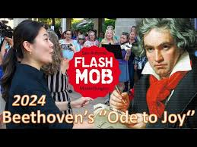
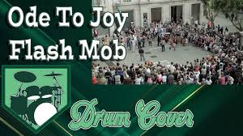
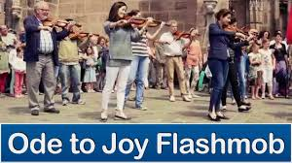
the "Ode to Joy"
The official anthem of the European Union is a piece from the final movement of Ludwig van Beethoven's Ninth Symphony, also called the "Ode to Joy", composed in 1824. The anthem is not intended to replace the individual national anthems of the Member States, but to celebrate the values they share and their "unity in diversity", as the European motto says. The anthem has no lyrics and consists only of music. In the universal language of music, this anthem expresses the ideals of freedom, peace and solidarity pursued by Europe. There is a version sung in Latin, neutral with respect to the member countries, which was composed in 2003 by Peter Roland.
Furthermore, “The Ode to Joy” has become in recent years the
ideal tool to celebrate European values through Flashmobs

Slide 5
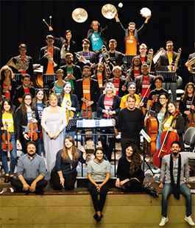
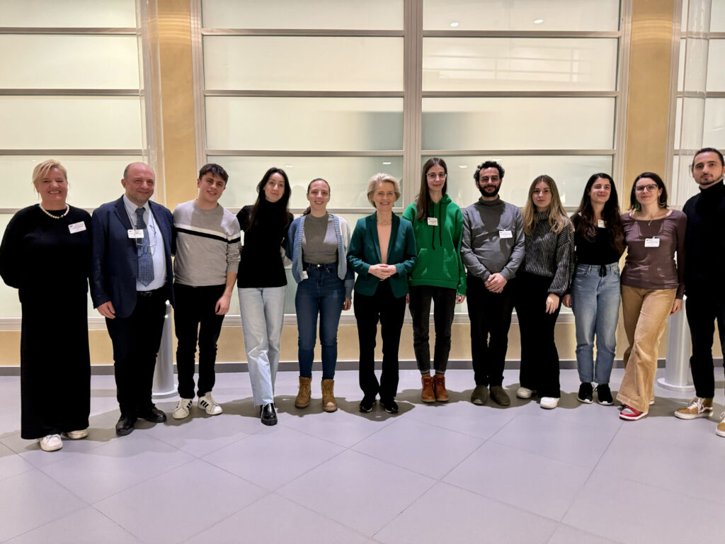
Erasmus Orchestra
The Erasmus Orchestra (EO) is the first orchestra composed of Erasmus students from European Conservatoires and Music Institutes.
Founded in 2017 by the Erasmus+ Italian National Agency INDIRE, the Erasmus Orchestra was established in 2017, to celebrate the 30th anniversary of the Erasmus+ Programme. This unique initiative brings together talented students from European Conservatories and Music Institutes who are either currently participating in or have completed an Erasmus+ mobility experience.
Supported since 2023 by the Association Européenne des Conservatoires, Académies de Musique et Musikhochschulen (AEC), the Orchestra has further solidified its role as a flagship cultural initiative of the Erasmus+ Programme.
https://www.erasmusplus.it/iniziative/erasmus-orchestra/info/

Slide 6

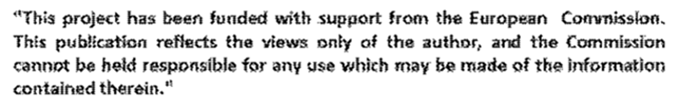
Thanks for your attention
by Giuseppe Costa and Alessia Ciaccio

