Slide 1
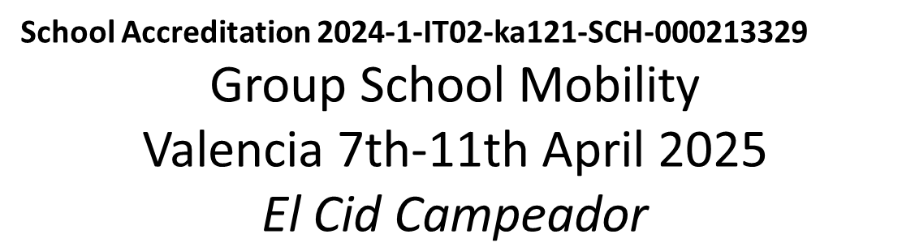
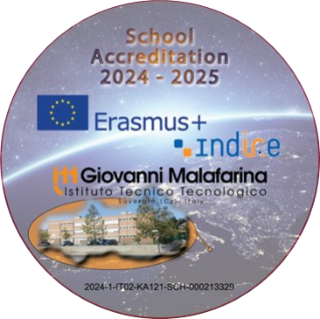


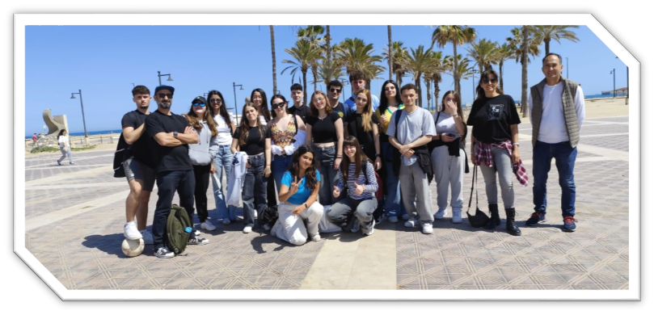
Valencia
Memories
I participated in the Erasmus+ project in Valencia, Spain with great expectations. Throughout the week, I took part in various activities, including visiting the historical gardens of Vivers, the Albufera Lake, a boat tour, and many others. My favorite activity was the visit at the Oceanogràfic, where I admired numerous animal species and watched the dolphins performing. Together with another Italian participant I held a presentation about Innovative skills trying to match the core skills with a digital enhancement.
In the free afternoons and evenings, I was engaged in several activities with the Spanish students, such as going to the beach, playing at the arcade, shopping and playing bowling. My host family was very welcoming and polite.
My Erasmus experience was truly amazing and helped me improve my language and digital skills.
Alessandro Chiriaco

Slide 2
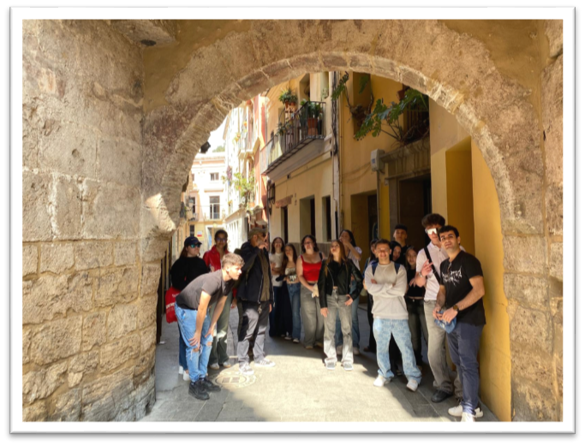
I joined my ninth Erasmus+ project mobility in Valencia, Spain. The Spanish students and teachers were very welcoming, especially the family of my host, Delfina, and I am very grateful for their kindness. Throughout the week, I did a lot of activities at school, and also visited several places, such as the Albufera lake, the historical Gardens of Vivers, and many more. My favourite activity was visiting the Oceanographic of Valencia, where I saw different marine species and dolphins performing. I had some afternoons free, and I went around with all the Spanish students and had fun together: we went to the beach, played bowling many times and also went to the arcade. I had so much fun in Valencia, and I can’t wait for the Spanish students to come to Soverato so we can have fun again. Specifically dealing with the activities I was proud to present a power point about Inclusion trying to integrate the other European values such as Digitalization and Sustainability.
Wenya Zhang

Slide 3
The week that I spent in Valencia was an incredible experience for my cultural and social life: as soon as I arrived I was warmly welcomed by my host family and for that week, actually also now…, I feel it as mine. I spent some hours a day to follow some activities inside the IES Campeador that was the receiving school and then I went around the city to visit the principal buildings. This experience helped me enforce my European feeling, but also let me strengthen my English language competences and learn a little of informal Spanish. Before leaving I prepared together with another participant a presentation about the power of Music as a tool of Communication and I illustrated some examples of initiatives such as The Erasmus Orchestra labelling it as one of the main flagship cultural initiative of the Erasmus+ Programme.
The last night I went to the center of the city, to have dinner together and it was an occasion to reinforce the bond among all Erasmus students. If someone asked me to repeat the same experience, I would immediately say yes. I thank the host family, all the Spanish students, their teachers and also all the people that helped this project come true, because for one week I felt at ease with a second real and warm family.
Giuseppe Costa

Slide 4
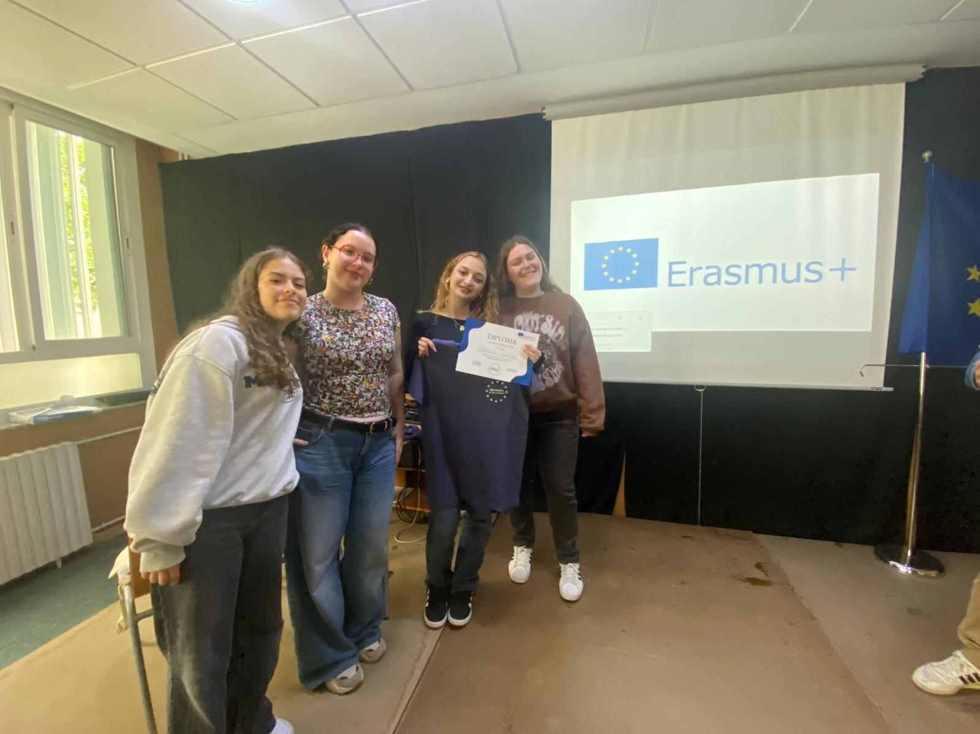
Thanks to the Erasmus Program I spent five intense days in Valencia, Spain.
Valencia is one of the best cities in which to discover the thousand faces of culture: from gastronomic excellence, to craftsmanship, to archeology, everything in Valencia speaks of art and history.
Guest of the “Campeador Institute”, thanks to their availability, the warm welcome they reserved and the kind ways with which they introduced me to the wonders of the city, I savored this wonderful experience even more: Albufera Natural Park is dedicated to raising environmental awareness and enhancing local biodiversity, offering visitors an immersive experience in nature; the Oceanogràfic of Valencia is the largest aquarium in Europe and is located inside the City of Arts and Sciences: inaugurated in 2003, it is a scientific and recreational center that faithfully reproduces the most important marine ecosystems on the planet. Visiting them was a fascinating and educational experience since they combine science and respect for nature.
The experience was highly formative: I certainly improved my English language skills, thanks also to the comparison and exchange of good practices with the teachers and with the students. In particular I dealt with the power of Music as a tool of Communication.
Erasmus is an extraordinary experience from a linguistic, cultural and personal point of view: you grow, you mature, you develop thoughts and beliefs, you break down prejudices, but above all you know the world and you open your mind.
Alessia Ciaccio

Slide 5
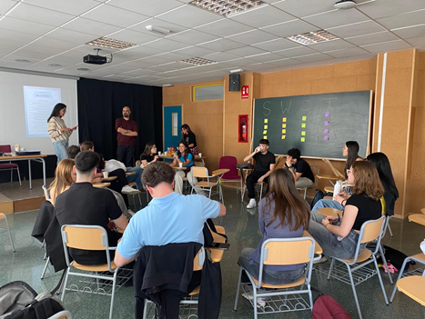
The week in Valencia was really fascinating, I had a lot of fun, unfortunately this is my last experience with the school regarding Erasmus, but it is definitely an experience I would do again. Since the arrival at the airport my host family was super kind and respectful towards me: with the girl that hosted me a really beautiful friendship was immediately born, even with the other boys/girls I had a great time and I had a lot of fun. As for the city of Valencia, there is not much to say: it is spectacular, first of all it is huge and fascinating in its culture and customs. I really liked the city center, especially in the evening, it is really beautiful, luckily we were close to the center, so with all the members of Erasmus we met at the "usual" traffic light and took the metro together. We visited so many places including: The historical gardens of Vivers, Caixa Forum, the Oceanographic Museum, we went to La Albufera where we also took a boat trip on the lake, we visited the historic city of Valencia. My favorite day is definitely the visit to the oceanographic, it is truly majestic and with a wide variety of animals, I also saw a dolphin show which was amazing.
As for specific formative activities I dealt with another Italian mate a really important topic regarding “HOW EUROPEAN UNION PROGRAMMES FAVOUR INCLUSION which, in my opinion, represent the most important priority of the Programme. This experience has aroused in me so many emotions, I have learned so many things, including Spanish customs and culture.
Andrea Brutto

Slide 6
The week that I spent in Valencia represented an incredible experience for my cultural and social baggage: as soon as I arrived I got well and warmly welcomed by hosts and families that, for that week, were like mine. I spent some hours a day to follow some activities inside the IES Campeador institute and then I went around the city to visit the principal locations. In the evening I went to the center of the city, to have dinner together, thus strengthening the bond among us.
The mobility helped me to enforce my European membership feeling surely, but also let me strengthen my English language competences and learn a little of informal Spanish. In particular I dealt with the initiatives undertaken by the European Commission to favour Inclusion such as ESF+, The European Solidarity Corps, The Action Plan for Integration and Inclusion, the CERV programme and FEI SUPPORT FOR THE INTEGRATION OF MIGRANTS.
In short, if someone asked me to repeat the same exact experience, I would immediately say yes. I would like to say thanks host families, the Spanish students, their teachers and all the people that helped this project come true, because for a week I found in Spain a second real and warm family.
Luigi Maria Natale

Slide 7
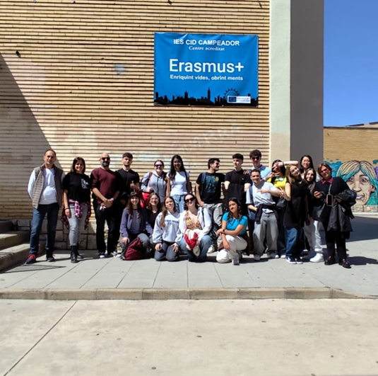
On April 6th I left for Spain with 7 other team mates for an Erasmus mobility; this was actually my second experience. I had a lot of fun. I expected a lot from this experience but I received much more than my expectations: I came back very happy, it was one of the most beautiful experiences in my life. I spent 5 days in Valencia. I visited various museums, the Oceanographic park, La Albufera, the botanical garden, the historic centre of Valencia, the central market, the City of Arts and Science. In addition, I met some very nice Spanish boys, the teachers organised several fun group and team games. After school we all went to eat together and then we met in the afternoon and stayed together until the evening. At first I was afraid of not knowing English well, of not being able to socialise with others, but I adapted and I still manage to understand and chat with them through social media. We went on keeping strict relationship even after the mobility and comparing our ideas about relevant matters I had introduced during my stay there such as the role of Digital skills as keys of the future.
I hope to have an experience like this again soon that will always remain in my heart.
Sofia Gualtieri

Slide 8
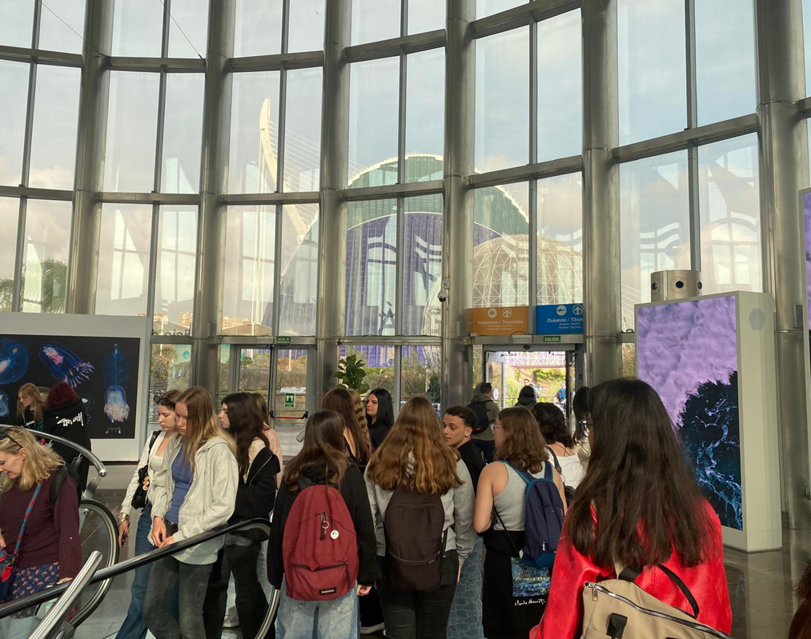


It was my first experience in Erasmus Programme. I learned a lot and I prepared before the mobility some slides stressing the importance of Digital skills and dealing with particular aspects such as communication, collaboration, sharing and privacy issues. The most memorable experience was at the Oceanogràfic: every corner told a different story, a piece of our incredible underwater planet. It made me reflect on how precious and delicate life is in the oceans, walking in that tunnel surrounded by sharks and manta rays swimming placidly above me... well, there I felt a very strong, almost surreal emotion. It felt like being inside a documentary, only the protagonists were passing within a meter of me! In short, the Oceanogràfic was not just a tourist visit, but an experience that touched me deeply, that made me feel part of something wonderful and that left me with a beautiful memory and a new awareness.
Thanks for watching
Giulia Seminaroti

