Slide 1



INNOVATIVE SKILLS FOR INCLUSION
School Accreditation 2024-1-IT02-ka121-SCH-000213329
Group School Mobility
Valencia 6th-12th April 2025
Alessandro Chiriaco Zhang Wenya
1

Slide 2



WHAT IS INCLUSION?
Inclusion is the deliberate process of creating environments where everyone can develop their foundational skills through innovative approaches. It means removing barriers and include all people, regardless of race, religion, gender, ensuring full participation. At the same time, it promotes an educational structure that integrates European values, Digitalization, Sustainability, and a strong dedication to Inclusion.

Slide 3


WHICH ARE THESE SKILLS?
The core skills of inclusion are crucial for cultivating a diverse and inclusive culture. These competencies are the abilities to value, respect, and support different prospectives, which can enhance performances while boosting engagement and satisfaction. By integrating inclusive basic skills into daily learning, individuals are able to succeed in diverse, interconnected environments and meet modern challenges with confidence.

Slide 4


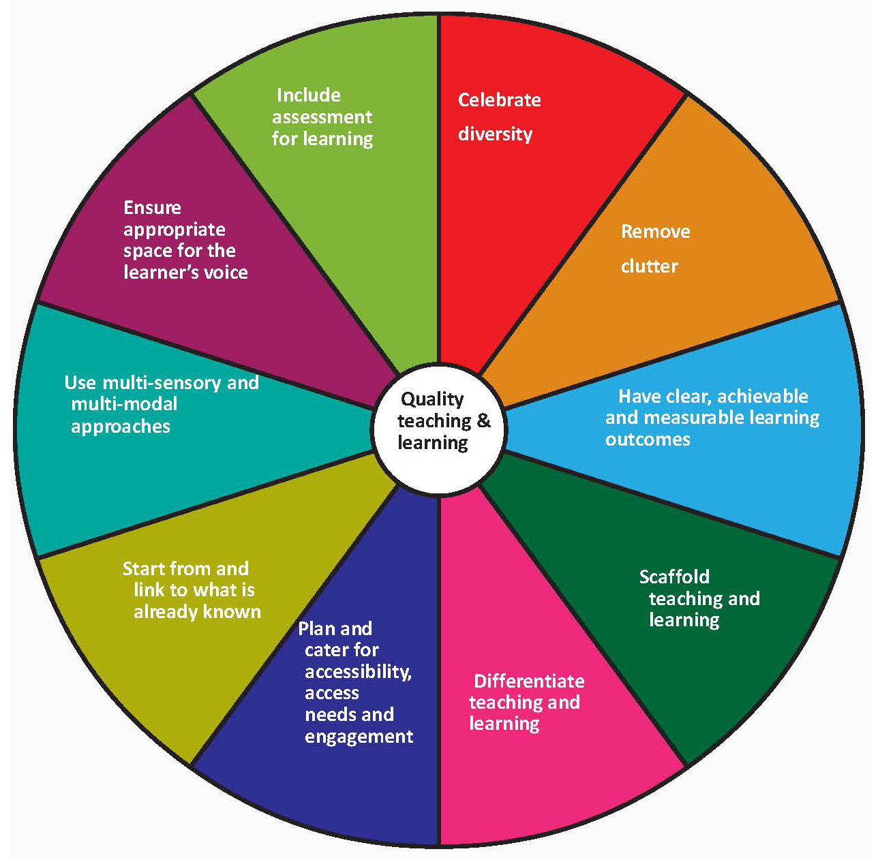
HOW TO USE THESE SKILLS
Successfully applying these skills involves integrating them into educational programs and daily activities. Educators and organizations should develop learning experiences that strengthen fundamental competencies with innovative strategies and digital tools. This method not only fosters creativity and teamwork but also supports broader educational objectives by promoting European standards and sustainability.

Slide 5

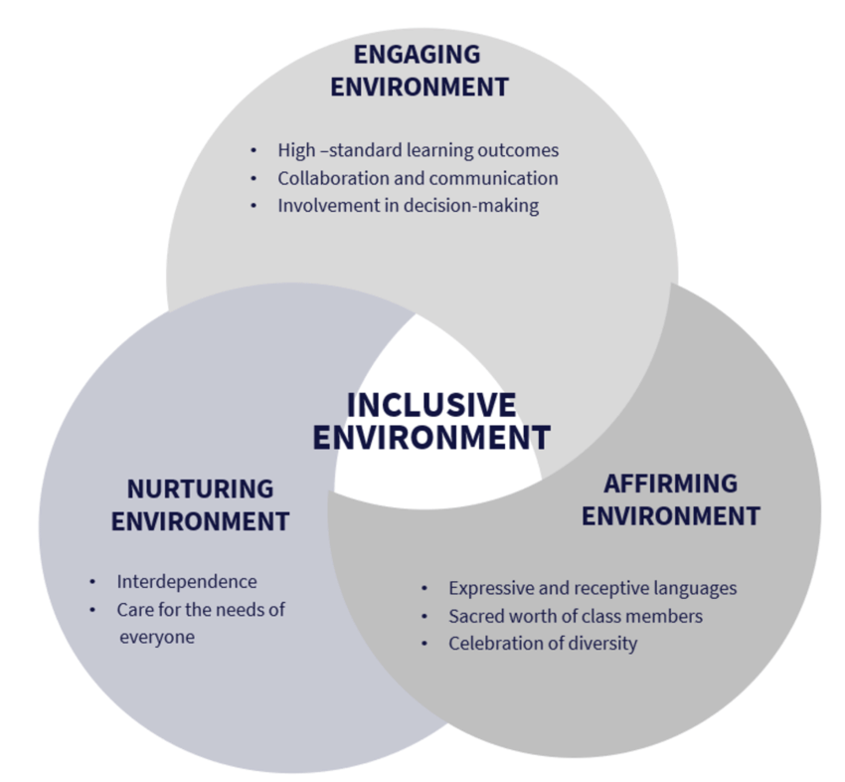

ADVANTAGES OF INNOVATIVE SKILLS
Embracing innovative strategies to enhance fundamental skills offers many benefits. It cultivates an inclusive atmosphere where diversity is respected, and everyone has the opportunity to contribute. This approach advances digital transformation and sustainability in education, improves teamwork in problem-solving, and elevates the overall learning experience. Ultimately, it aligns with European educational principles, equipping individuals to succeed both within their communities and on a global scale.

Slide 6


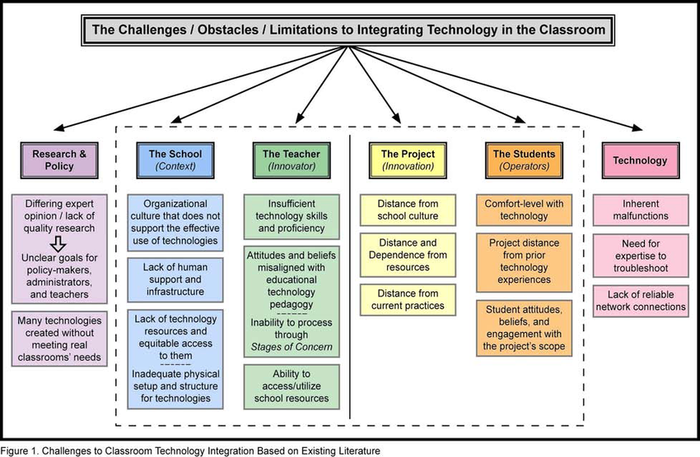
DISADVANTAGES OF INNOVATIVE SKILLS
Although the advantages can be considerable, implementing innovative methods for developing fundamental skills presents challenges. It demands significant investment in modern technologies and ongoing professional development. Traditional educational structures may resist change, and disparities in digital access can create obstacles for some communities. Additionally, aligning European integration, inclusivity, digital transformation, and sustainability requires careful planning to address logistical and financial constraints, necessitating well-designed policy support.
6

Slide 7



Conclusions
In conclusion, developing innovative skills for inclusion is crucial for contemporary education and social advancement. Strengthening fundamental abilities through a progressive approach enables a well-rounded educational framework that incorporates European values, inclusivity, digital transformation, and sustainability. This method equips individuals to tackle future challenges while promoting a culture of lifelong learning, equity, and adaptability in an increasingly dynamic world.

Slide 8

THANKS FOR YOUR ATTENTION

