Slide 1






HOW EUROPEAN UNION PROGRAMMES FAVOUR INCLUSION
School Accreditation 2024-1-IT02-ka121-SCH-000213329
Group School Mobility
Valencia 6th-12th April 2025

Slide 2





ESF+: AN INVESTMENT IN INCLUSION
The ESF+ is the EU's main financial instrument for investing in people. It aims to improve job opportunities, promote education and training, and strengthen social inclusion.
It goes beyond simply supporting employment by addressing the root causes of social exclusion, such as poverty, discrimination and lack of access to essential services.
Special attention is paid to vulnerable groups, such as unemployed young people, people with disabilities, migrants and marginalised communities.
Projects funded by the ESF+ can include vocational training programmes, childcare services, digital inclusion initiatives and community development projects.

Slide 3


ERASMUS+: MOBILITY AND DIVERSITY
ERASMUS+ IS AN EXCHANGE PROGRAMME THAT OFFERS MOBILITY OPPORTUNITIES FOR STUDENTS, TEACHERS, YOUNG PEOPLE AND YOUTH WORKERS. Mobility is not only an educational experience, but also an opportunity to develop intercultural skills, promote tolerance and combat prejudice. The programme adopts specific strategies to ensure access for participants with fewer opportunities, such as people with disabilities, young people from disadvantaged backgrounds and refugees.
Non-formal learning activities, such as volunteer camps and youth exchanges, play a key role in promoting inclusion and active participation

Slide 4



SOLIDARITY FOR
INTEGRATION
The European Solidarity Corps offers young people the opportunity to take part in volunteering projects across Europe, addressing social and humanitarian challenges.
Projects can cover the integration of migrants, the fight against poverty, environmental protection, health promotion and many other areas.
The programme promotes solidarity, active citizenship and a sense of social responsibility among young people.
Volunteering provides young people with the opportunity to gain valuable skills, develop their intercultural awareness and contribute to the well-being of local communities.
Image:
Young volunteers working side by side on a social inclusion project

Slide 5




Integration: EU Strategy
The Action Plan for Integration and Inclusion provides a strategic framework for the integration of third-country nationals in the EU.
The plan focuses on some main pillars: education, employment, housing and social participation.
The aim is to ensure that migrants have equal opportunities to participate in the economic, social and cultural life of European societies.
The plan also promotes the fight against discrimination and racism by raising awareness and supporting initiatives to combat prejudice.
RESPECT
INCLUSION
DEVELOPMENT

Slide 6

CERV programme: promoting European values
The CERV programme aims to protect and promote the rights and values ​​enshrined in the EU Treaties, including equality.
It supports civil society organisations active at local, regional, national and transnational level. It fights inequalities and gender discrimination. It promotes citizens' engagement and participation in the democratic life of the EU.

Slide 7





FEI: SUPPORT FOR THE INTEGRATION OF MIGRANTS
The EIF supports Member States' efforts to integrate third-country nationals.
It finances projects that promote access to education, employment, housing and public services.
It supports awareness-raising and information activities on migrants' rights and duties.
It promotes the exchange of good practices on integration among Member States.
It helps build more inclusive and cohesive societies, where all residents, regardless of their origin, have equal opportunities.

Slide 8


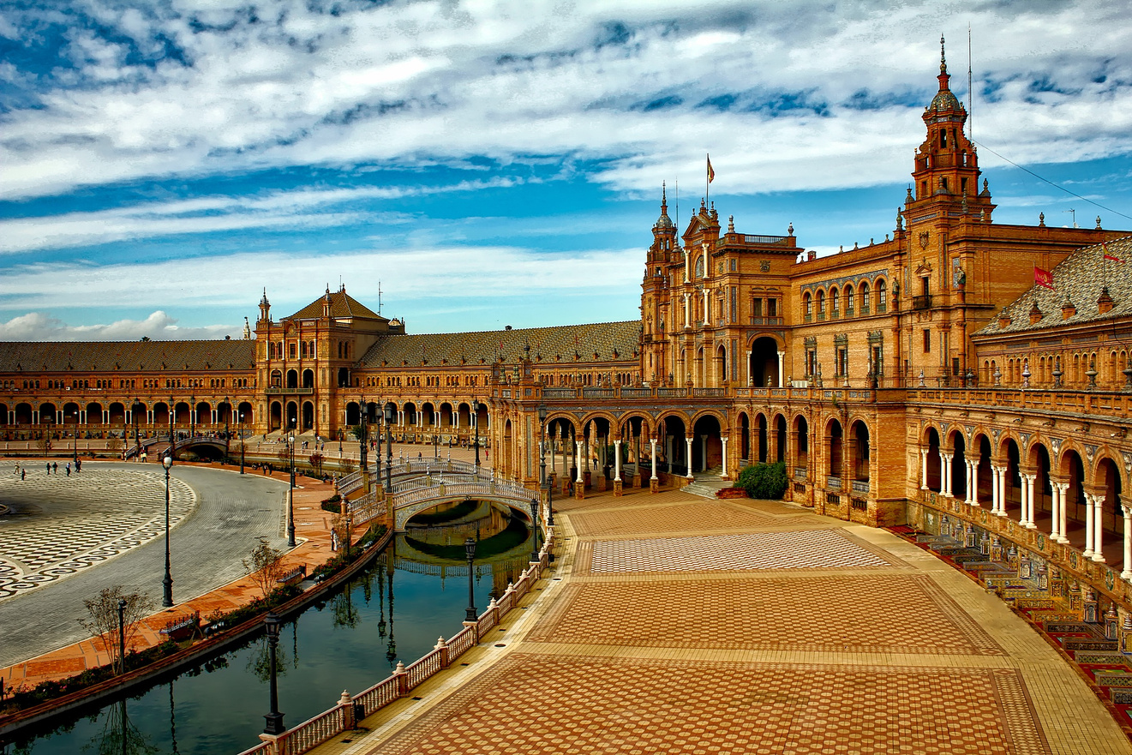

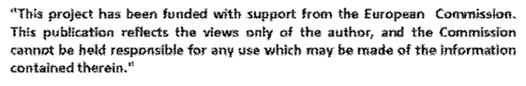
Thank for your attention
by Luigi Maria Natale and Andrea Brutto

