Slide 1


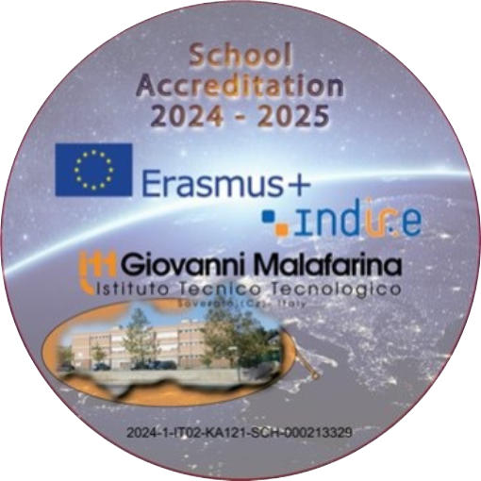

Music as an inclusive and European Value
Institut Guillem Catà Manresa
10th-14th February 2025

Slide 2
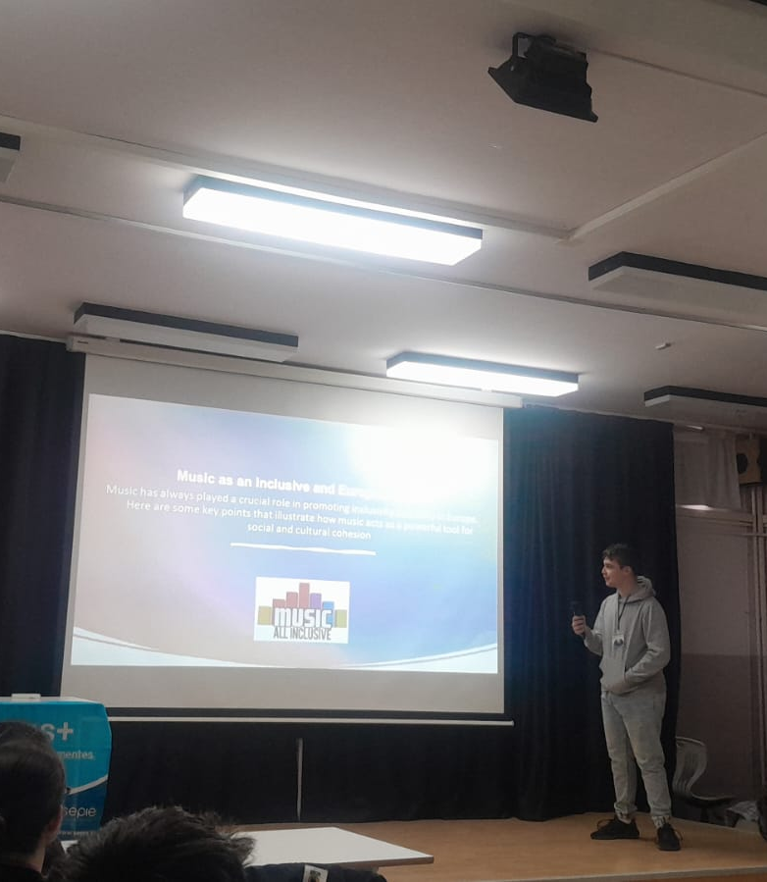
The Erasmus+ Project
The Erasmus+ Project: "Music as an inclusive and European Value"
We had the unique opportunity to participate in the Erasmus+ program in Manresa, Catalonia. The project was entitled "Music as an inclusive and European Value" and aimed to explore the role of music in connecting different cultures and promoting inclusion.
During our stay, we took part in intense music workshops and group activities with students from the Guillem Catà Institute.

Slide 3
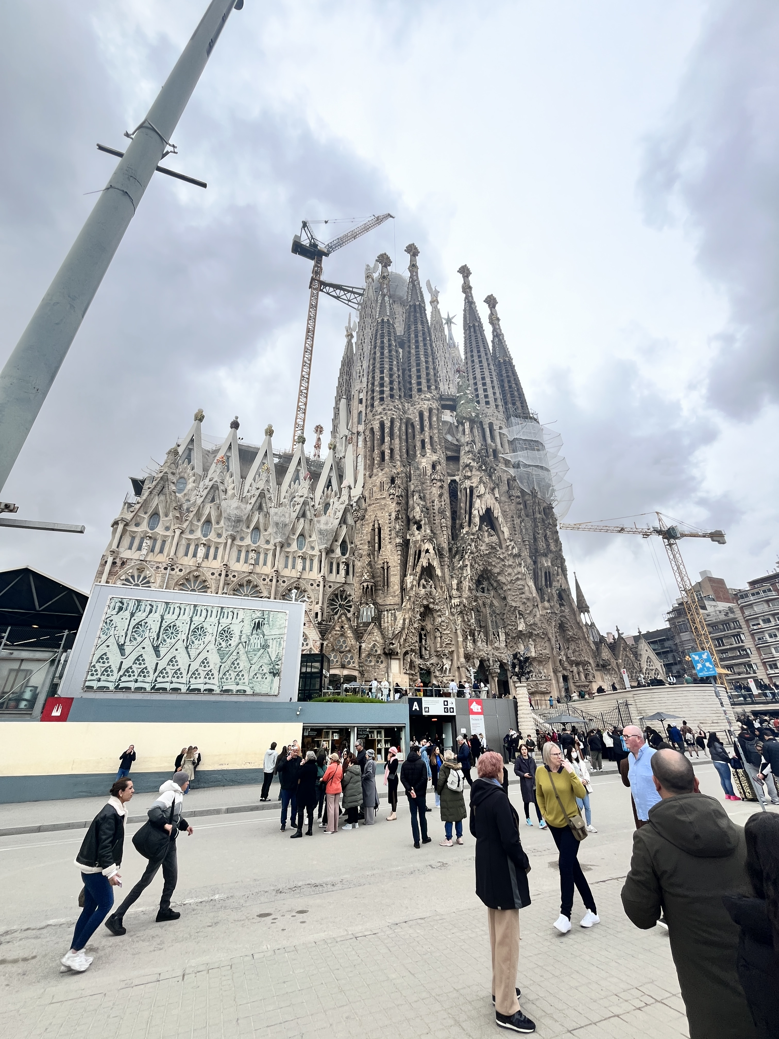
Visiting the Sagrada Familia
We visited the Sagrada Familia in Barcelona, ​​one of Antoni Gaudí's masterpieces. The extraordinary architecture, unique details and grandeur of the basilica impressed us. It was an experience that allowed us to admire the art, discover the history of the city and appreciate the majesty of the place.

Slide 4
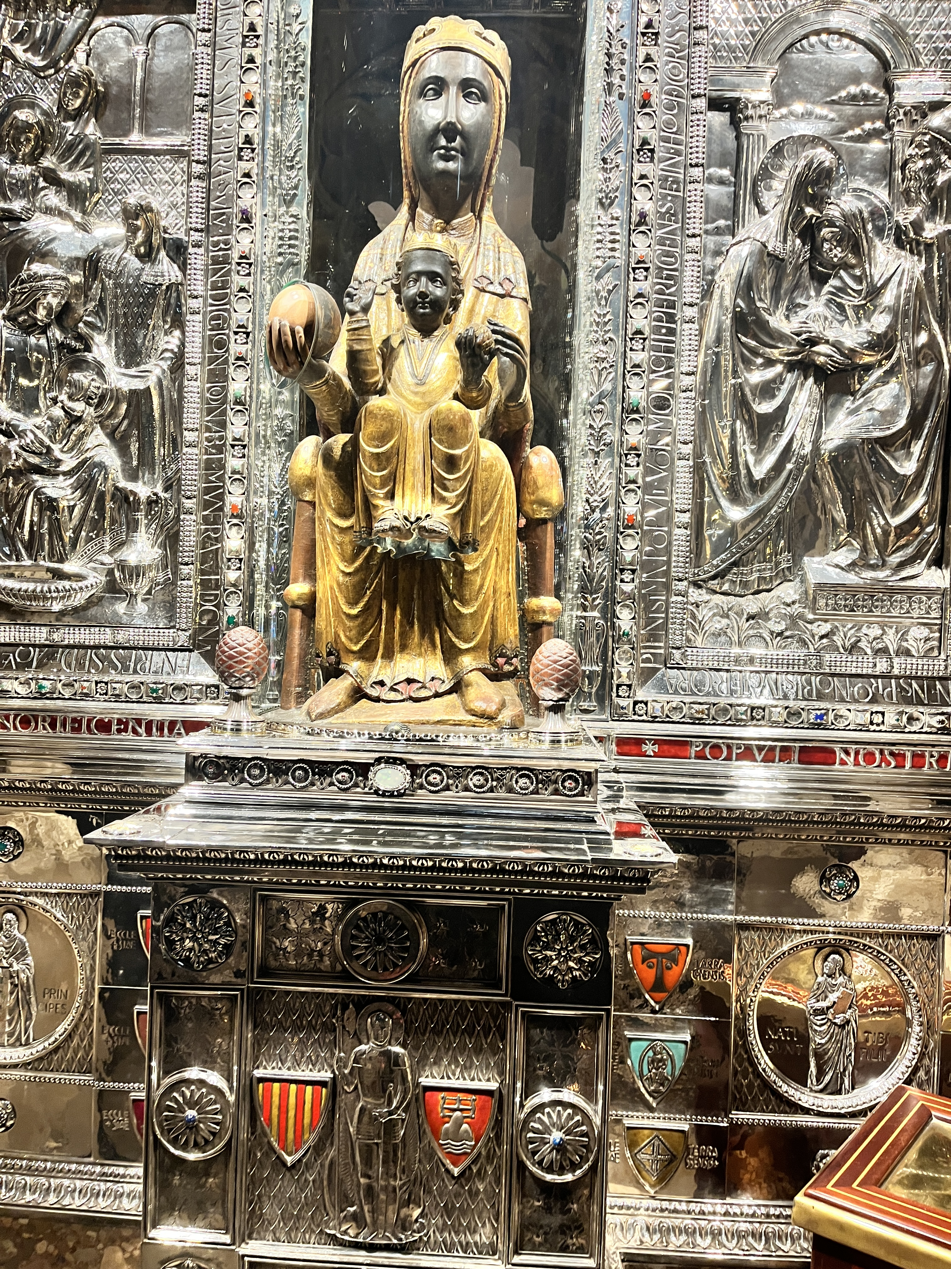
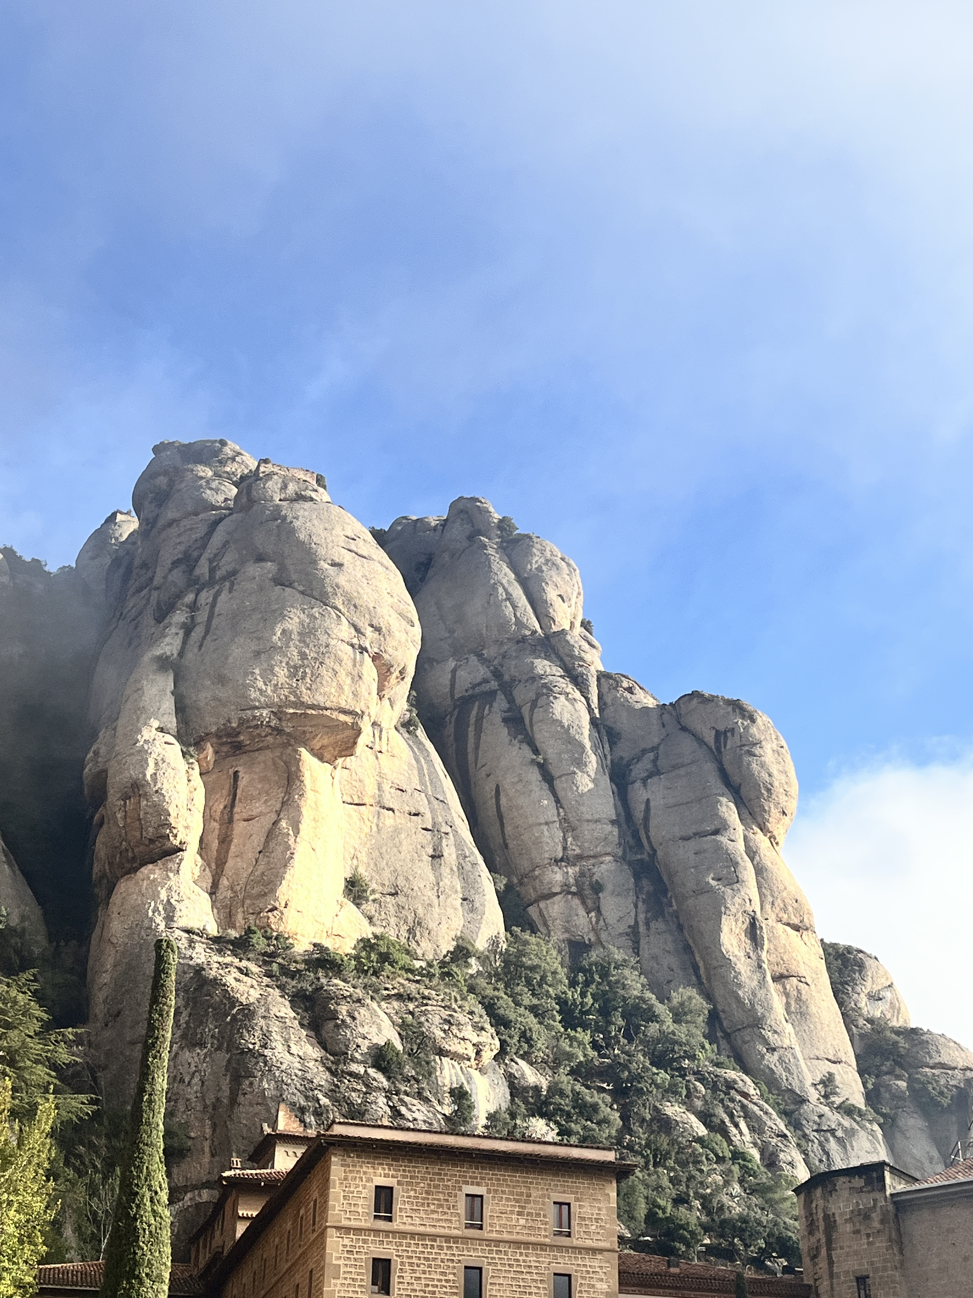
Visit to the Montserrat Monastery
We had the privilege of visiting the famous monastery of Montserrat, located in the peaks of the Catalan mountains and famous throughout the world for its centuries-old artistic and spiritual heritage. Among the Gothic and Baroque naves we immersed ourselves in the history of this sacred place, which still today transmits a sense of profound peace and reflection. We were able to appreciate not only its immense artistic riches but also the tranquility that emanates from this mountain hermitage.

Slide 5
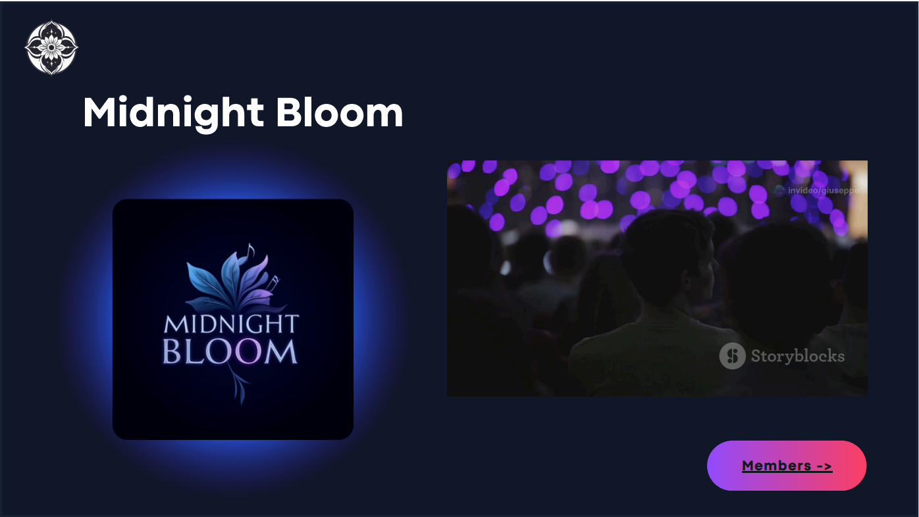
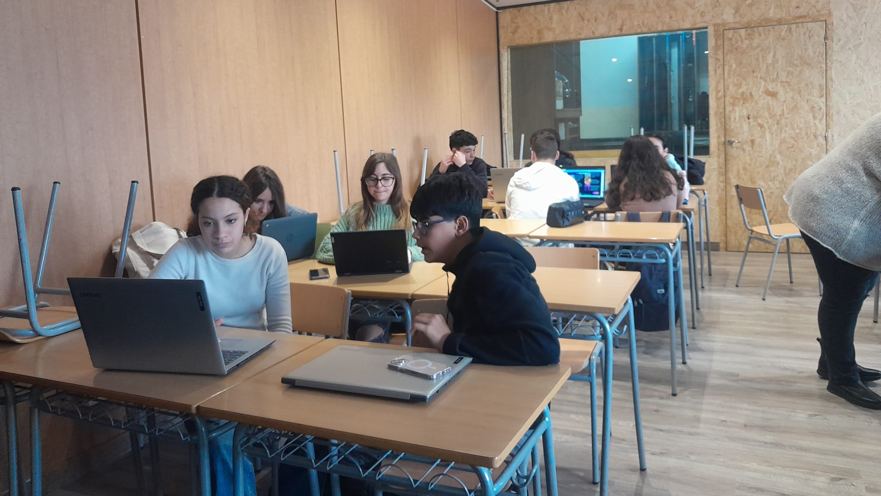
Creating a Canva Presentation
We worked together as a group to create a presentation on Canva, where each member contributed original ideas and content. This activity allowed us to learn from each other by engaging with students from different cultures, developing new teamworking and creativity skills. Some of us proposed innovative schemes while others added detailed graphics and texts. Despite the language differences, we managed to coordinate and finalize an engaging and well-structured project.

Slide 6
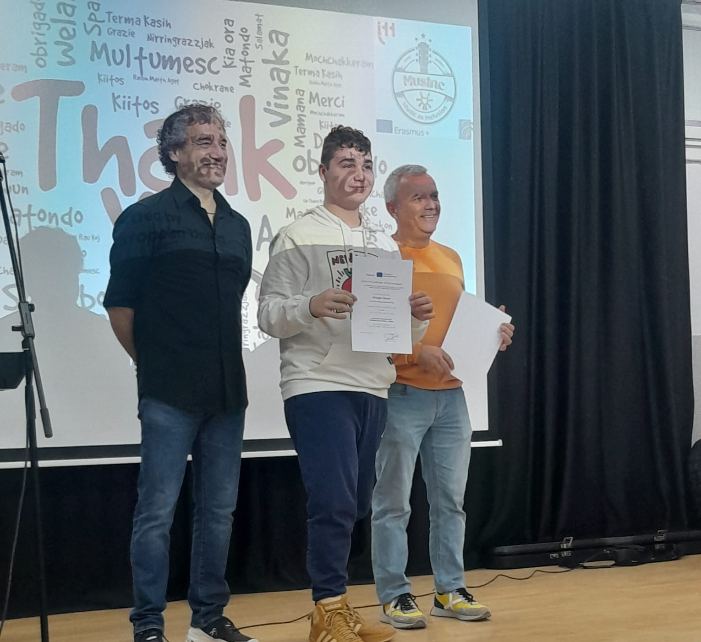
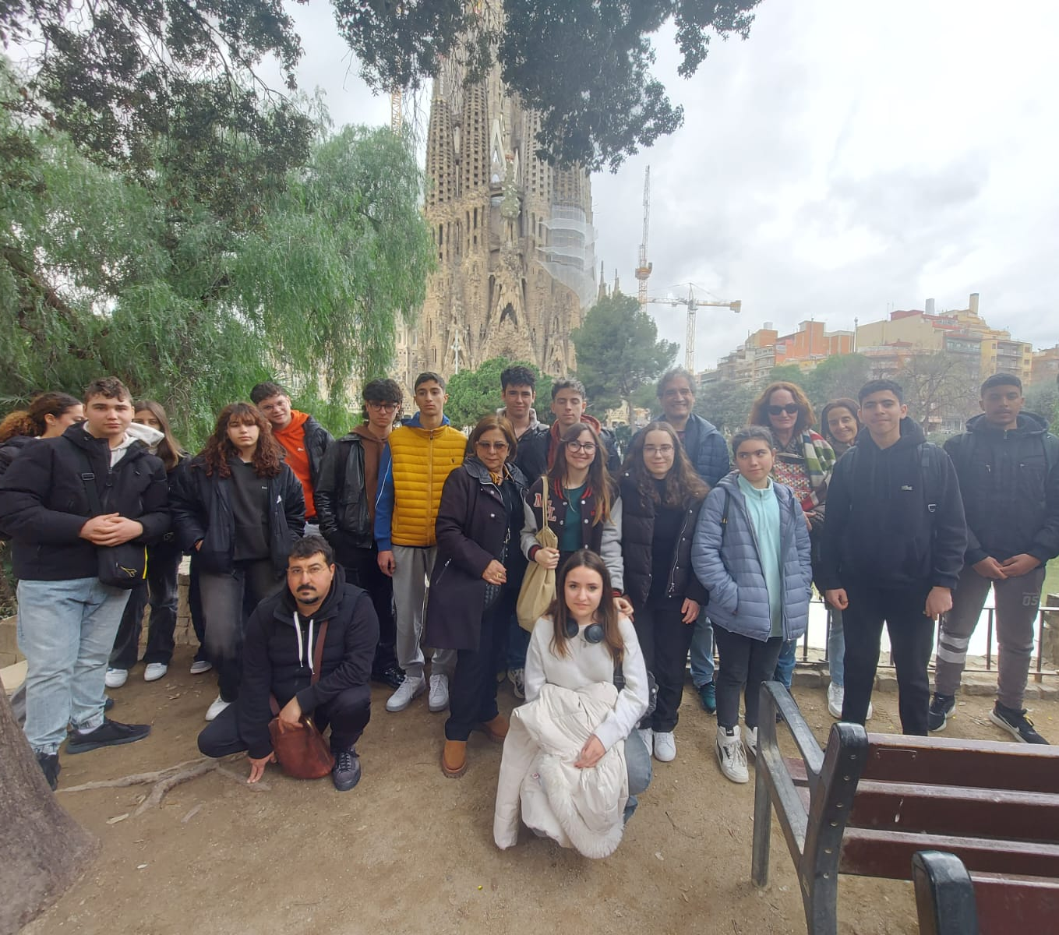
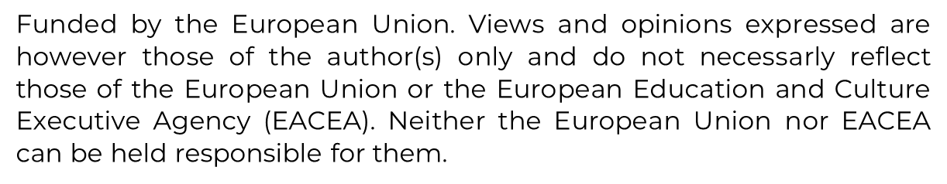
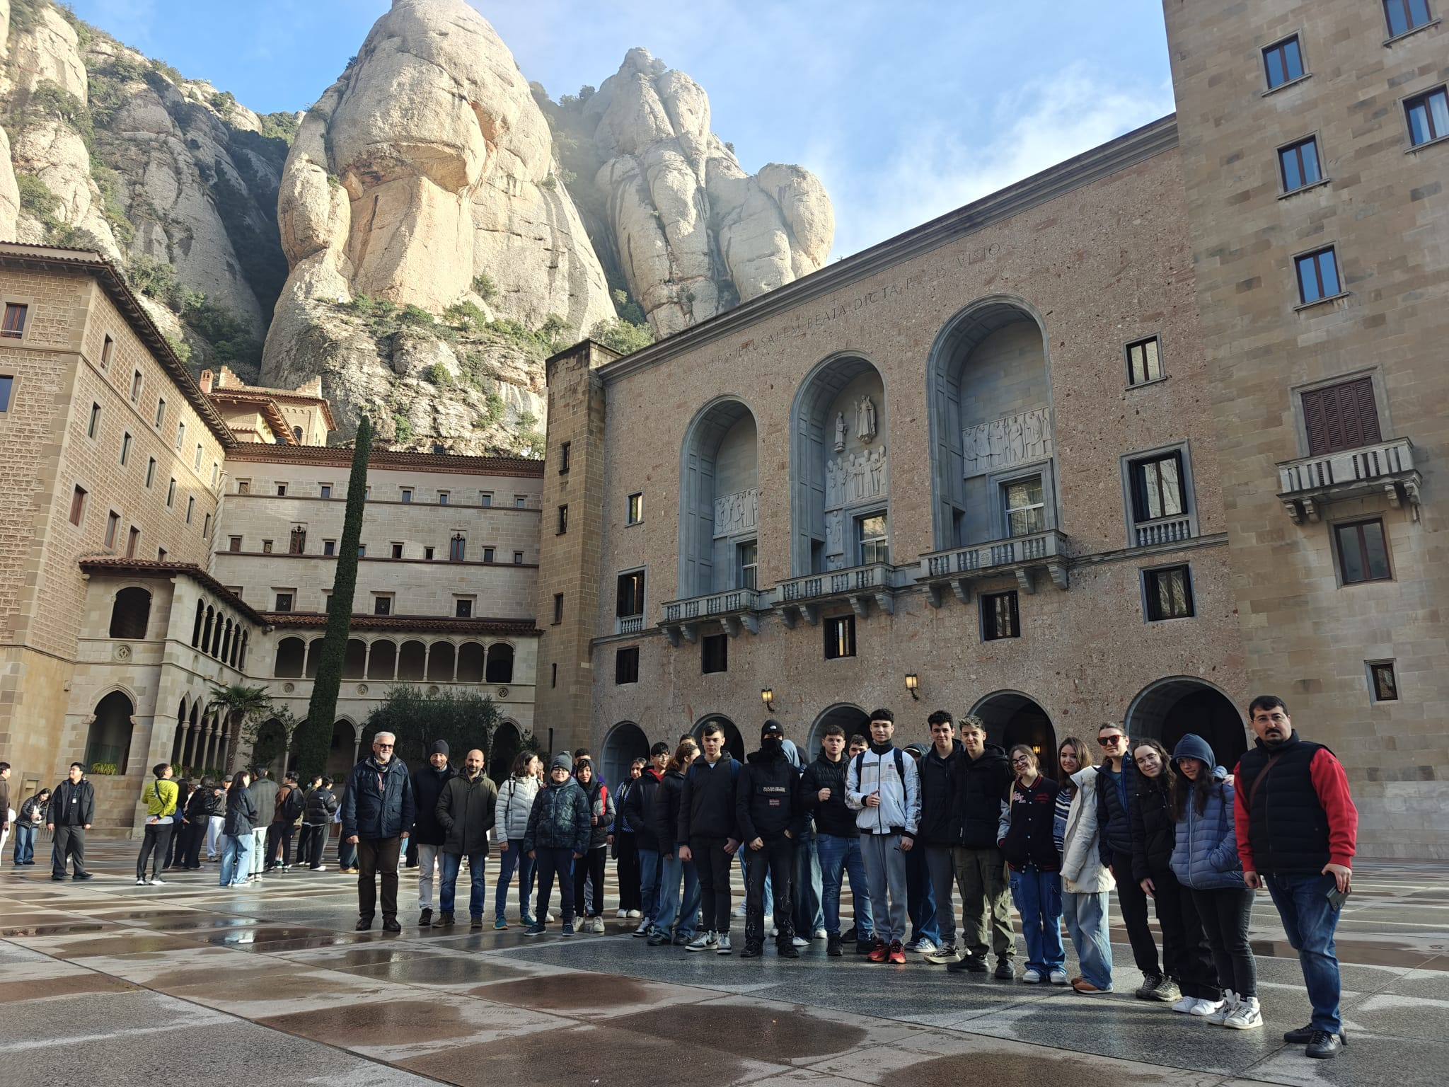
Greetings
The Erasmus+ experience was formative in many ways, allowing us to mature individually and culturally. By exploring music as a European value, we understood the importance of collaboration and inclusiveness. It showed us how precious it is to engage with different realities to broaden our horizons.
We are grateful to the school and teachers who made it possible. I thank my classmates who shared unforgettable moments with me and the organizers whose commitment and dedication made every phase of the project perfect.
Giuseppe Viscomi

