Slide 1

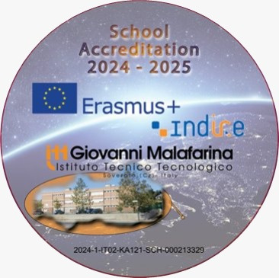


Inclusive
Logbook
School Accreditation 2024-1-IT02-KA121-SCH-000213329
Group School Mobility
10th-14thFebruary 2025
Institut Guillem Catà Manresa

Slide 2
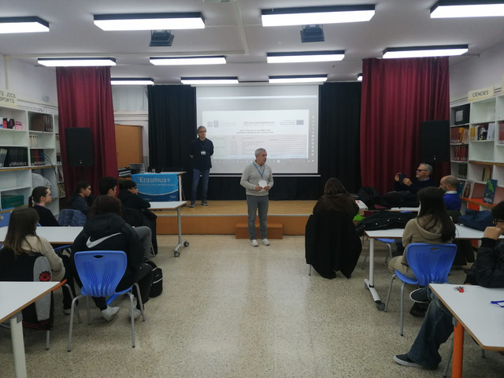

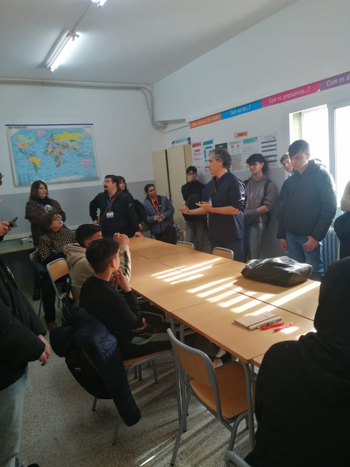

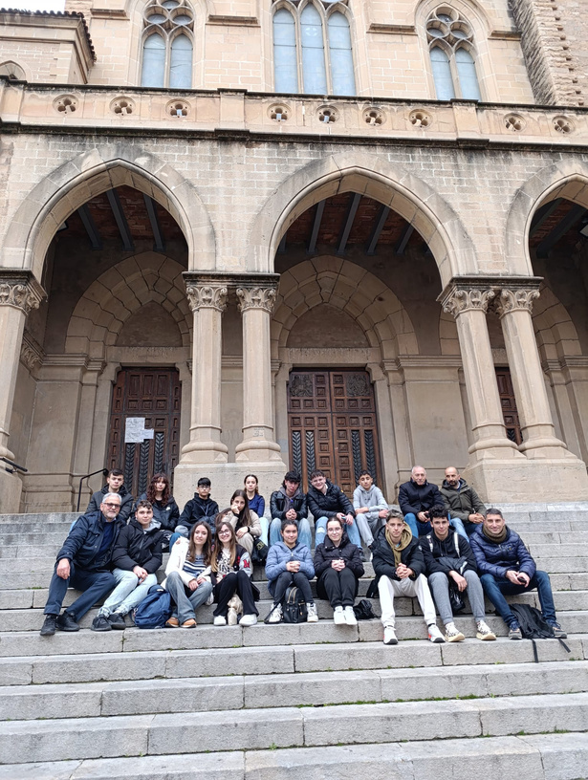
February 10th 2025
On the first day, we went to school with our hosts for the first hour, then we all met in the school library and heard the presentation of the school before getting a tour of the institute, exploring classes and labs.
After a break, we gave our presentations about sustainability and Music for Inclusion.
In the afternoon we all meet in Manresa and got divided in groups to go around the city and followed an interactive tour taking photos and videos with the monuments.

Slide 3

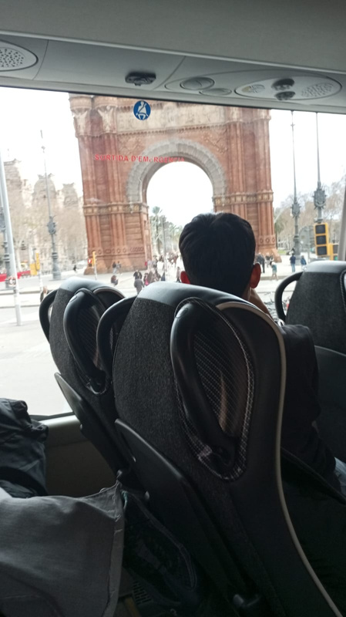
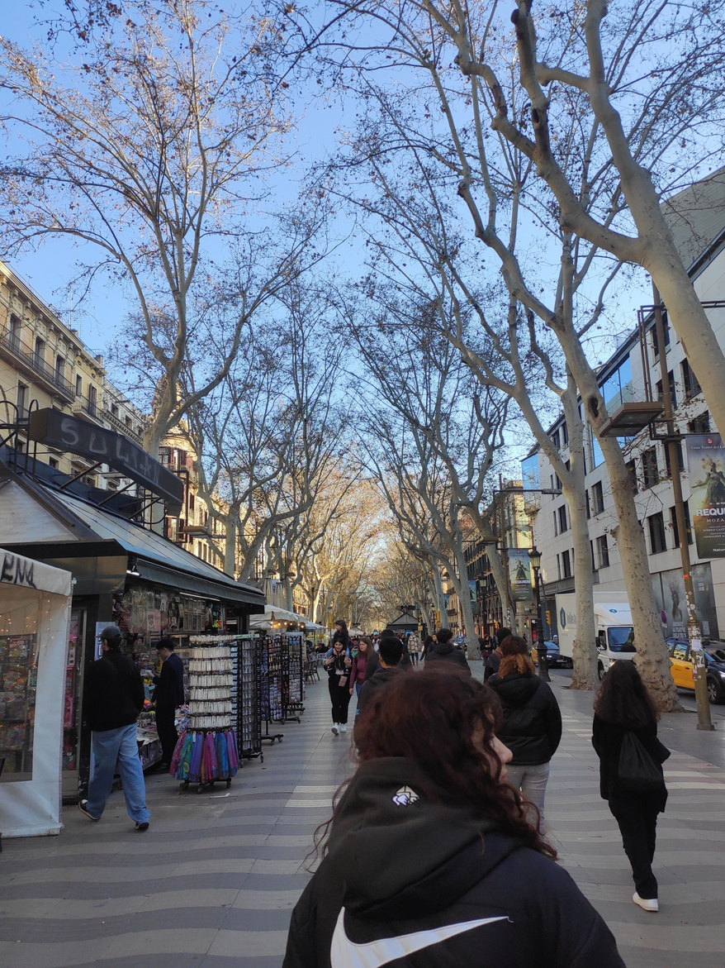
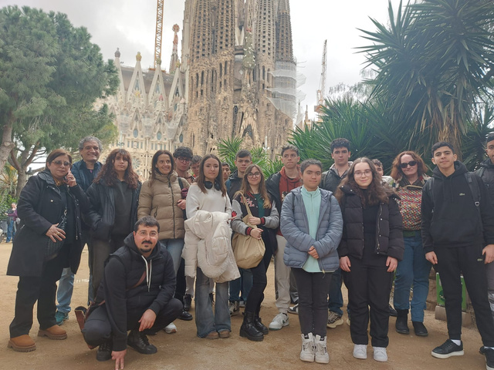

February 11th 2025
The second day was dedicated to visit Barcelona. We got a guided tour from the bus, with explanations about the city’s modernist architecture and then went to the famous “La Sagrada Familia” by Gaudì and other places by foot.
We took a long walk in “La Rambla” the most well known street in central Barcelona.

Slide 4

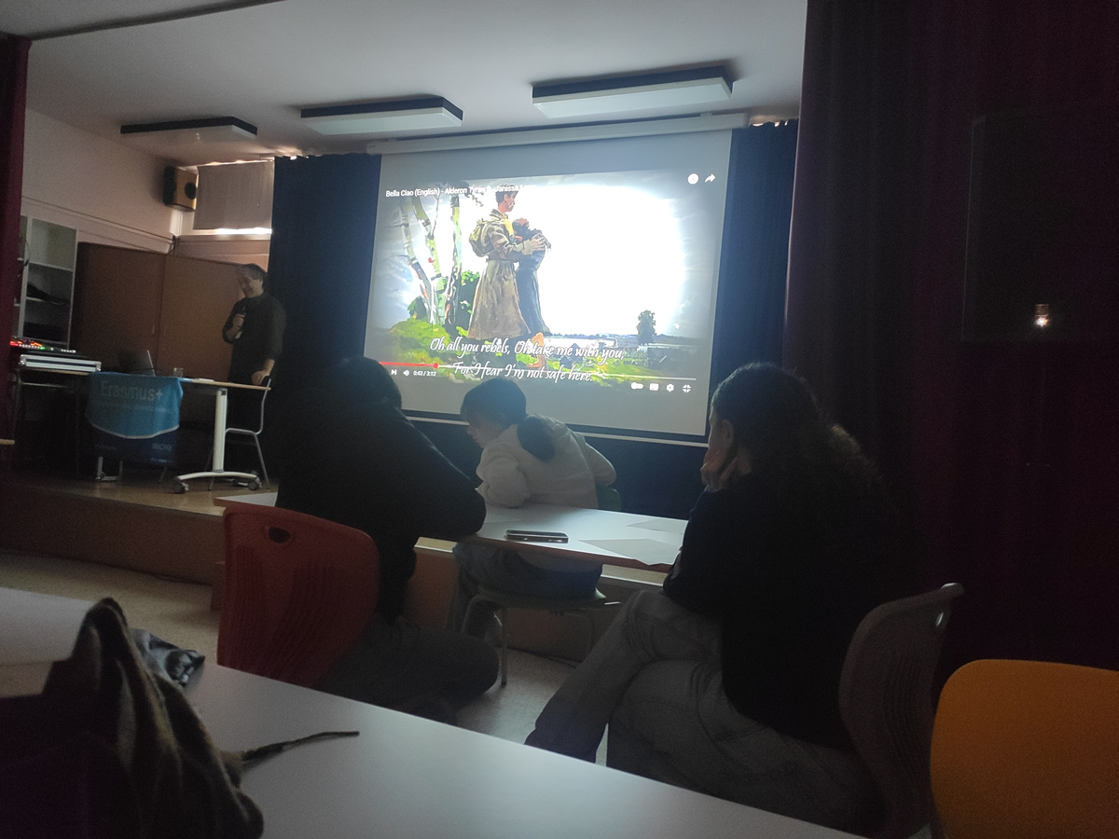

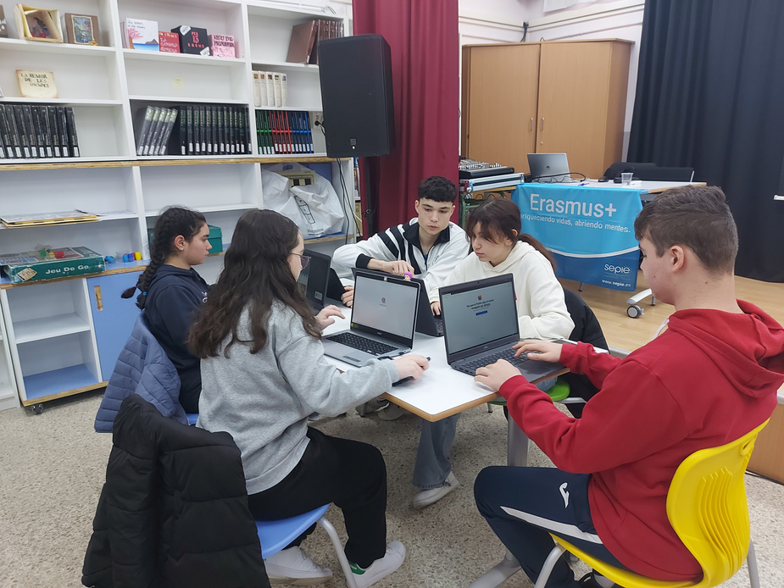
February 12th 2025
On the third day we attended a workshop about music in Catalan, Italian and Spanish, learning how important it is to translate correctly the lyrics in songs being aware of the meaning but also of the melody.
Finally we all translated a song, “Bella Ciao” for the Italian students and “L’estaca” for the Catalans, into English and confronted our work.
We also did the presentation about use of AI in school and started a project about a band website that we finished on Friday.

Slide 5
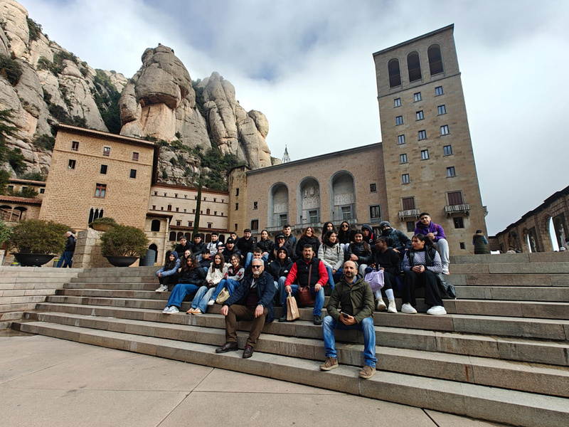
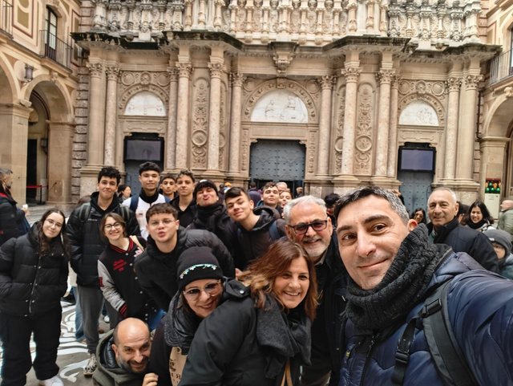
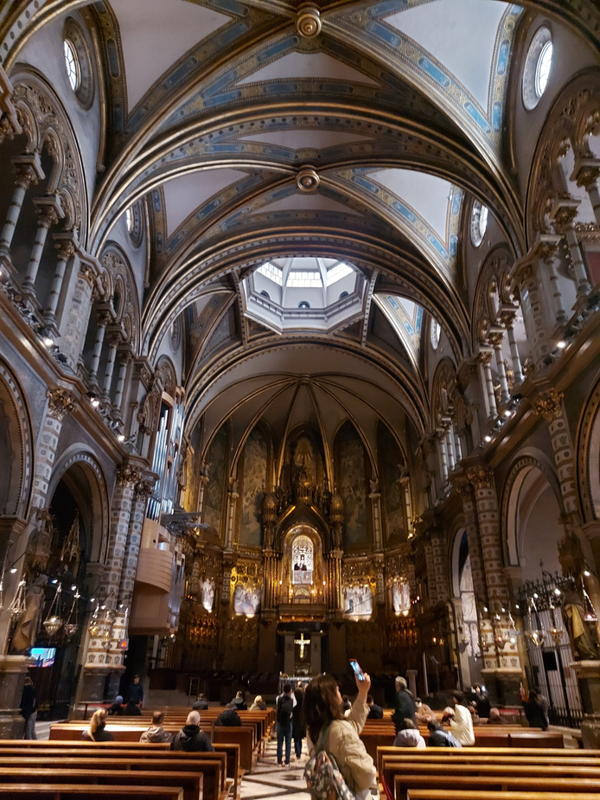
February 13th 2025
On the fourth day we visited the Mountain of Montserrat. We explored the city and then went on a tour inside the monastery where the famous Black Madonna is situated. The monastery has a baroque style but with much other influences.
Some of us decided to walk up the mountain like people usually do there.
At 2:30 PM our students held the presentation about how Erasmus prepares us for the future.

Slide 6

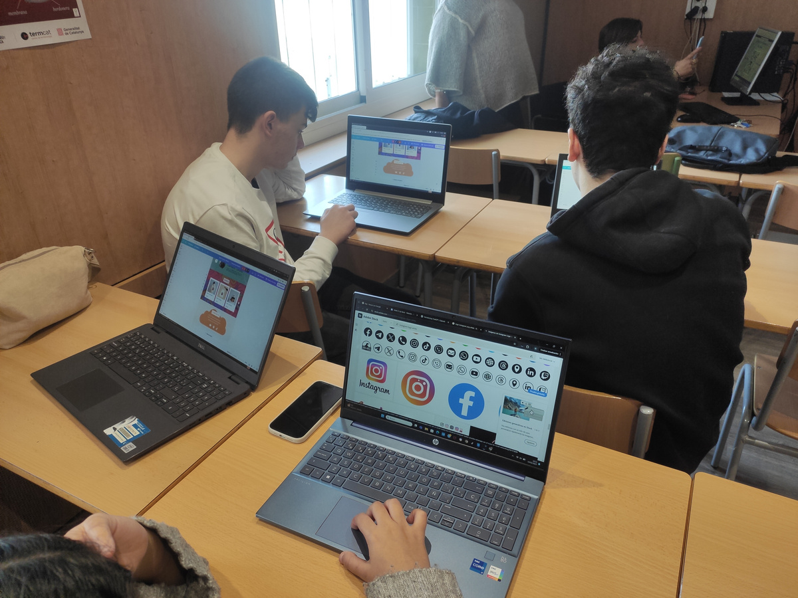
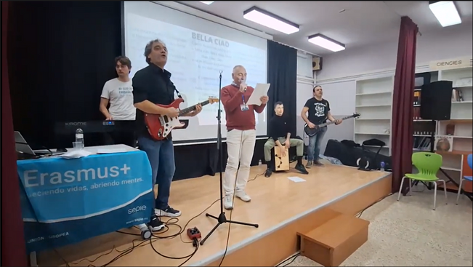
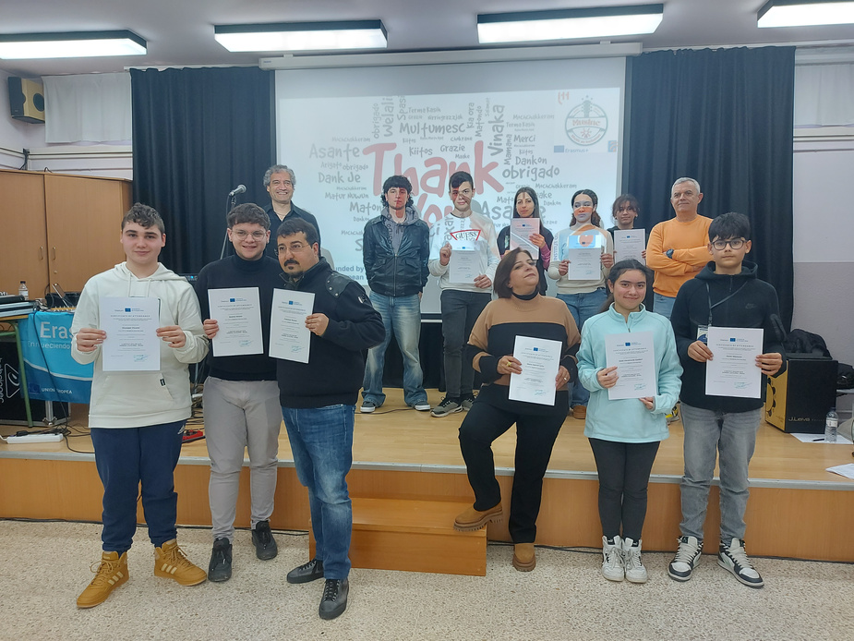

February 14th 2025
On the last day we finished our group project from Wednesday, that was about imagining ourselves like members of a band and creating a website and content using Canva and AI tools.
At the end, we received our certificates of attendance and witnessed an exibition of the music we learnt about in the mobility played by professional musicians and sang all together.

Slide 7

Th
Funded by the European Union. Views and opinions expressed are however those of the author(s) only and do not necessarly reflect those of the European Union or the European Education and Culture Executive Agency (EACEA). Neither the European Union nor EACEA can be held responsible for them.

